Slide 1

Journey Towards Proactive Operations
Iwan ‘e1’ Rahabok
e1@vmware.com | +65 9119-9226
Notes:
Last Update: Jan 2023

Slide 2
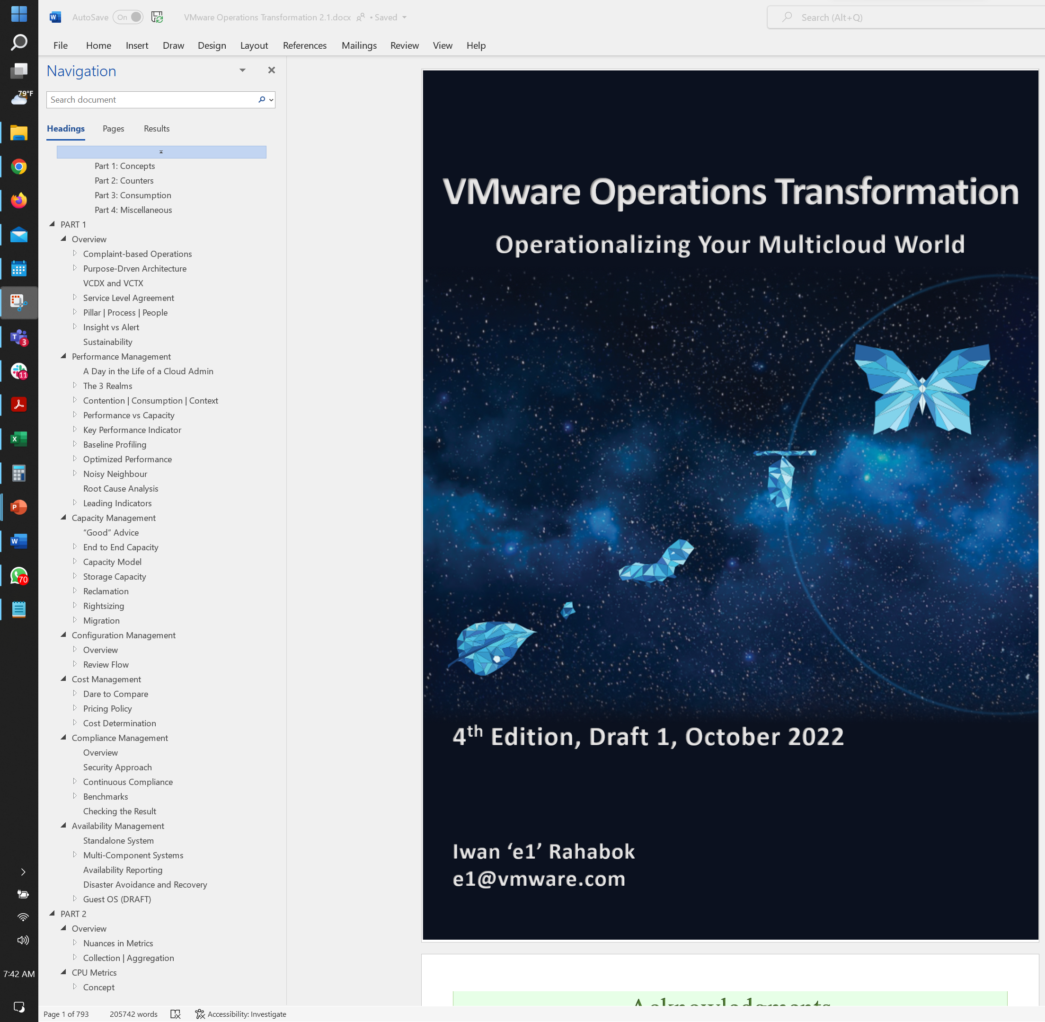
Book vs Workshop
The Book
The Workshop
VMware Operations Transformation
Operationalize Your World
Focus on the Operations, the process.
Focus on the Architect, the individual.
In-depth Reading
Peer Sharing and small group discussion.
Hands-on. Access your vR Ops and Log Insight as you read along
Not a hands-on session. Live demo by Facilitator, and sharing by attendee.
Complete coverage of operations
Only performance and capacity management, and focus on more pressing components
~1 month period in multiple reads & apply
1 day physical event, with ample time for networking & peer sharing
The Workshop is based on the book. To keep it within 0.5 day, it takes a small subset of the book. The original workshop ran for 2 days.
It’s designed for workshop-style delivery with active discussion. Not designed for large scale, one way lecture. Designed for Infrastructure Architect, not other roles. The book covers all roles.
Notes:
Note: the book gets a monthly update. Picture shown is earlier version.
The deck is designed for audience participation. For example, get an audience to explain, as the texts are all there in the slide actually.

Slide 3

Our Agenda Today
Ice Breaker & Networking
About your speaker
About your world as Infrastructure Architect
Typical IT operations challenges
About You & environment you are responsible for
Operationalize Your World
Performance Management. With baselining for proactive operations
Capacity Management
Peer Sharing
Networking Lunch
The road ahead

Slide 4
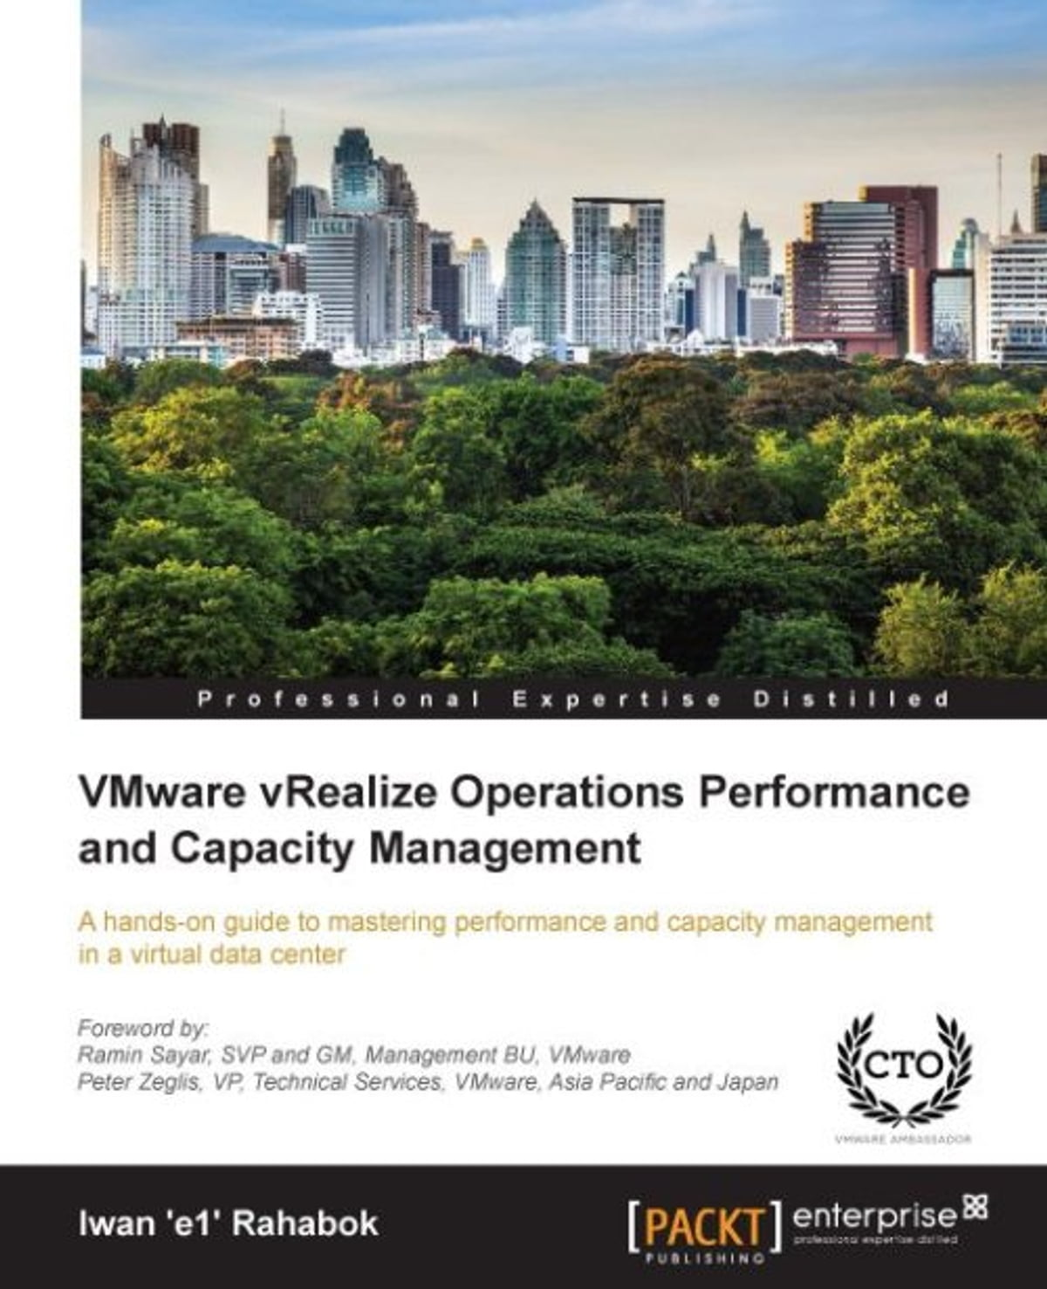
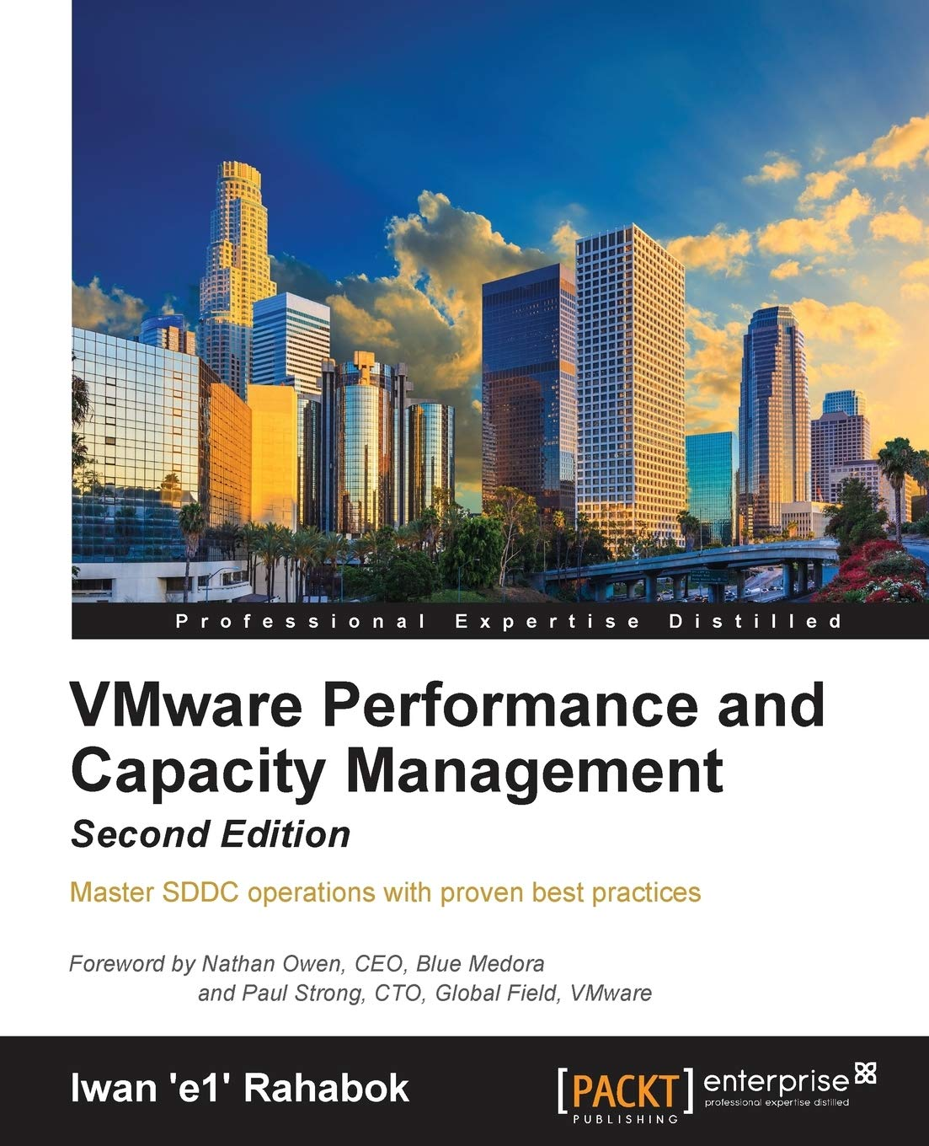
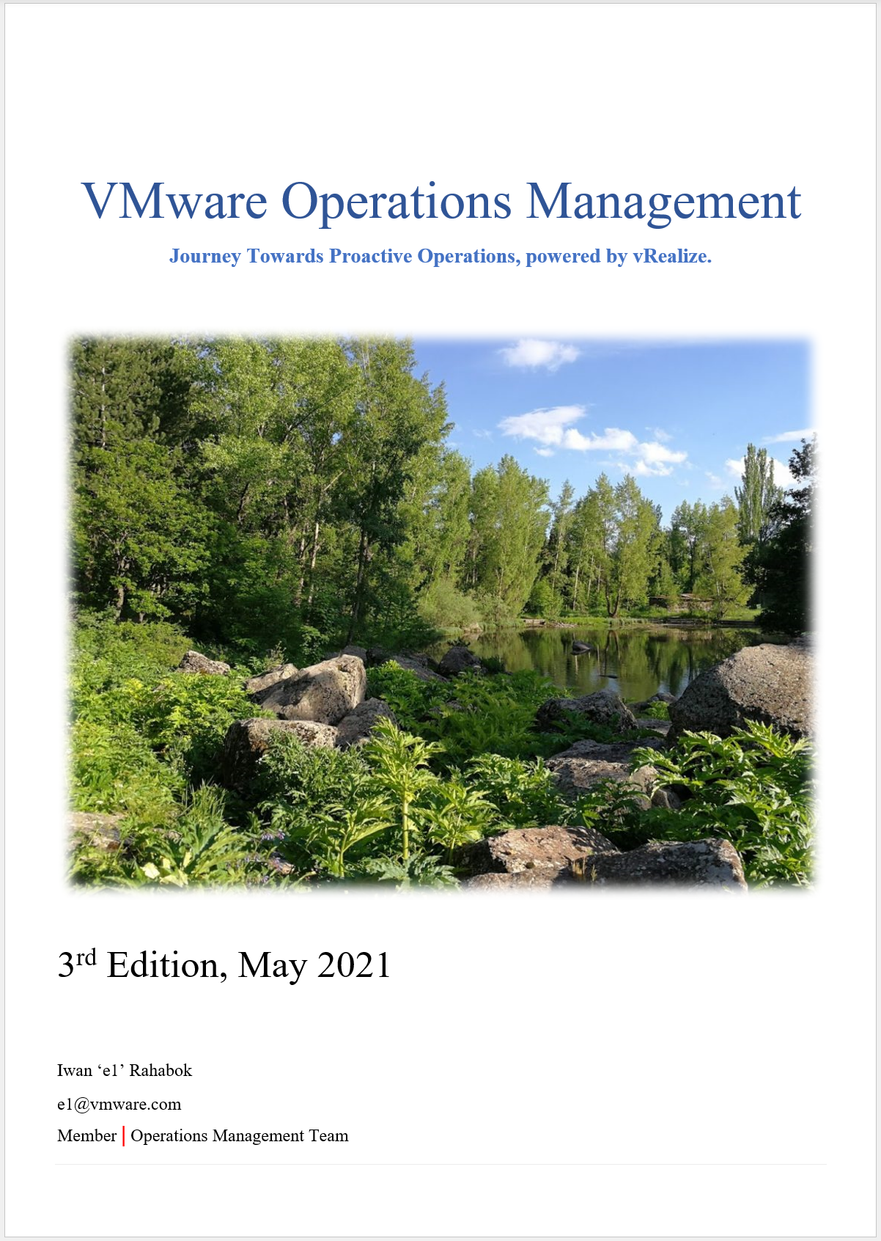

About Your Speaker
Since I’ll be taking your valuable time today….
2012 - 2014
2015 - 2016
2017 - 2021
ETA 2024
Domain Architect, Cloud Operations Management, VMware.
Team Member for: Aria Operations content (dashboard, alerts and reports)
Notes:
Point of the slide
Material is made freely available. Book is open source and editable
Google iwan vmware
ACK Poh Wah

Slide 5
The Rise and Fall of Infrastructure Architect
First Thing First: You.
Impact on your work
Impact on you
Relevance to Business
X86
Commodity
Business Architect
Service Architect
Systems Architect
System
Services
Cloud
Consumer
Bespoke
Standardized
Infra Architect needs to move up from “techie”. IaaS, not SDDC. DaaS, not EUC
Notes:
Key point: architecture is becoming a given, so move up as that’s where your career needs to go. You can’t beat the young ones with tech. For example, I met a 20s engineer that graduates with AI degree. He knows AI deeper than I do. Or a 20s with 3 years of solid K8 experience. What they can’t beat you is your years of experience. That translates into ability to engage with CIO, and relationship in the industry.
Commodity: it initially hit servers, and now it’s hitting storage too. Dedicated storage arrays are literally disappearing, being replaced with converged infrastructure. Storage Admin job is going down with the arrays. Part of network is also being virtualized.
Reference in the book:
Part 1 Chapter 1 “Overview” chapter, especially VCDX and VCOX section.
Part 4 Chapter 9 “Infrastructure Architect” chapter for background and personal sharing. We all have our story
[e1: add DevOps impact?

Slide 6
Which world do you operate?
As tech complexity rise significantly, how is your career progressing in the world of IT?
Generalist
People Manager
Manager, Leader, Director, Department Head, Chief, etc.
Specialist
Individual Contributor
Architect, Developer, DBA, Administrator, SRE, QA, etc.
Generally more relevant to CIO
Operations Management
Generally more respected in the tech community, less political jobs
Notes:
The First P
An exchange of 2 PowerPoint slides.
Specialist: dinner or drink
Is there a 3rd option

Slide 7



Your World. Not operationalized.
How it started
Your Customers
Your Boss
“Need more HW! Your infra is slow”
“Your infra is not full. Add more VM!”
You
Notes:
We creates the Operationalize Your World because we see a lot of VMware Admin/Engineer/Architect struggle. They are squeezed in between their customers and their boss.
Customers demanding better service, faster performance, higher uptime, fewer disruption.
CIO demanding less budget.
You.
You are a pro. You can architect a solid enterprise-grade global infrastructure. So why are you squeezed in between? This is something we want to solve.
If you need to know the answer right now, the short answer is because your Customers and your Boss aren’t measuring the same thing. You need to align them.
Reference in the book:
Complaint-based Operations, located in Chapter 1 of Part 1.
VCDX and VCDX, located in Chapter 1 of Part 1.
Interdependancy, located in Chapter 1 in Part 1
----------------------------
On the lighter side, do you recognize 2 of the photos?
Your Boss. That’s Ajay, my former big boss and advocate of Ops ☺
You. That’s Karen, head of R&D for vR Ops team in Armenia. Armenia is the home of vR Ops. I’ve been privileged to spend a total of 9 weeks to date in the last several years.
You can find Karen at https://www.linkedin.com/in/karenaghajanyan/

Slide 8
Operational Challenges
Examples of what customers globally have shared with me
Performance
“We get complaints from application team that our infrastructure is slow. But when we check all the counters are okay. App Team say 5-minute interval is too long to detect the issue”
“How to know the problem before application team complains? What are the KPI or leading indicators?”
“How to do end-to-end monitoring, and have 1 console that all team can agree on?”
Interdependence.
Capacity
What’s the best practice for Performance Management? For Capacity Management?
“We want to reclaim resources from oversized, but application team won’t let us”
“We see our clusters still have capacity. But how high should we push the utilization? We’re concerned about performance”
“How to justify tech refresh? Our utilization is not high enough”
Notes:
“We get complaints from application team that our infrastructure is slow. But when we check all the counters are okay.”
“We want to reclaim resources from oversized, but application team won’t let us”
“We see our clusters still have capacity. But how high should we push the utilization? We’re concerned about performance”
“How to justify tech refresh? Our utilization is not high enough”
“How to know the problem before application team complains? What are the KPI or leading indicators?”
[e1: what about cloud operational challenges? Does it simply become cost, or performance also important?

Slide 9
Other Questions…
Common questions I got from customers, partners, and employee
We’re bombarded with alerts. They can’t be all important as we don’t have many complaints
Why is Windows/Linux showing a different metrics to VM? Which one is the correct one?
Why is the VM disk latency high on vCenter but low on the physical array?
We have cluster capacity metric. What about cluster performance (%) metric?
CPU Metrics | VM | ESXi
Run | Yes | No
Used | Yes | Yes
Usage | Yes | Yes
Core Utilization | No | Yes
Utilization | No | Yes
Demand | Yes | Yes
Why so many counters just to measure utilization?
Why VM and ESXi are not consistent?

Slide 10

About You
Day 2 experience and expertise are with the practitioners, not vendors
Day 2 challenges you or team face:
Performance
Capacity
Compliance
Cost
Availability
Environment you are responsible for:
No of VM
No of Cluster & ESXi
Environment Category (mission critical, business standard, etc.)
Kubernetes
Non vSphere: Nutanix, KVM, etc.
Public Cloud (AWS, Azure, etc.)
Any other info
People and Process:
Size of Infra Team.
Who does what and when? Daily SOP, Weekly SOP, etc.
What tools used for what?
Size of App Teams. Relationship with App Teams
Capacity Planning and Tech Refresh
Notes:
Why sharing? Because the knowledge of Operations reside in practitioners, not product vendors. We can have 10 customers having identical architecture, hardware and software, including the configuration. But the way these 10 run their operations will not be identical. The reason is they have different people, different process, different culture. It could be because their size, industry and country are different.

Slide 11


Unifying the Consumer & Provider Layers
Your Message: “You get what you paid for”
Price/Performance defines the IaaS offering.
The reason Gold Class is 2x the price of Silver because it is 2x better. That’s the fair way to justify higher price.
While hardware and architecture are identical, the SLA per VM is better.
Better in all 4 aspects of SLA:
Higher availability
Faster performance
More secured
Better service.
What if VM is free? Write the business justification for each class of service.
“Performance”
Consumer
Price
Provider
Notes:
And the reason why their demand doesn’t connect well is because they are looking at different things. So you need to unify them. Design the same model for both entities. Same operational models, else you are caught in between.
For SLA, the most important that your application care the most is Performance SLA. Availability SLA and Security SLA are a given.
Reference in the book:
Begin with The End in Mind, located in Chapter 1 in Part 1
The Restaurant Analogy, located in Chapter 1 in Part 1
Service Level Agreement, located in Chapter 1 in Part 1

Slide 12

Purpose-driven Architecture
You buy SDDC from vendors. You sell IaaS to your customers.
Purpose
Serve the Pods, VMs & Applications. The primary focus, hence metrics, come from these consumer layers.
KPI
Is it serving the Pods or VMs or Applications well? Need to consider availability, performance, and security.
Cost
Lower than Public Cloud, especially VMware-based. Achieved by higher density and simpler customer experience.
Pillars
Class of Service. With Performance SLA + Availability SLA + Security SLA
Proof of Success
Happy customers. They want self-service portal that empowers them.
Proactive Operations, not Complaint driven. Insight-based, not Alert-based
Capabilities
Self-Service Portal. Cover all stages (provisioning, monitoring, decommissioning)
Automation, Workflow and Approval.
Notes:
Point of this slide: Begin with the end in mind
Major difference between SDDC and IaaS
Most architecture, especially central storage array, lacks the per-VM latency as the array only sees LUN.
What proves that the architecture has delivered. What metrics should be used to measure that?
Reference in the book:
Part 1 Chapter 1 Overview: read the Purpose-Driven Architecture section

Slide 13
The difference between Enteprise-grade Cloud and
non Enterprise-grade Cloud is…
For many internal private-cloud service provider, the SLA already exist. You already said it’s “good”. The problem is what exactly is “good”?
SLA
The hardware, the process, the skills, the technology are just mechanism to achieve what you promise in the contract
Notes:
Point of this slide: SLA is expected.
Reference in the book:
Part 1 Chapter 1 Overview: read the Service Level Agreement section

Slide 14
Class of Service
Price/Performance. Formally defined relationship
Tier | Price | Overcommit | Performance | Positioning
Gold | Highest | 1:1 | Perfect (100%) | Performance Guarantee. Suitable for latency-sensitive applications.
Silver | Moderate (50% of Gold) | 1:2 | Great (95%) | 50% discount for only 5% penalty. Suitable for most Production workload.
Bronze | Low (25% of Gold) | 1:4 | Good (90%) | 75% discount for only 10% penalty. Suitable for Test & Dev workload.
Free | Free! (funded by higher tiers) | 95% Utilization | Best Effort (85%) | Suitable for temporary project. No Availability SLA, no Performance SLA
Hardware is identical for all tiers.
Notes:
Point of this slide: SLA needs to start at Day 0.
Reference in the book:
Part 1 Chapter 1 Overview: read the Service Level Agreement section

Slide 15
Example: Class of Service
Agree with CIO on the business model before deciding on hardware. Quantify the Service, then choose the Hardware
Tier | Price | Compute | Storage | Performance | Remarks
1 (Platinum) | Highest | 1:1 | N/A (allocation is not applicable as it does not impact performance and carries capacity risk) | Perfect (100%) | CIO decided not to offer, as no business wants to pay the price. They want it, but unable to justify the price
2 (Gold) | Moderate (33% of Gold) | CPU 1:3 RAM 1:1 | All Flash | Great (95%) | Based on 50/50 split between CPU & RAM. 0% discount on PCU and 67% discount on RAM results in 33% overall discount Hardware sizing should maximize consumption. Based on 1 vCPU 4 GB RAM. Typical standard. 40 core X 3x overcommit X 4 GB RAM per vCPU = 480 GB. Add additional CPU and RAM for vSAN and NSX as appropriate
3 (Silver) | Low (67% of Gold) | CPU 1:6 RAM 1:2 | All Flash | Good (90%) | Gold SLA (99.95%) vs Silver SLA (99.9%) Viewing from 0.05% vs 0.10%, the Silver SLA is 2x lower.
4 (Free) | Free | n/a | Hybrid | n/a | VM size capped to 2 vCPU 8 GB RAM. No performance consideration. Drive utilization high.
Identical hardware & infrastructure for ease of operations. Difference is in SLA, which is at VM level
Notes:
Your ESXi size needs to be balanced. By that it means it has to map to demand. If your VMs are compute heavy, then your hardware should map to it, else you’re wasting money and the excess will not be used.
A good general rules of thumb is 1:4 ratio between CPU:RAM. If you have 36 cores then you should have 144 GB RAM for your Tier 1
40 cores x 3:1 Ratio x 4 GB per vCPU gives 480 GB RAM. This is pretty close to 512 GB. You still have 32 GB for All Flash vSAN.

Slide 16
IaaS Operations Maturity
How KPI complements SLA
KPI is leading indicator. SLA is lagging indicator. KPI gives insight into what could happen. SLA simply reports what already happened.
KPI is easier to implement. It does not require class of service. It tracks absolute (facts), not relative to promise.
E.g. it reports disk latency of 11 ms. Whether that meets SLA or not depends on the class of service.
KPI looks at more counters. SLA is limited to what you’re comfortable putting on the business contract (hint: keep it to 1 counter per service)
What if you’re not ready for SLA?
Complaint
KPI
SLA
5-minute average.
SLA is part of business contract.
Customers can track the SLA via self-service portal.
1 policy for each Class of Service.
Pricing & QoS are used to differentiate each class.
SLA = 1 month average of SLI
KPI used to support SLA for proactive remediation
20-second average.
IaaS Performance is quantified & measured.
KPI includes Guest OS, if IT owns VM sizing.
1 common policy for all. No formal class of service defined. Performance is based on production environment.
Insight based, with SOP.
RCA is closed with alerts set up
Complaint-based Operations. Metrics based on user complains
Blamestorming among team. Politics come into play.
Alerts-driven, not insight driven. Reactive and firefighting.
You walk from where you stand. Adopt KPI, then SLI, then SLA.
Notes:
Point of this slide: If you do not have Formal SLA, then don’t jump into it until you know your own, actual, performance. Quantify your real numbers.
SLA is an agreement between 2 parties. KPI represents 1 object
Reference in the book:
Part 1 Chapter 1 Overview: read the Service Level Agreement section

Slide 17
KPI → SLI → SLA
How they work together. Consumer and Provider. 6 metrics
KPI
Example
Start with this. If you don’t have KPI, promising SLI will result in even more complaint. You need to back up your SLI with actual ability to monitor and troubleshoot. KPI goes wider and deeper than SLI.
It measures absolute performance (fact, reality), not relative (against promised threshold). If Gold is better than Bronze, you need to be able to prove it. KP applies the same Green-Yellow-Orange-Red range for all, regardless of class of service. KPI is not related to contract.
VM KPI includes VM, Guest OS, and Apps metrics.
Cluster KPI >< average of its VM KPI.
Infra KPIs are internal to provider, while VM KPI is for each VM owner. They measure different things. This is KPI, not SLI, so the 2 layers are not related. VM KPI has Guest OS metrics, which is irrelevant to Infra. Cluster KPI has ESXi metrics.
(Notice the inconsistency in the numbers. They are intentional to show the difference between KPI, SLI and SLA)
KPI (last 5 minutes)
Gold VM 001 and Bronze VM 001 happen to be unlucky. Other VMs are doing better, as cluster number is higher.
Gold VM 001
99.3%
Gold Cluster 01
99.6%
Bronze VM 001
88.8%
Bronze Cluster 01
93.1%
SLI
KPI can’t explain why Gold can be better than Bronze yet Gold fails SLA while Bronze pass SLA. This is where SLI comes in. Notice the name Service Level. SLI is a small subset of the KPI metrics. Only the ones listed in the business contract.
KPI is absolute, SLI is relative.
VM SLI = Average of 4 SLI (CPU, RAM, Disk, Network) 1 standard for all class of service. So expects Bronze to fail more, which is what it should be.
Cluster SLI >< Average of its VM SLI Cluster SLI = Count of VM that fails SLA.
SLI is a 5-minute counter, so can’t be used yet as the business contract is defined in 30-days. SLA is required for that. Both use the same metric.
Notice Cluster SLI does not care about VM SLI value. It only cares pass or fail. It counts how many fails that’s all.
Why Bronze VM KPI is lower than its SLI? Unlikely but possible. Reason is KPI uses more metrics & scope includes Guest OS (not just IaaS).
The Gold VM and the Gold Cluster fail to meet their promised threshold. But this is just 5 minute, it does not mean SLA is breached.
SLI (last 5 minutes)
Gold VM 001
75%
Gold Cluster 01
2 / 100 VM
98%
Bronze VM 001
100%
Bronze Cluster 01
0 / 200 VM
100%
SLA
VM SLA = 30-day average of VM SLI. Yes, a simple average over the SLA measurement period. Warning: It can take up to 30-days to “forget” the failure in the past because the counter is average of last 30 days. It does not care about the future
Cluster SLA >< 30-day average of Cluster SLI. Cluster SLA >< Average of its VM SLA It is % of VM who fails SLA.
SLA is compared against guarantee. It’s typically near 100% but never 100%. E.g. Gold is 99.99% while Bronze is 99.97%
It is both the goal and the reality. No such thing as internal SLA as that’s just SLA + Buffer.
SLA (last 30 days)
Looking at the last 30 days, Gold pass while Bronze fail. A single SLI failure may not mean SLA failure.
Gold VM 001
Pass
Gold Cluster 01
0 / 100 VM
100%
Bronze VM 001
Fail
Bronze Cluster 01
2 / 200 VM
99%
Notes:
Current implementation varies among adapter
vSphere: what we have is SLI, and it’s not correct too
Horizon: what we have is KPI. We don’t have SLI as we don’t know what the SLA should be
vSAN: what we have is the building block of KPI.

Slide 18
IaaS KPI Metrics
How to start if you do not have SLA
Performance Metric (%) |  | Dashboard
Biz App KPI | There are 3 metrics here, 1 for each layer (Business, Application, Infra). | A table in dashboard can’t have different columns showing different time period. You can’t have columns showing last 1 day, last 1 week and last 1 month in the same table. As a workaround, use the Health Chart
VM KPI | It contains Guest OS counters. If the value drops, IaaS team need to check if it’s Guest OS or VM or infrastructure by looking at the components’ metric. It’s unaware of Class of Service as it’s not a relative counter. However, Gold VM is expected to perform better and higher KPI reflects that. Infra Team and App Team need to agree on acceptable value for each class as there is no formal SLA.
vSphere Cluster KPI | Includes both VM and ESXi, so it can’t be the average of the VM KPI. VM KPI also contains Guest OS metrics, which is irrelevant to the Cluster KPI. Gold Cluster is expected to deliver better and higher KPI reflects that. Infra team needs to establish acceptable number for different classes of cluster as there is no class of service.
vSAN KPI | It aims to answer if the issue is at vSAN or not, so it only contains vSAN related.
VM SLA | Only applicable for customers with formal agreement between the 2 team or entities.
vSphere Cluster SLA

Slide 19
A day in a life of Operations Team…
App Team XYZ complains to IaaS Team that her VM is slow.
Her application architect has verified that:
Windows CPU and RAM utilization is good.
Disk latency is good. No network drop packets.
A
Check ESXi utilization. If it’s low, tell her to doubt no more.
B
Buy her a nice lunch + flower. Ask her to forget about it ☺
C
Call your VMware TAM/GSS/PSO. That’s why you pay them right? ☺
D
Roll up your sleeve! You are born for this!
Notes:
It’s a common story. This presentation was born many years ago from stories like this. I joined VMware back in 2008 as SE. I got call by customer to troubleshoot where the problem is.
While the answers are humorous, you know there is an element of truth in it. It is not easy to handle this. You can easily burn hours troubleshooting.
It does not have to be this way.
This is The Acid Test of your IaaS business. If your help desk is unable to figure out if the problem is due to infra or apps, then you do not actually have an IaaS. You’re still operating as a System Builder, not a Service Provider. You may do a chargeback, but if you cannot define where your Service ends, you are a system builder.
The reason you are not able to close the case in 1 minute is because you have not set defined your IaaS. You need to quantify what fast is.
For details, see Chapter 4 of the book.

Slide 20
The answer you want
Is the problem caused by IaaS not serving the VMs or Nodes well?
If yes…
Which part of the Infra: CPU, RAM, Disk, Network?
How bad is the problem? Needs to be quantified, with 20-second metrics
Alert already triggered, and IT is already working on it. We’ll inform you on the analysis outcome.
If not…
Is it caused by Guest OS and VM-level setting?
How to prove it convincingly? Never try to convince an angry person ☺
E
Self Service
within 60 seconds
Notes:
This is what your customers want. The App team, tenants, VM owners, or whatever they are called, all want to know if they are being served well.
Even if the IaaS is free, they still want to know what’s causing the performance problem.
So your IaaS needs to be architected so it can give this answer. The monitoring system is simply reflecting the reality.

Slide 21
The 3 Realms
A story of 3 Teams. Each should ensure their own layers are healthy
Layers
Sample Metrics
Business
Business Results
How much sales do we make today?
How many customers buy our products this week?
On average, how long did the XYZ transaction take this hour?
How many customers login yesterday?
On average, how long do they stay?
Handmade
Most common metric is Page Response Time
Business Transaction
Application
Individual Node
How long does SQL Query ABCD take in the past 7 days?
What’s SQL Server free memory value 1 hour ago?
What’s the overall application uptime?
Are my apps configured for performance?
Vertical
Metrics depends on each apps and needs
“The System”
IaaS
VM or Container
What’s Windows CPU Run Queue?
What’s the peak VM CPU Contention in the past 24 hours?
What’s the total IO hitting vSAN from 9 – 6 pm yesterday?
What’s the buffer in physical switch right now?
Virtual Infra
Horizontal
Common Metrics applicable for all apps
Physical Infra
Notes:
Explain that there are 3 levels of observability. Focus on your own first, before meddling with other people territory.
The upper layer is also harder to measure. The second layer requires Telegraf agent and Log Insight agent.
Page Response Time is how many second the app or website respond to the user. Users don’t care what technology is used. When a user clicks a button on the mobile app or website, she expects the system to get back within seconds, not minutes.

Slide 22
Lack of Cross Stack Observability
Why Top-to-Down troubleshooting requires a lot of real-world battle experience
Vertical in Nature
Troubleshooting Layers
Example of Metrics
Business Layer
Customer complain. User Joko feedback system was slow when he tried to make payment.
Analysis showed that he made payment on 28 Feb 2020 at 3:14 pm. On that date, 888 payment transactions took 6.3 seconds on average. Worst was 20.1 seconds, and 95th percentile was 7.9 seconds.
Application Function Layer
(custom code)
The payment transaction uses 8 functions calls. For him, the function GetBankDetail() took 5.0 seconds. The other 7 functions took 15.1 seconds, faster than the average of 888 transactions on that day. Code was last changed on 14 Feb. No performance regression detected based on max and count above threshold.
Application Software Layer
(3rd party product)
The applications use Mongo DB, Apache Tomcat, and other popular COTS software. None of these software show abnormal behaviour in their metrics.
Guest OS Layer
(Ubuntu Linux)
The application spans across 7 tiers and 80 containers. All the 80 containers run on Ubuntu Linux.
Ubuntu showed normal utilization counters for CPU, memory, disk and network. All are well below 70% based on 1 minute average.
IaaS Layer
(AWS Singapore)
The app uses the following services: EC2, S3 and Aurora
What counters & events are exposed by AWS: Service related vs shared-infra related.
Horizontal in Nature
There is no context-passing when going down the stack.
In most cases, lower stack was not and should not be designed based on upper stack. Example: ESXi IO Blender effect

Slide 23
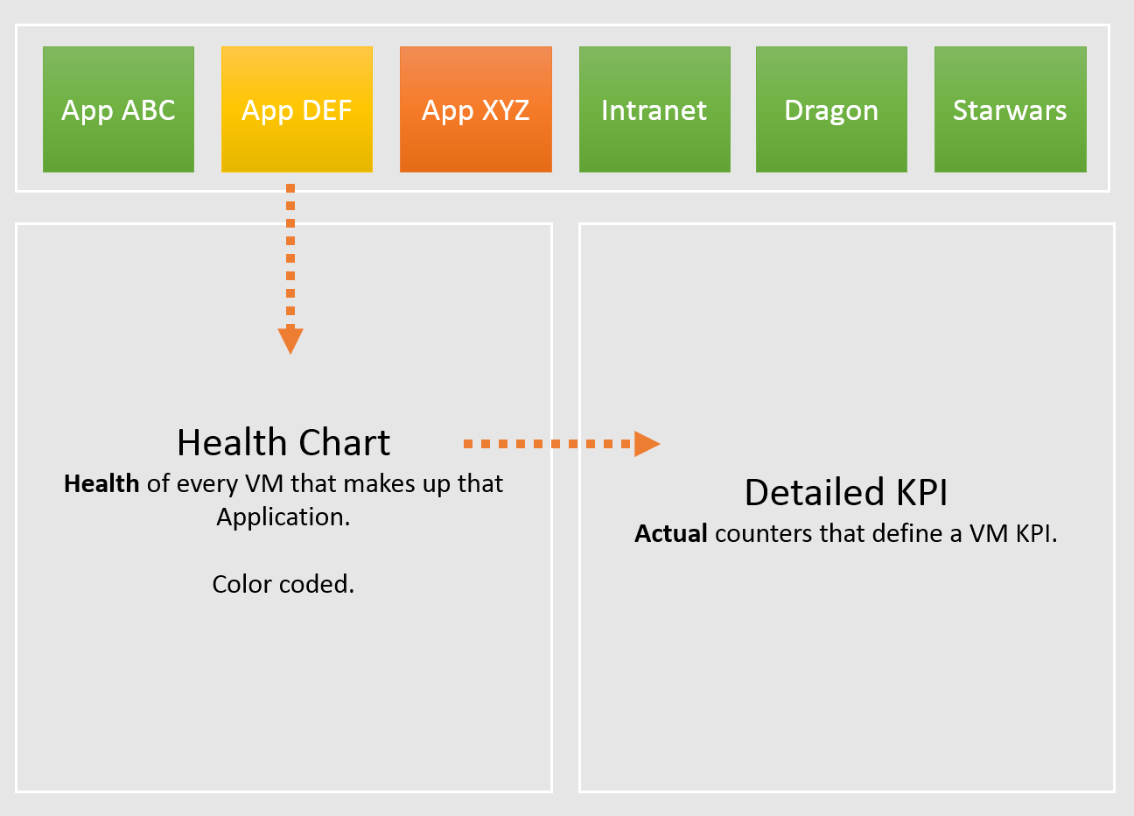
Tier 1 Business Applications
If business is affected, is it because of Infra? Be transparent and details
Mission Critical Business Systems.
Keep to Top 10 only. #11 is definitely less critical than #1, so focus on the top 10 first. Once settled then expand
No non-critical systems shown. Different threshold.
On the big screens.
For all System Owners to see. Transparency builds trust.
Color coded. Threshold based. Easy to see pattern.
Goes deep.
Drill down to actual raw counter.
Cover both contention & utilization.
Notes:
Point of this slide: you can actually create a biz app dashboard.
Another area where CIO cares is applications. By that we meant business application, not individual ISV products (e.g. MongoDB, Apache Tomcat).
Since they serve different business purpose, using different softwares, but run on the same IaaS, how do prove they are all performing well?
Reference in the book:
Part 3 Chapter 9 Other Dashboards: Read the “Multi-tier Applications” section. Note this is not OOTB.

Slide 24
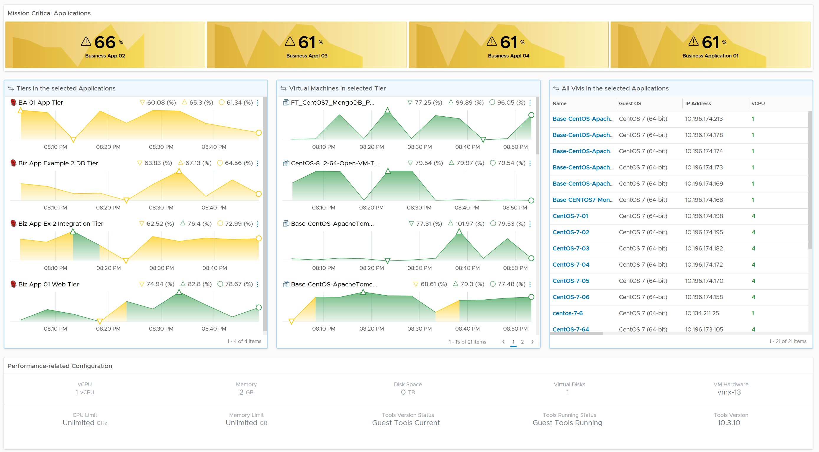
Notes:
List of Tier 1 applications. Avoid listing all applications, as it will cluster the screen. Not all apps deserve to be on the front page, as the monitoring team will be overwhelmed.
Note. The version in the book is more advanced, but more complex. As it’s a custom dashboard, there are multiple possibilities.

Slide 25
KPI for Multi-tier Application
1 metric per business application
Load balancer
Load balancer
Web Server
Web Server
Web Server
Web Server
Biz App KPI = Worst (App Tier KPI)
A tier performance can impact other tiers
Load balancer
Load balancer
App Server
App Server
App Server
App Server
App Tier KPI = Average (VM KPI) Has to be average, else a single VM dominates entire business applications. In a large business system with many VM, this can be too aggressive, resulting in too many alerts. Alerts fatigue.
DB Server
(Active)
DB Server
(Passive)
Notes:
An Application spans multiple VMs, and has multiple tiers. It might include physical servers. It might also include non-servers, e.g. Load Balancers.
An Applicaton spans multiple software and Guest OS.
An Application may use all styles of containment: physical server, VM, container and serverless.
An Application may span multiple physical location. It uses global load balancers.
LB can be physical, virtual, or a service.
Implementation at vR Ops: Each Tier should be a group or tag or Application Tier
Reference in the book:
Part 3 Chapter 9 Other Dashboards: Read the “Multi-tier Applications” section. Note this is not OOTB.
Part 4 Chapter 4 Super Metrics.

Slide 26
What you measure vs what you manage
You can’t manage what you cannot measure
Metric Type
Ops Management
Business Application
Business metrics
Business Appl Perf
VM
VM
App Contention
App Performance
Guest OS
Service
App Utilization
App Capacity
High utilization does not compromise performance, so long there is no Q.
If Q = 0, then utilization at 100% is in fact maximum performance. If we can’t measure Q, then put buffer (90% utilization)
Guest OS Contention
Guest OS Performance
Guest OS Utilization
Guest OS Capacity
VM Contention
VM Performance
VM Utilization
VM Capacity
ESXi & Datastores
ESXi Contention
ESXi Performance
ESXi Utilization
ESXi Capacity
vSAN, NSX & Physical infrastructure
vSAN KPI
vSAN Performance
NSX KPI
NSX Performance
Notes:
Now that you’ve seen the 2 x 2 in previous slide, let’s break it down further.
Service is a process or application running inside the Guest OS. Take MS SQL. It has utilization (e.g. SQL memory) and contention (e.g. query in the queue). SQL memory can be full, and that does not mean it has memory performance.
Guest OS Queue means the request aren’t even sent to the underlying VM. The hypervisor does not know that there is a demand, as it’s stuck in the Guest OS. Windows or Linux kernel has not processed it yet. As you can imagine, Guest OS queue directly impacts application performance.
CPU Run Queue means not enough CPU, so it’s capacity issue. Also, Queue should only happen when utilization is high. High Q on Low Utilization indicates unbalanced distribution. Adding more CPU won’t solve the unbalance.
Same thing with RAM. If there is plenty of free RAM, then paging should be low. If there is a lot of Paging but Free RAM is high, then it’s something wrong.
Guest OS Performance is not the same with VM Performance. Reason is not all loads may come down to the VM. Guest OS performance is impacted by queue inside the Guest.
Guest OS Capacity: right sizing
VM Capacity: snapshot, CPU system
Does high utilization impact VM performance? No
A VM does not become slower when going from 10% to 95%. We are not dealing with mechanical machine here. A VM can run at 100% all the time, so long the queue is low, it’s fine. In fact, that’s what you want!
VM Performance here covers Guest OS also. VM + Guest OS should be seen as 1, as Application team does not care. A VDI does not even care about the OS.
Example of Infra Contention: VMkernel Queue, ESXi physical NIC buffer overflow. Infra level contention that cannot be tied to specific VM.

Slide 27
“VM” KPI Counters
From Application Team viewpoint, VM and Guest OS are the same thing
CPU
RAM
Network
Disk
Inside Guest OS
(Linux, Windows)
Run Queue
Context Switch
Paging Rate (MB/s)
Committed %
OS Output Queue Length
Driver Queue
OS Queue
Driver Queue
Utilization
In Use
Modified + Standby
Throughput (bps, pps)
Latency
Latency
Outside Guest OS
(VM)
Run | Used
System + VMX + MKS
Zipped, Swapped, Swapped to Host Cache
Throughput (bps, pps)
IOPS.
Throughput (Large Block)
Ready + Co-Stop + Overlap
Other Wait + Swap Wait
Contention
TX Dropped Packet
Normalized Latency
Outstanding IO
Latency
Other performance counters:
vMotion stun time. Reported by Log Insight
NUMA migration Reported by ESXCLI
P-State & Xeon Hyper Thread effect. Reflected by Used, Usage, Demand
What counters are not included in the above? Why?
Why is utilization included?
Notes:
There are many counters that can impact a VM/GOS performance. Focus on contention, not utilization. I listed utilization here as data is averaged every 5 minutes. Within that 300 seconds, there can be short burst of contention which is not properly reported. Ideally, what we need in vR Ops is both the average and peak (1 second peak). So 1 is the average of 300 data points, while the peak captures the worst.
Can you notice what counters are missing?
VM Memory Balloon. This is an ESXi counter for utilization. While it’s charged to the VM, it does not mean the VM has memory performance, nor it is running out of capacity.
VM CPU Usage and Demand.
We will share what can be monitored with vR Ops and how you can combine/aggregate these counters into 1.
For OS Output Queue Length, in Windows it’s under PerfMon: Network Interface. Thanks Cameron Fore for the answer!

Slide 28
KPI of a single VM
How do we define the performance of a single VM, from infrastructure viewpoint?
 | Metric | Green | Yellow | Orange | Red
Guest OS Contention | Peak CPU Run Queue Length per vCPU | 0 – 1 | 1 – 2 | 2 – 4 | 4 – 8
 | Peak Disk Queue Length (count) | 0 – 20 | 20 – 40 | 40 – 80 | 80 – 160
Guest OS Utilization | Free Memory (MB) | 512 – 1024 | 256 – 512 | 128 - 256 | 0 - 128
Guest OS | RAM Page-out Rate (page/sec) | 0 – 1000 | 1K - 2K | 2K – 4K | 4K – 8K
VM Contention | Peak CPU Co-Stop among any vCPU (%) | 0 – 1% | 1 – 2 | 2 – 4 | 4 – 8%
 | Peak CPU Ready among any vCPU (%) | 0 – 2% | 2 – 4% | 4 – 8% | 8 – 16%
 | Peak CPU Other Wait (%) | 0 – 1% | 1 – 2 | 2 – 4 | 4 – 8%
 | Peak CPU Overlap (%) | 0 – 0.5% | 0.5 – 1 | 1 – 2 | 2 – 4%
 | Peak RAM Contention (%) | 0 – 0.5% | 0.5 – 1 | 1 – 2 | 2 – 4%
 | Peak Read/Write Latency among vDisk (ms) | 0 – 10 ms | 10 – 20 ms | 20 – 40 ms | 40 – 80 ms
 | Peak Network TX Dropped packet (%) | 0% - 0.25% | 0.25 – 0.5% | 0.5 - 1% | 1 - 2%
VM Utilization | CPU Run – Overlap | 0 – 95% | 95 - 97% | 97 – 99% | 99 - 100%
IaaS High Utilization | VM Memory Ballooned (%) | 0 – 2% | 2 – 4% | 4 – 8% | 8 – 16%
IaaS high utilization | VM Memory Compressed + Swapped (%) | 0% - 0.25% | 0.25 – 0.5% | 0.5 - 1% | 1 - 2%
Peak = 20 second average.
CPU Usage is set to high as 95% is actually very good performance. In future we should replace with value from Tools.
Not included
Guest OS: Dead Process. Not sure what value to set, as we need to profile. In future can add
Network errors packets (%). No metric. Needs Tools
Network queue. No such metric.
Network RX Dropped Packets. Too many false positive.
CPU Context Switch. Not sure what values to set.
RAM Page-in. This could be binary or proactive page in.
RAM Page Fault. How to measure?
Swapped File Remaining. Corelate with available memory?
vMotion. No visibility. It’s an event. Plus what value should we assign?
Most utilization, such as disk IOPS. As no way to put them into brackets.
Undesired network packets, such as broadcast and multicast. They do not actually cause performance.
Notes:
Reference in the book:
Part 1 Chapter 2 Performance Management: read the “Optimized Performance” section
[e1: SLA not relevant here. If SLI (not SLA) is breached then improve the cluster performance]

Slide 29
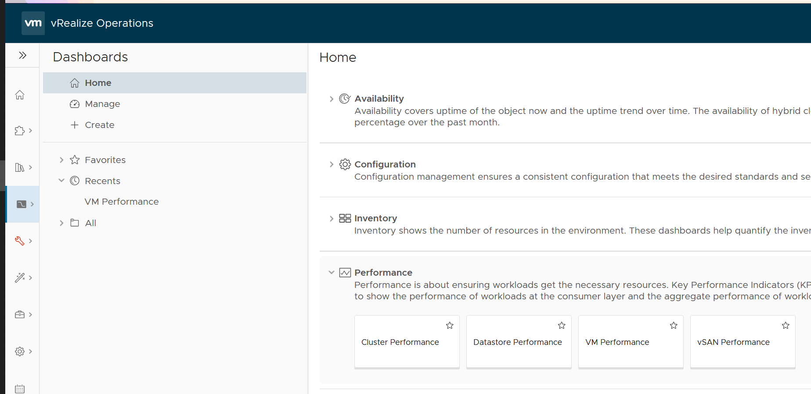
Live Demo: VM Performance Dashboard
1
2
Notes:
Scenario: Single VM troubleshooting
Limitations
Windows Event not included yet. Need to know which events are relevant. Can use Log Insight to forward.
Additional Actions
Network is best managed separately. Ensure no dropped packet, no retransmit packet in DC, especially at physical layer. Ensure broadcast and multicast match your expectation, both the throughput and the pattern.

Slide 30
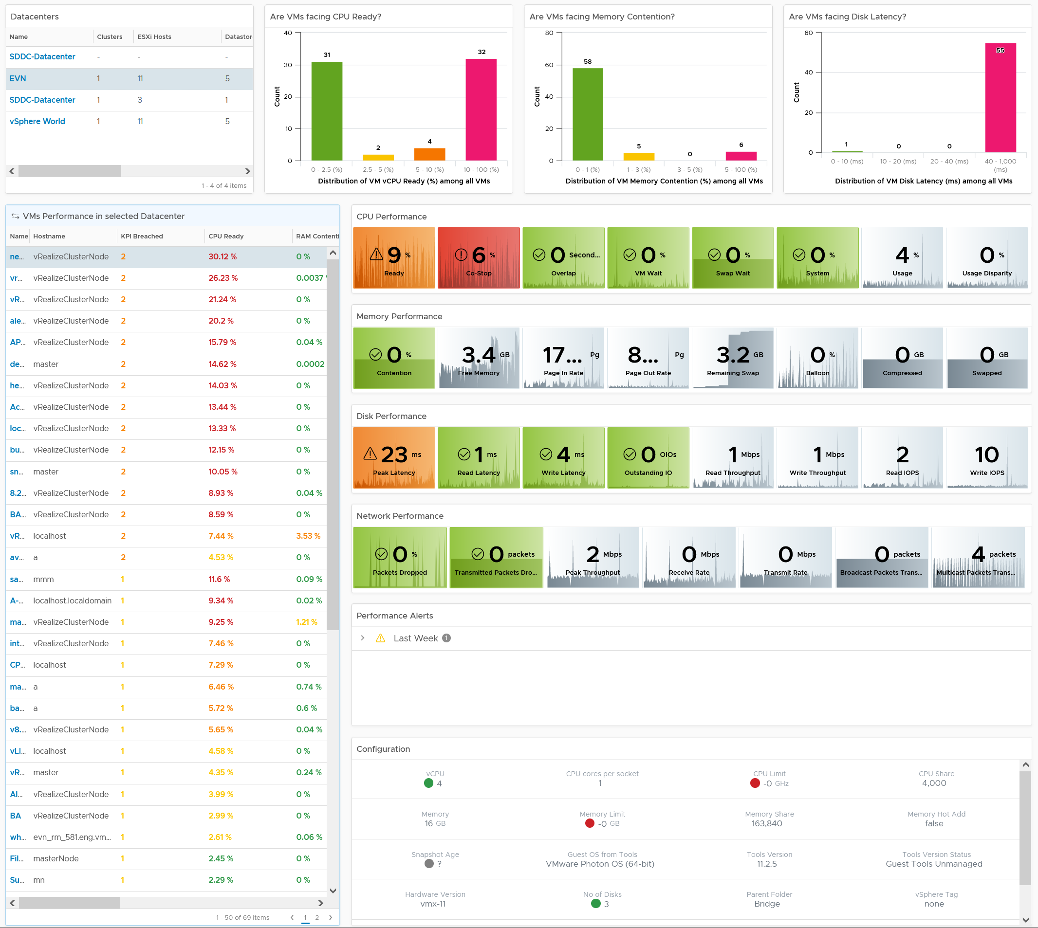
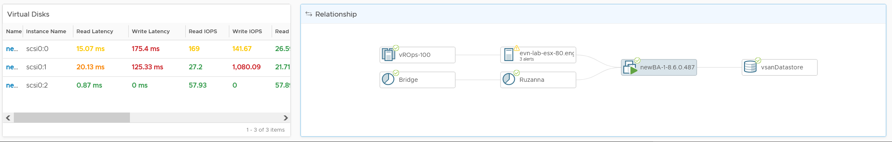
Overall Analysis
Quickly see the big picture
Pro Tip: add cluster for large environment
VM
Analyse many VMs.
Color coded. User configurable.
Sort | Filter | Export.
Choose any time period. Peak follows!
In-page Drill down. Context retain.
KPI Metrics.
Both Contention n Utilization
Guest OS and VM
Color coded.
vCPU and vDisk level, not just VM average
31 KPI Metrics
Relevant Alerts
Only Performance alert
Relevant Configuration
that impact performance
Virtual Disks
Drill down to Read & Write
Navigate to related object
Notes:
Summary
Bird-eye view
Clearly shows where the problem is
CPU | Memory | Disk | Network
Clearly show what the problem is
Read or Write?
Received or Transmit?
Contention caused by high utilization?
Detail
No need to figure out what metrics to choose!
Dashboard Time
Relevant alerts
Relevant configuration
Is it caused by underlying infra?
Can drill up to cluster, host, vSAN and datastore

Slide 31
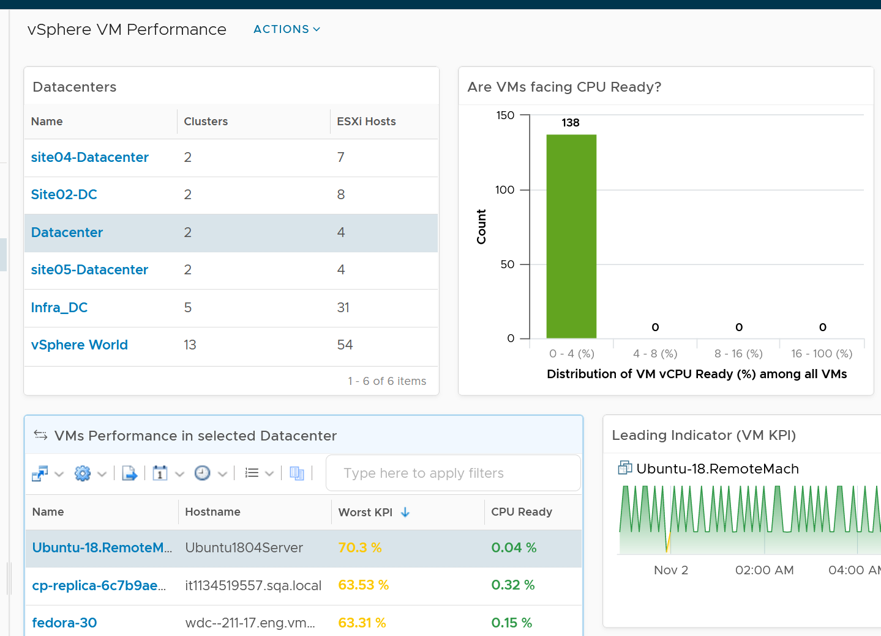
1 | You can select a specific DC. To see all VM, choose vSphere World object
2 | To find specific VM, use the search bar
3 | To select a VM, select the row.
1
2
3

Slide 32
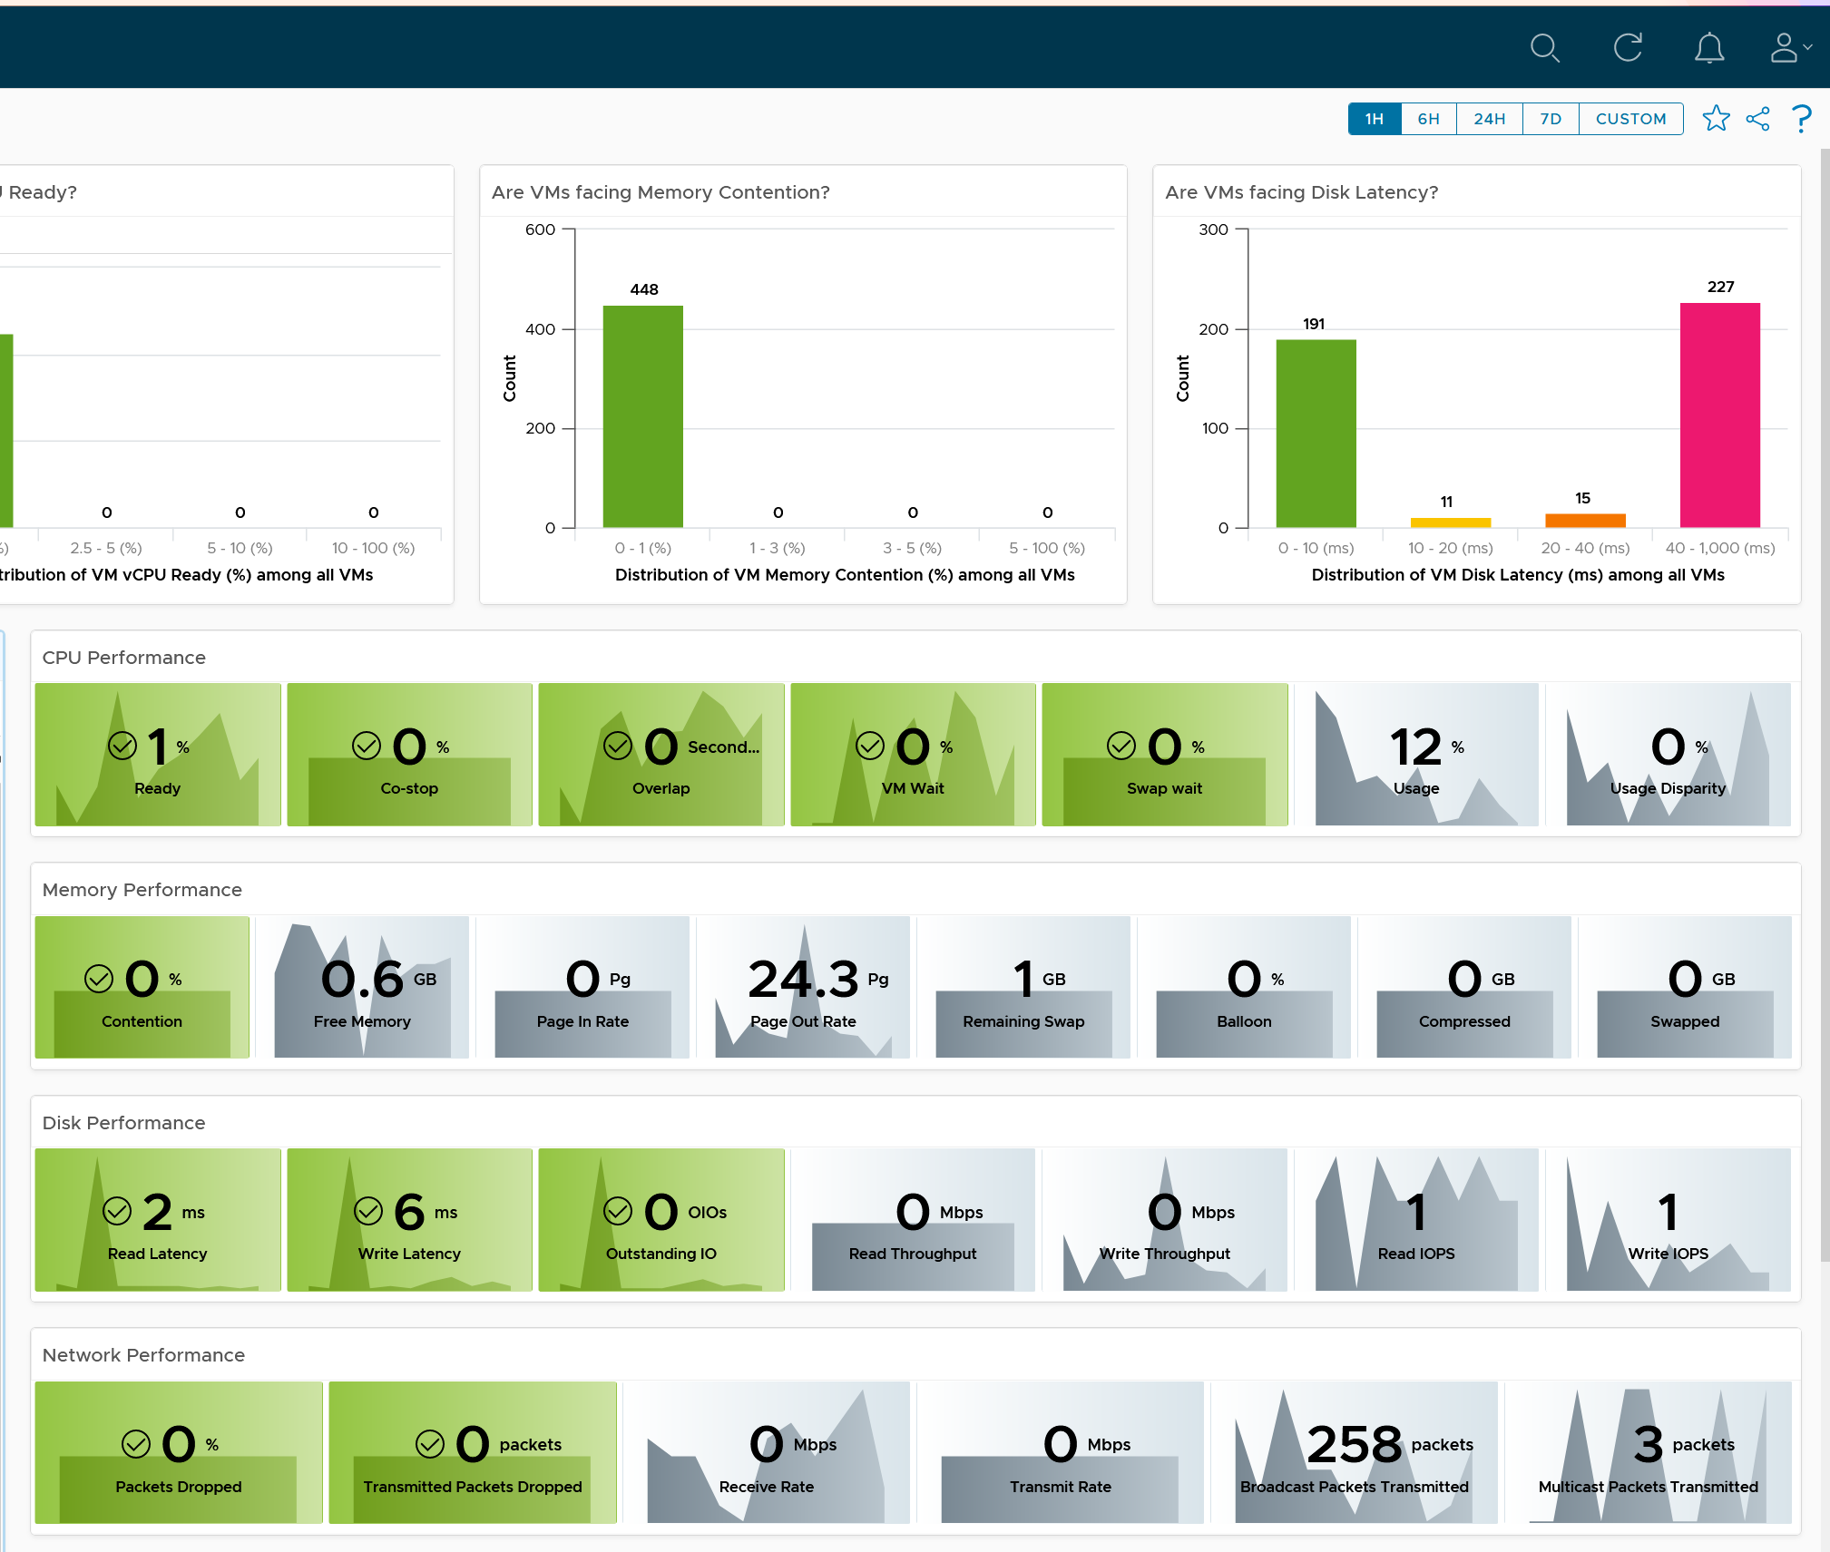
1
Why is CPU Run Queue the first counter?
Why are there 8 counters for CPU?
2
Why only Memory Latency is color coded?
Notes:
If it’s bad, then we need to go into troubleshooting to find out why a particular metric is bad. That requires us to know the metrics, which we do not have time.

Slide 33
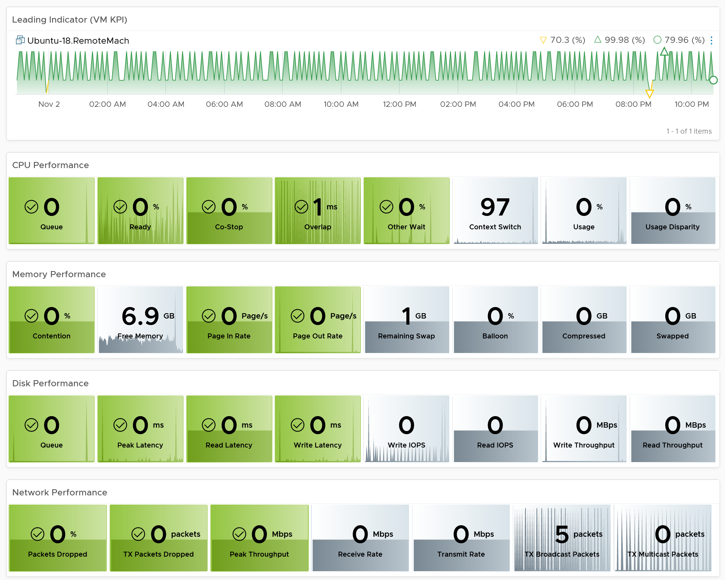
Notes:
[e1: Performance (%) can be lower. Multiplier bug?

Slide 34
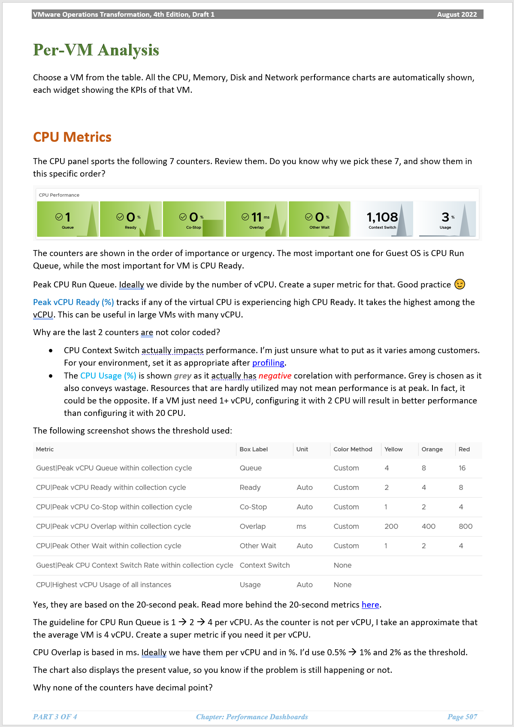
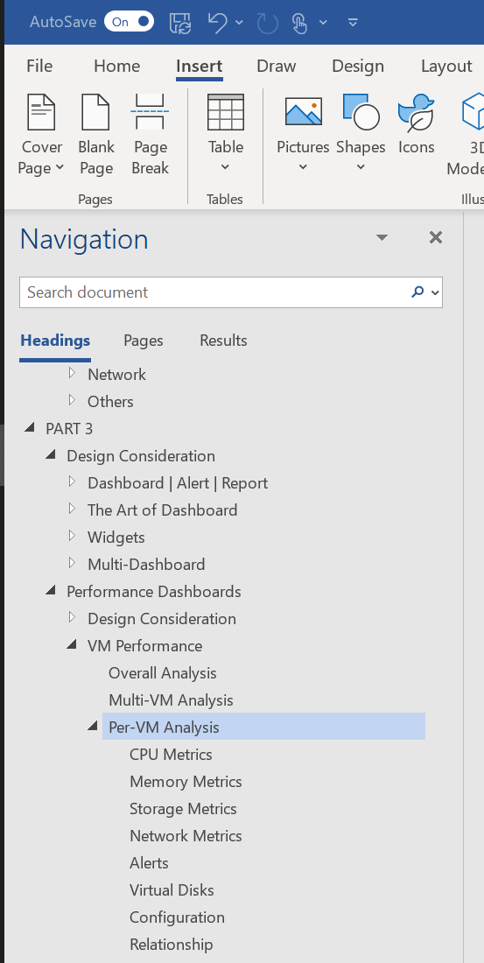
Video + Documentation
In-depth explanation on the dashboard
Written
It was written in MS Word for Windows, not Mac.
In MS Word, open the Navigation Pane.
Go to PART 3
Go to Performance Dashboards
Go to VM Performance
Watch Video here
Notes:
This is where I document all the metrics. Note it’s around 800 pages + 3 chapters exclusively at vmwareOpsGuide.com
We do not have time to cover every metric. Typically, OYW is a 2-day workshop.

Slide 35
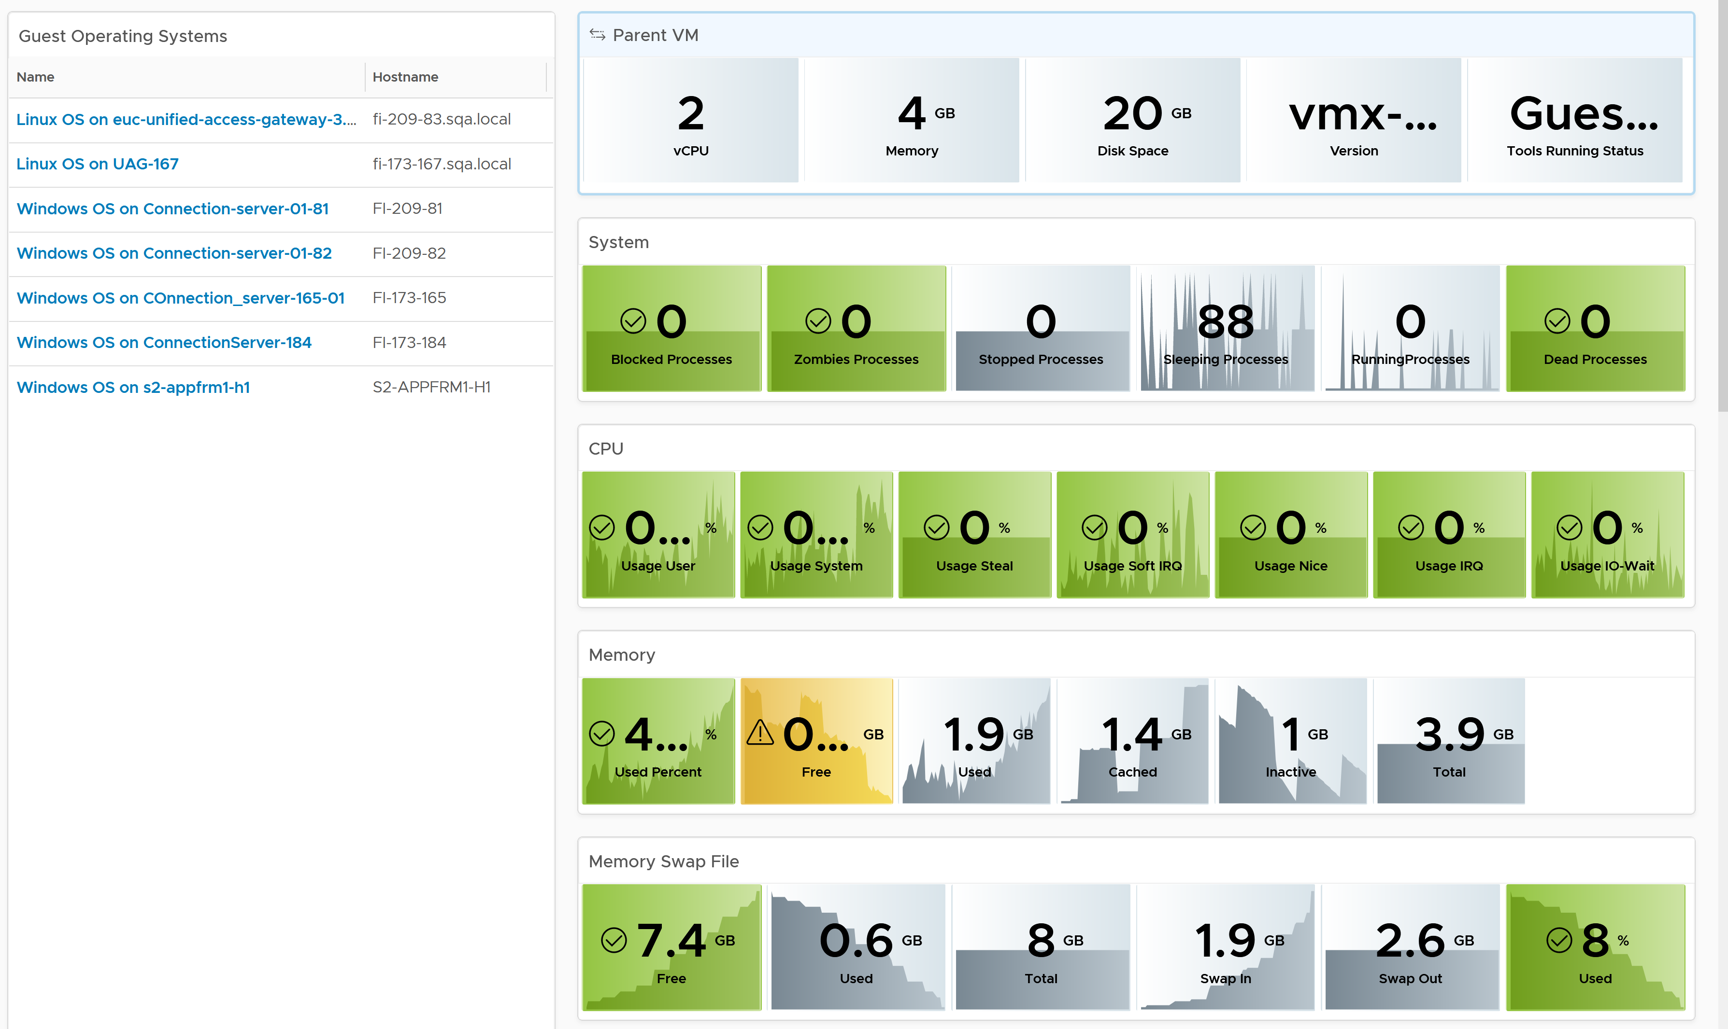
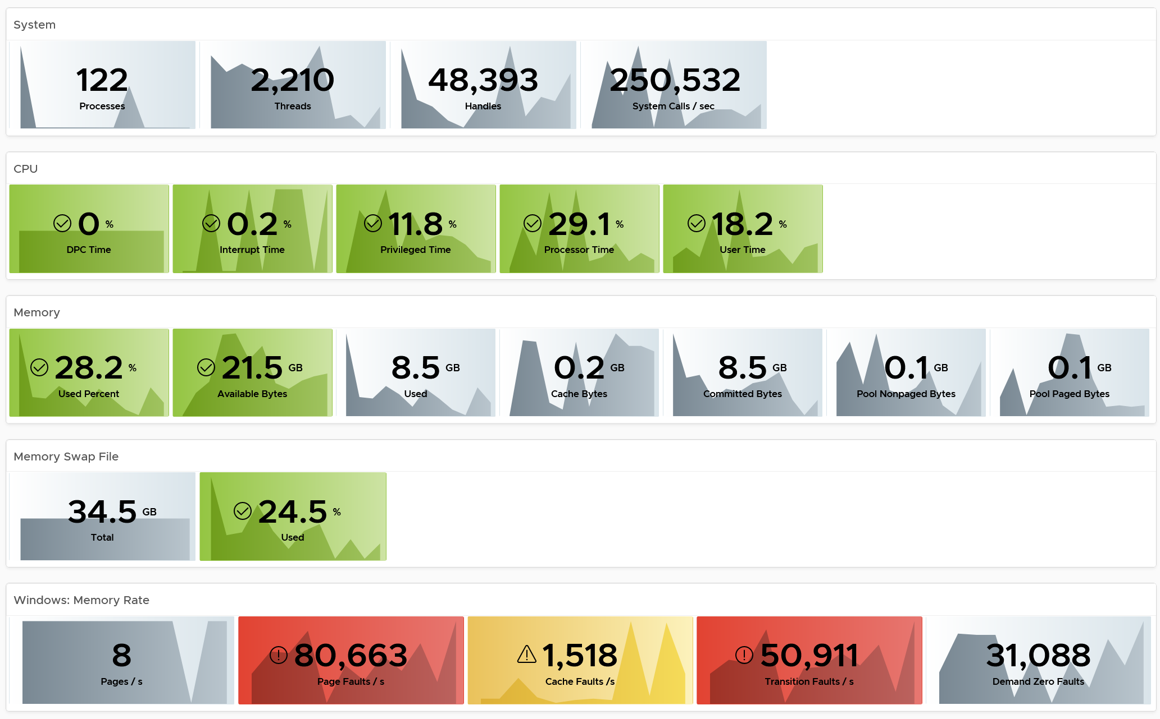
Windows or Linux Dashboard
Designed to complement the VM Dashboard
Drill down from VM into Guest OS. Go back up (via the Parent VM scoreboard widget)
Covers Windows and Linux. The dashboard don’t look neat as they do not share the same metrics.
Customize as you deem appropriate. Use the SLA baseline profiling technique to establish threshold.

Slide 36
Windows and Linux do not provide equal observability
 | System | CPU | Memory | Disk | Network | Remarks
Windows
Linux

Slide 37
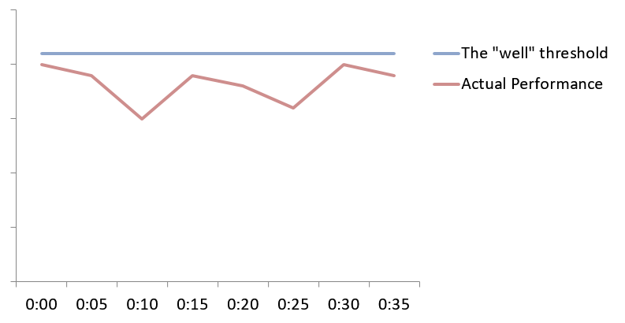
Performance SLA: Your defense line
SLA protects IaaS Team from high spike that’s within the SLA
How to define?
If no complaint
in the past 35000 measurements, why complain now?
35000x with no complaint
Relationship Driven
(dynamic, politic)
No agreement
Undefined Expectation
Variable Expectation
Notes:
Even without SLA, the data is useful. If you measure the performance in the past 1 month, that’s almost 35K datapoint. When a VM owner complain, and the performance metrics are showing better data, there is no technical basis to complain
But if there is a spike, how to define. That’s where SLA comes in.

Slide 38
How to operationalize IaaS SLA
Especially when you already have running workload
Analyze complaints
Performance SLA Exist?
No
Relative numbers
Baseline actual performance
Define
Socialize!
Yes
Absolute numbers
Infra Senior Management
Application Teams
Industry Best Practice
Proven guidelines
Yes
Any Complaints?
Improve as appropriate
Architecture Review
Tech Refresh &
Redesign
Measure Improvement
No
Based on Business Goals
Notes:
How many of you have Availability SLA in place?
How many of you have Performance SLA in place?
If you do not have, how to define?
You have 4 inputs to consider:
Complaints.
Actual Performance. Fact.
Industry Best Practice

Slide 39
Why Baseline Your Performance?
Actual data is critical input for SLA
The application team are….
Happy ☺
Unhappy ☹
Mixed ☺☹
Profiling is a proactive exercise to ensure performance is maintained as your environment grow or change.
Profiling prevents infrastructure from being blamed for application-level changes. For example, if your database size grow, it can slow down the application.
Establish the SLA while everyone is still happy.
If it’s unclear if the issue is due to IaaS or not, then the profiling quantifies the complaints so they can be measured.
It shows how bad the situation is, and how much improvement is needed. This can help in justifying additional capacity or tech refresh.
It might prove the blame on infrastructure is not right, if the counters are good.
It also reveals the full picture as it analyses the entire VMware environment, not just the VM with complaints.
Some are happy and while others are not.
In large environment with many VM Owners, it’s common to see different owners have different threshold. A 10% CPU Ready may be acceptable for Owner A yet a 2.5% CPU Ready causes Owner B to be upset, even though both VMs are in the same class of service.
Profiling brings up these facts to facilitate discussion to get everyone agree on the same SLA, because it’s a shared platform.
Notes:
Slide to explain to senior IT Management on why you’re doing the exercise.
1 - 3 months of data needed. 26298 data points per quarter

Slide 40
Quantifying your service quality
Threshold you can use when there is no SLA
IaaS | VM Counter | Threshold | Importance | Remarks
CPU | Ready | 5% | SLA | Average of all vCPU.
RAM | Contention | 1%
Disk | Latency | 20 ms |  | Average of all virtual disks.
CPU | CoStop | 2.5% | Supporting metrics | Same threshold as effect is the same
 | Overlap | 2.5%
 | Other Wait | N/A |  | Not used due to known bug
Disk | Outstanding IO | 40 |  | Must profile before committing
 | Queue Length | 40 |  | If you are responsible for Windows/Linux. Must profile before committing
IaaS | Counter | Explanation
CPU | Run Queue | It depends on the application. Not something Windows or Linux can control. For memory, follow app best practices (e.g. JVM, DB)
 | Context Switch
 | Usage Disparity
RAM | Free Memory
RAM | Page-in rate
 | Page-out rate
 | VM Balloon | Not a VM performance counter, but an ESXi capacity counter.
 | VM Compressed
 | VM Swapped
Disk | IOPS | Utilization, not contention counters.
 | Throughput
Network | Throughput (bps)
 | Throughput (pps)
 | Dropped Packet | False positive. Make sure network is healthy
The SLA is based on 5-minute average, not 1-minute.
The SLA is based on VM average, not individual component (e.g. 1 vCPU)
SLA is based on 100%, not 99.9% or others. Reason is you’re starting from no SLA.
You use the 20-second average as an internal threshold. Note this is 15x sharper.

Slide 41
Which numbers to represent?
How to summarize from millions of datapoints?
Worst Values
Each row is a VM.
3 months gives you 26,298 data points.
26+ millions per 1000 VM.
99.9th percentile means eliminating the worst 29.8 data points per VM.
That means ignoring the worst 131 minutes of the 3 months period (covering maintenance, upgrade, exceptional activities)
99.9th Percentile value
Best Value in 3 months
Take the Worst
Take the Average
Analyse these 2 numbers
Notes:
If the average of the worst is higher then the worst of the 99th percentiles, that means you have a lot of one-time, 5 minute spike impacting many VM.
If

Slide 42
Going Forward to Proactive Operations
Assumption: the complaint is due to IaaS, and not Guest OS or Application
Relative Data | Absolute Data | Recommendation
Valid Complaint | Bad Performance | Adopt industry best practice. Review gaps between actual performance and industry best practice. Align design & configuration with performance best practice. If hardware is old, tech refresh to increase capacity and performance, while reducing cost.
Valid Complaint | Good Performance | If the performance issue is short lived, analyse further with 20-sec peak. If this is the cause, improve performance further. Discuss and quantify the required performance with application team. Use tech refresh but focus on performance, not capacity.
No Complaint | Bad Performance | Assess if there is a risk for future complaint. If yes, this is your window to improve. Ideally, align design & configuration with industry best practice. If hardware is old, tech refresh to increase capacity and performance, while reducing cost.
No Complaint | Good Performance | Ideal situation. But make sure expectation is not set unrealistically high. Educate why the drop of performance is acceptable as you overcommit workload. Check if present both performance & capacity are enough for future demand.
Align with Best Practice
Further Analyze with 20-sec peak
Tech Refresh
Set expectation
Notes:
Good Performance = better than industry best practice.

Slide 43
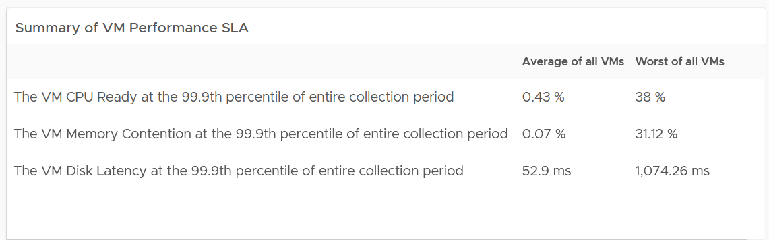
Live Demo: VM Performance Baselining
Using the Summary Table to determine the SLA
If the worst is good then your IaaS is performing well.
If the average is bad that means your IaaS is not performing well.
Split into 2 groups (Production and Non-Production). Production environment should have better result
Notes:
Summary
1 summary chart
Overall Profiling
3 distribution charts. Based on 5-minute
Detail Profiling
Table. CPU Ready, Memory Contention, Disk Latency
Worst and not 99th P for each VM in the last 1 – 3 months
Reason is we’re doing 300-second average, and not 20-second
Conservative: Average of Worst Value
Aggressive: Average of 99th Percentile

Slide 44
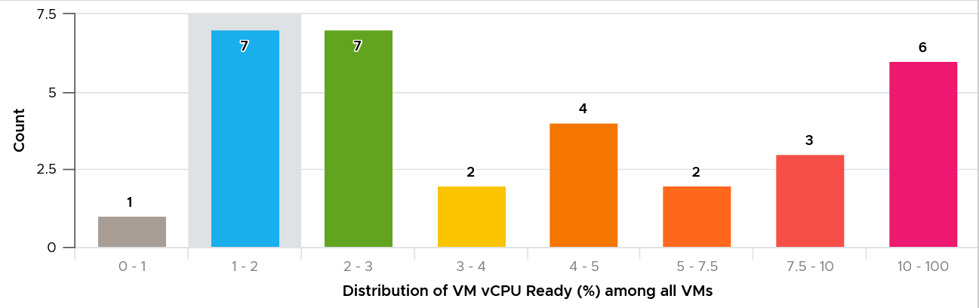
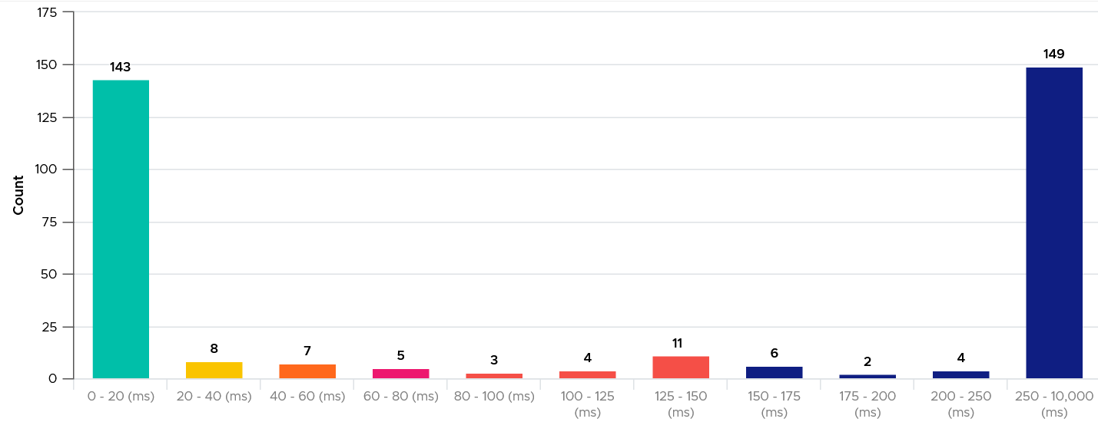
Live Demo: VM Performance Baselining
Is the bad performance an outlier?
Summary Table does not show the distribution among the values.
A distribution chart can tell if there is outlier (really bad value but rare) or you have real problem (plenty of bad values)

Slide 45
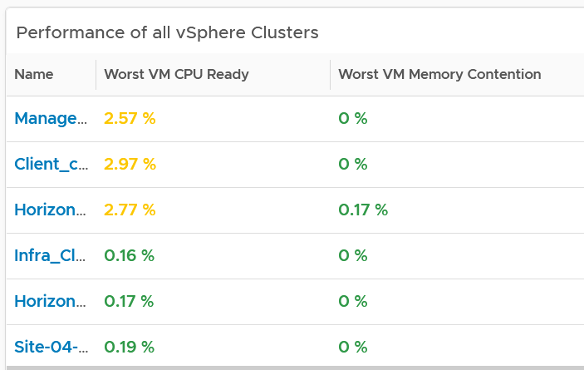
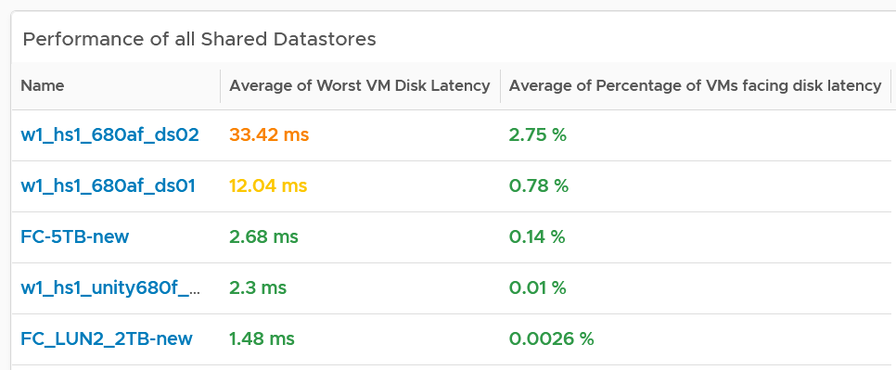
Live Demo: Infra Performance Baselining
Which Cluster or Datastore are not performing?
Complements the VM-centric view by showing the clusters and datastores that need attention.
It shows both the breadth and depth of the performance.
If your new design maps 1:1 to the old, you can do before and after comparison for each cluster or datastore.

Slide 46
Proactive Operations
Daily Check

Slide 47

A formal event with ticket recorded in the system.
Response mandatory.
Immediate timeline (hours).
Reactive.
Management by Exception
Alert
Insight
Not a formal event.
Does not require immediate response.
Longer timeline (days - weeks)
Proactive. No alert generated, no alert storm. Use dashboard to find out.
Management by knowing the Big Picture
Limitation: Early warning can contain false positive
Notes:
Alert vs Insight
There are 2 areas that early warning cover
Performance
Availability
Availability covers soft errors. Example is soft failure in hardware. vSphere 6.5 has predictive HA, which vMotion VMs and empty a host proactively when it detects that the host will experience fault.

Slide 48
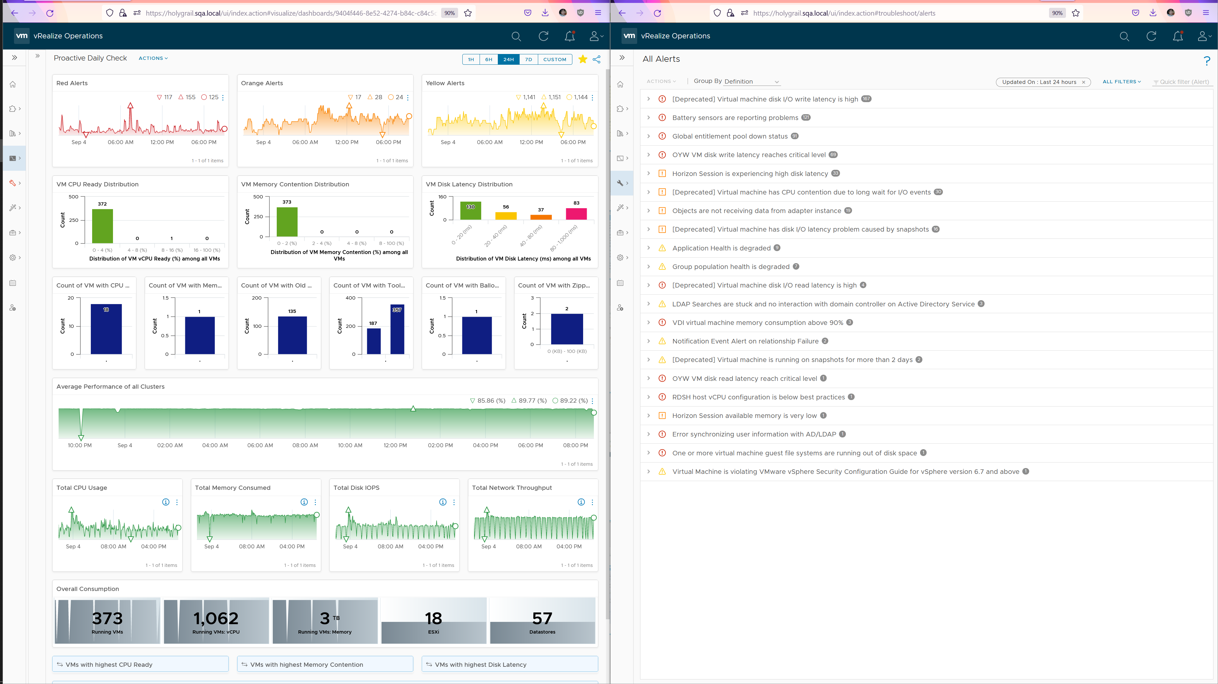
Using Alerts and Insight together
Open 2 separate Windows
Insights.
UI is visual. Trend charts and Distribution charts showing overall picture
Alerts
UI is task-oriented. A list of alerts to act on. Start with the most prevalent or most critical
A great way to justify why your work requires a 50” 4K curved monitor to your management.
You’re welcome.

Slide 49
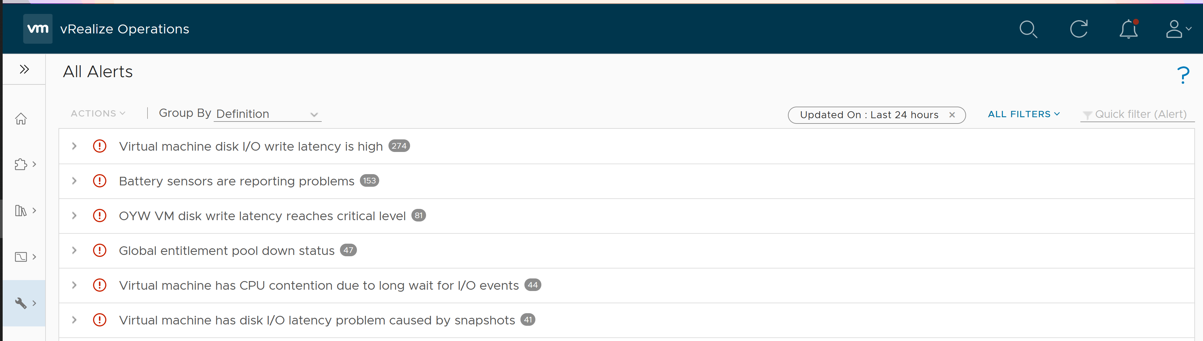
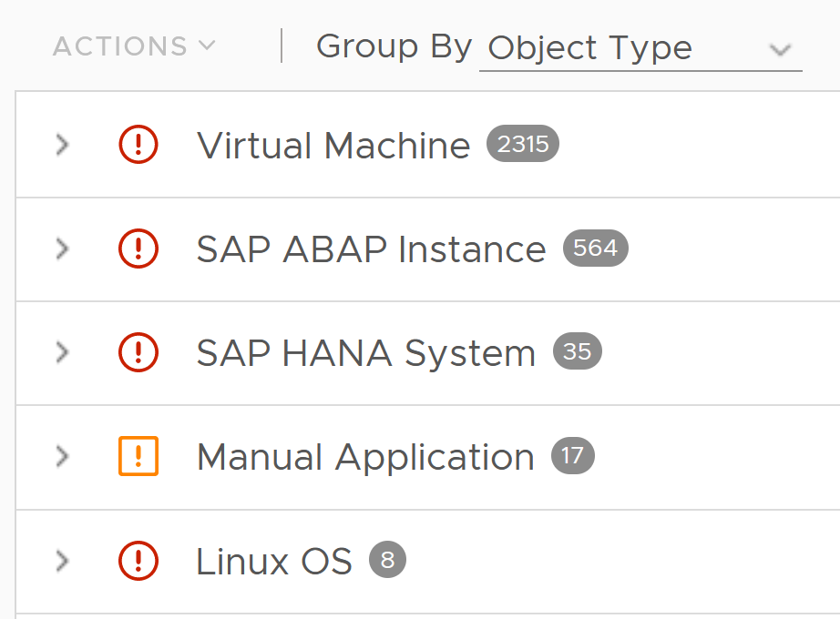
Using Alerts and Insight together
How the Daily SOP Dashboard complement the Alerts home page
Set the timeline to 12 or 24 hours, matching your daily cadence.
Do not filter to Active only, so you can see
What problems are the most common? Fix them permanently so they no longer appear here
By looking at the objects, any insights gained?
Notes:
Customize to your needs
Disable the alerts that you do not need
Narrow the alerts to only specific objects by creating policy.
Increase the thresholds or remove yellow (and orange)
Add more symptoms

Slide 50
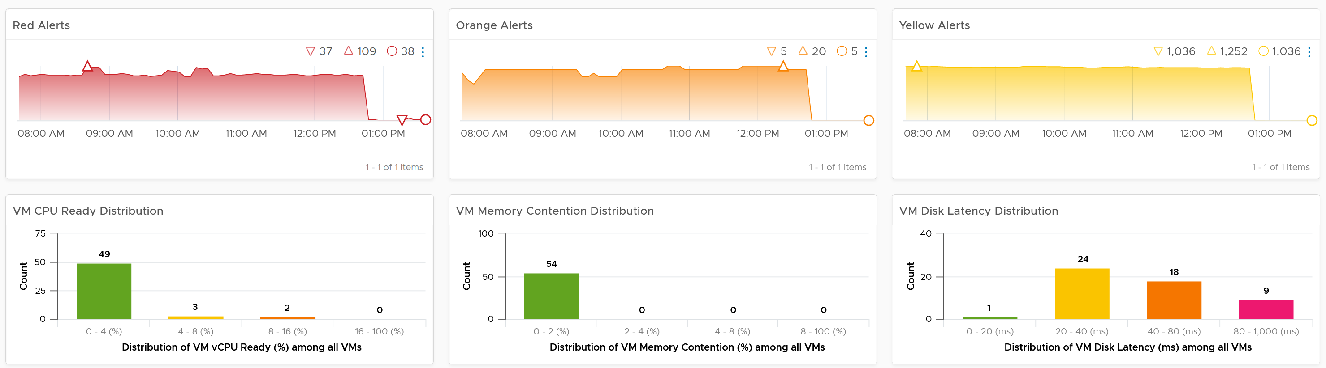
Daily Insights Dashboard: Part 1
Use it to complement Alerts
Is the trend unusual? Form an expectation of what’s normal for your environment as it develops pattern. Compare it with what’s happening (e.g. DC upgrade, public holiday)
What’s the overall IaaS performance among all the VMs? Is it a CPU, memory, disk problem?
Notes:
What’s the distribution of VM performance?

Slide 51
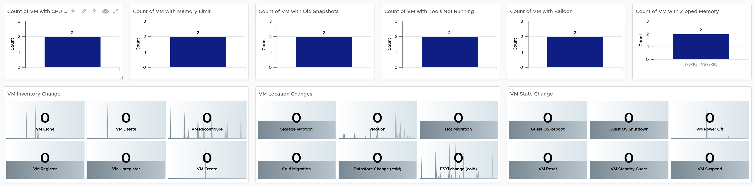
Daily Insights Dashboard: Part 2
Use in conjunction with alerts
Typical misconfiguration that cause performance problems. Ensure they are in-line with your expectation
Important changes on VMs. Ensure they match expectation of the day

Slide 52
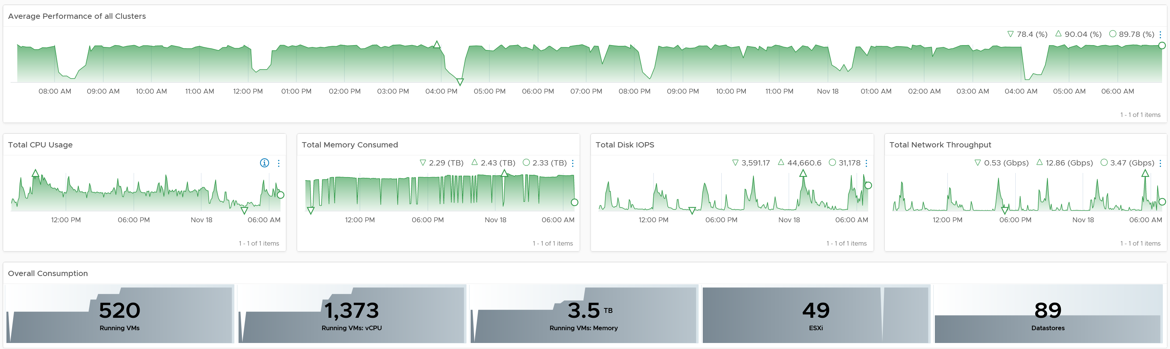
Daily Insights Dashboard: Part 3
Beyond alerts, what consumption and contention issues are potential alerts?
This is the overall performance. It should be stable or cyclical overtime
This is the overall utilization. It should be stable or cyclical overtime
Basic counters. Should be stable or move as expected

Slide 53
Log Insight
Is undesirable events rising? Are they matching your expectation?
Area | Information | Description
Availability & Performance & Inventory & Configuration | Total Events | All (good and bad). Suitable for something that have expected ceiling or pattern, such as vSphere DRS, vCenter Tasks. If DRS becomes a lot more active, it could be bad for performance
 | Error Event | If this is increasing more than the environment growth, over a period of time, something amiss. However, log entries tend to be dirty with fake error messages. The higher the proportion of fakes, the less useful the log becomes. If it’s too many, group so we can see if there is change among the group Examples: vCenter Tasks ended with error (note: need to clean up the query as some errors are not true error)
Availability & Performance | Undesirable Event | Not what you want, but they may not be errors as some changes are legitimate. Examples for Inventory: VM deletion, folder deletion Example for Configuration: snapshot during office hours, VM setting change (e.g. limit set), resource pool created Examples for Performance: vMotion bandwidth, vMotion stun time, vMotion downtime, VMkernel SCSI latency, Long VMFS reserve time Example for Availability: VM powered off, VM reset, Guest Shutdown, vSphere HA, ESXi states (maintenance mode) You need to compare actual with expectation. For example, if you delete 258 VM and logs say 261, something not right.
Security | Undesirable Event | Examples: “Loosening” Firewall changes (e.g. disable, allow all IP), root login, administrator login, dangerous console commands such as deletion, promiscuous mode enabled, ports being opened, SSH enabled, DCUI enabled
Audit | Not Applicable | Not for day to day. It’s for audit team. Who did what action to which object, and when
If you react, you lose. You need to anticipate. However, the longer the prediction, the higher the chance of wrong prediction. Hence aim for the next 10 hours, at the start of your day. Look at signs of storm brewing, such as undesirable events, increasing or strange utilization patterns, soft errors, etc.

Slide 54
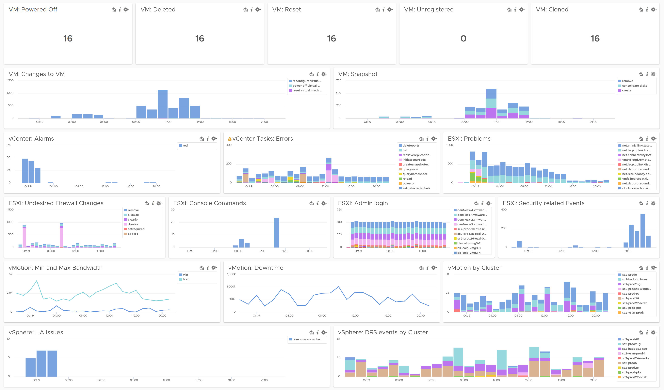
Day-to-day Operations
To be checked 2x a day. Start of Day and End of Day.
Undesirable VMs events.
Are they inline with your expectation? Right amount and right timing? Harmless events such as VM relocation, snapshot, powered on were filtered out
Undesirable VM changes & Snapshot.
Are they inline with your expectation? Harmless changes filtered out. Are changes and snapshot taken during office hours?
Issue
vCenter Alarms, vCenter tasks that ended with error, and ESXi potential problems.
Security
Any malicious changes? Anyone issuing shell commands at ESXi console? Login by root?
vMotion
Is the bandwidth lower than expected? Is the downtime longer than expected? Some clusters did a lot more vMotion than usual?
HA and DRS
Any issue with HA and DRS? Is DRS a lot more active than expected? Which cluster is behaving abnormally when?

Slide 55
VM Alerts: CPU Performance
How 12 alerts are reduced to 1
Alerts to deprecated (not disabled) | Reasons
VM is demanding more CPU than the configured limit | This happens due to CPU limit or CPU overcommit situations. Limit is a configuration item. There is no need to wait until you an alert is triggered. Configuration is best done via proactive SOP dashboard. So we should not have it as a condition in the alert as it changes recommendation. We assume there is no limit.
VM in a cluster is demanding more CPU than its entitlement
VM in a DRS cluster is demanding more CPU than its entitlement
VM is demanding more CPU than its entitlement
VM on a host with BIOS power management not set to OS controlled is facing CPU contention | BIOS power management is a setting. Configuration is best done via proactive SOP. Why wait until you get an alert then react? Dashboard also lets you need to see big picture and context, as some clusters may have different power management setting. We no longer check for CPU Latency metric as it’s too volatile. Affected by both HyperThreading and Power Management
VM on a host with BIOS power management not set to OS controlled is facing CPU contention
VM on a host with BIOS power management set to OS controlled is facing CPU contention
VM on a host with BIOS power management set to OS controlled is facing CPU contention
VM has CPU contention due to long wait for I/O events | No need 4 separate alerts as the remediation action is the same for all of them. Also, the correlation for specific cause could be wrong. The I/O event is actually based on the CPU Other Wait counter. The metric value is small, so the actual impact is negligible. In vSphere 7U2, there is a bug that makes this number big. There is no solution yet from vSphere so this alert gets triggered for nothing.
VM has CPU contention due to memory page swapping in the host
VM has CPU contention due to multi-vCPU scheduling issues (co-stop) caused by snapshots
VM has CPU contention due to multi-vCPU scheduling issues (co-stop) caused by too many vCPUs
Notes:
Limitation: bug on vSphere 7.0 U2 onwards https://kb.vmware.com/s/article/85393. No workaround

Slide 56
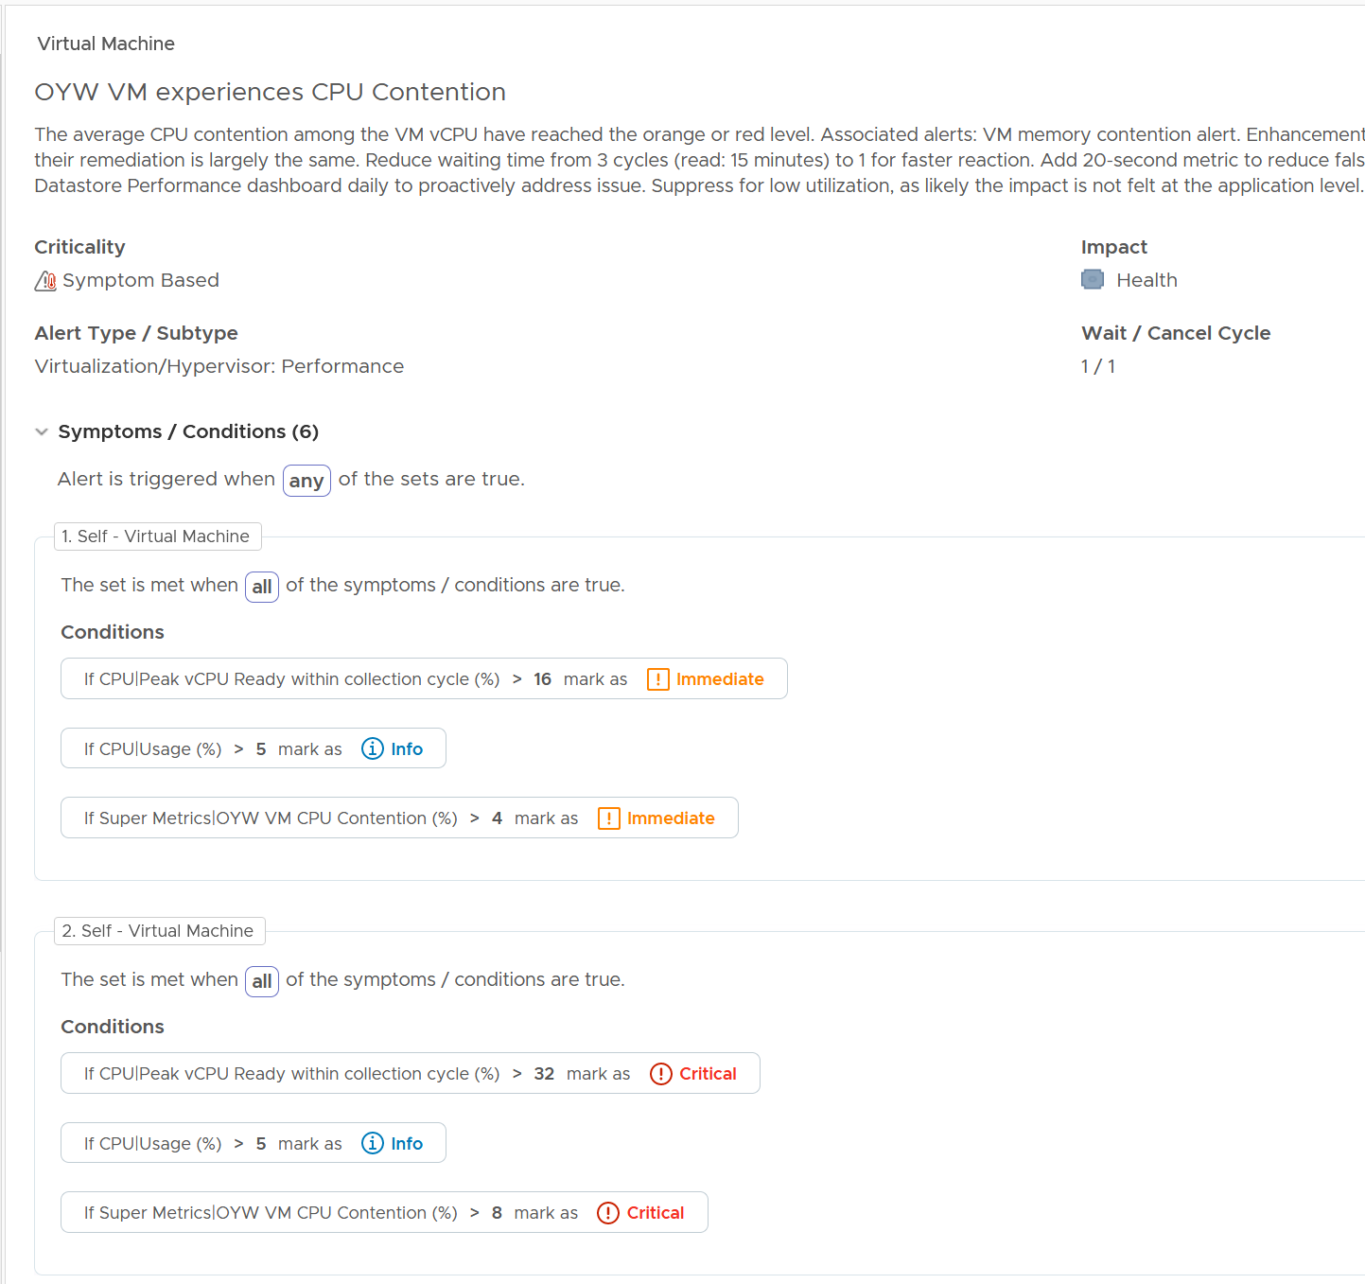
New Alert: VM experiences CPU Contention
Replaced the 12 alerts in previous slide
Enhancements
Instead of CPU Latency metric, it uses CPU Ready + CPU CoStop + Overlap + Other Wait. These metrics do not depend on power management, so it’s more appropriate for this purpose than CPU Latency. For details of use case for CPU Latency, see Part 2 Chapter 2 CPU Metrics.
Added CPU Usage to eliminate triggered alert when hardly anyone affected.
Add 20-sec peak to ensure problem is real
No yellow.
Limitation:
bug on vSphere 7.0 U2 onwards https://kb.vmware.com/s/article/85393. No workaround? Can Eng check in the code?
Notes:
Old alerts are deprecated as they use volatile metrics

Slide 57
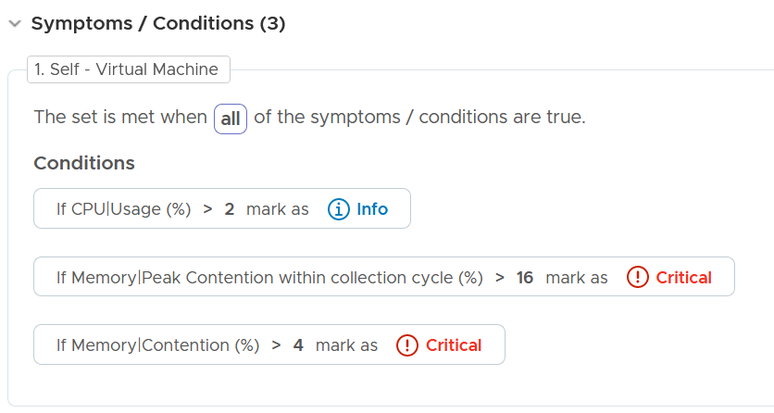
VM Alerts: Memory Performance
3 alerts → 1
Alerts deleted | Reasons
VM has memory contention caused by swap wait and high disk read latency | Correlation between memory latency and the specific symptoms are not clear or could be wrong. It can't be proven also. It’s best not to state it as it could be misleading. In the case of Memory Limit, it’s just one of the factors causing contention. There are other factors, such as high usage on parent ESXi and VM share, and it’s impossible to see which one actually caused the problem.
VM is experiencing memory compression, ballooning, or swapping due to memory limit
VM has memory contention due to memory compression, ballooning, or swapping
A new alert:
Name: “VM experiences memory contention "
We disable yellow. Only orange and red level.
We add 20-sec to tighten the condition, reducing the false positive
Added condition to eliminate low utilization.

Slide 58
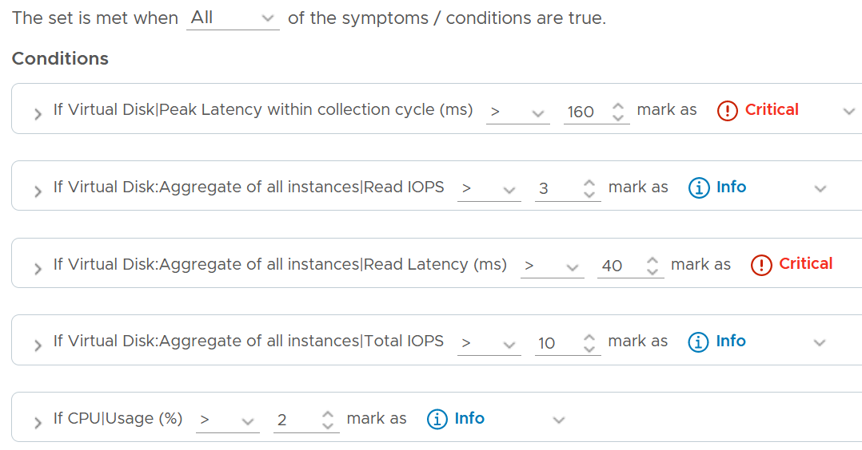
VM Alerts: Disk Performance
3 alerts → 2
Alerts deleted | Reasons
VM disk I/O read latency is high | They fire too often while app team do not feel a problem. The word “high” is confusing. It maps to red, orange or yellow? Better remove ambiguous word in the name.
VM disk I/O write latency is high
VM has disk I/O latency problem caused by snapshots | It's a guess that can't be proven, so better keep it general. The counter Other Wait has false positive bug (see KB)
2 new alerts:
Name: “VM experiences memory contention "
We disable yellow and orange to reduce noise.
We add 20-sec to tighten the condition, reducing the false positive
Added condition to eliminate low utilization.
We still keep Write and Read separate as the remediation is different.
Fix wait cycle to 1 as customers want it earlier. No change in Cancel Cycle (3)

Slide 59
Other Changes to VM Alerts
2 alerts → 0
Existing Alerts to be deprecated | Reason for Deprecation | Solution
VM is running on snapshots for more than 2 days | Could be intentional, meaning the alert itself is invalid. That’s why it should be deprecated not just disabled. Also, config issue is best covered via SOP dashboard | Daily SOP Dashboard, as it’s configuration issue. Limitation: to exclude ISV Appliance, need to create custom group for them and exclude them in the View Filter.
VM has unsupported VMware Tools | Could be genuine constraint (some appliance controlled by ISV vendor)

Slide 60
Performance vs Capacity
Context: IaaS
Focus
Time
Counter
Availability SLA
Utilization
IaaS Performance
VM How the IaaS serves its VMs
1 second – 5 minutes
Contention. Utilization is for troubleshooting, not monitoring.
Does not take into account. Not relevant
Based on raw. Usable Performance
IaaS Capacity
IaaS VM Capacity Management is merely right sizing
1 month – 1 year
Utilization. So long there is no contention.
Takes into account. Tier 1 is in fact Availability-driven.
Based on usable. Usable Capacity vs Total Capacity
Notes:
Point of the slide: 2 sides of the same coin. Related but not the same.
Reference in the book:
Part 1 Chapter 2 Performance: read the Performance vs Capacity section

Slide 61
Utilization
Just a means to an end. It’s not something you manage
Utilization depends on the purpose.
Different goal → different interpretation and metrics
Performance
100% utilization is not only good, it’s perfect. So long there is no queue, drive this high
Low utilization may mean bad performance. Check Q
Look at actual utilization. Ignore Buffer and HA.
Use 5 minute interval. If you suspect Peak, then zoom into 1 minute
Look at 1 day time period
Capacity
100% utilization is bad, especially it breaches Usable Capacity
Low utilization always mean good capacity
Look at relative utilization. Include Buffer and HA.
Use hourly or daily average. Peak is taken care of by measuring contention directly.
Look at 3 – 6 months
Notes:
Point of the slide: do not manage utilization as its meaning depends on the purpose
Reference in the book:
Part 1 Chapter 2 Performance: read the Performance vs Capacity section

Slide 62
2 Dimensions of Performance
How Deep vs How Broad
How severe is the problem?
What’s the worst that happens to a single VM.
Once you know this, the next logical question is below.
How widespread is the problem?
How many VMs are affected?
The answer impacts the course of troubleshooting. Is it isolated incident or widespread?
Isolated → look at the affected VM more closely
Widespread → look at common area (e.g. cluster, datastore, resource pool, host)
 | Metric | Green | Yellow | Orange | Red
How Broad? | % VM with CPU Ready >1% | <2.5% | < 5 | < 10 | > 10
 | % VM with RAM Contention >1% | 0% | < 2.5 | < 5 | > 5
 | % VM with Disk Latency >10 ms | 0% | < 2.5 | < 5 | > 5
How Deep? | Max VM CPU Ready | < 2.5% | < 5 | < 7.5 | > 7.5
 | Max VM RAM Contention | < 1% | < 3 | < 5 | > 5
 | Max VM Disk Latency | < 10 ms | < 20 | < 30 | > 30
Notes:
Point of the slide: using 2 dimensions make it easier than 1.
Reference in the book:
Part 1 Chapter 2 Performance: read the “Breadth vs Depth” section

Slide 63

What’s my overall Performance? Overall Capacity?
Hard to answer, especially in large environment
Aggregation is misleading
Members are not interchangeable. Examples:
Can’t put business VM into NSX Edge cluster
Can’t move Singapore load to New York
Show a trend line. 1 trend line, not many trend lines.
Show a table, listing all members (e.g. clusters).
Each table does not show average. It shows Peak + 95th percentile.
Drill down In-context.
Solution
Average is useless
Average of a large number does not give reaction time operationally. 95th percentile better.
Need to show across time
Can’t average 3 months information into 1 data point.
Patterns are important (weekday vs weekend, business hours, etc.)
Need to drill down in context
Quickly see the detail of selected member.
Not losing the big picture, and can rapidly toggle among members for analysis
Notes:
Point of the slide: Rolling up is hard. You either take the extreme (outlier) or you lose the details (by averaging).
Reference in the book:
Part 2 Chapter 1 Overview: read the Collection | Aggregation section

Slide 64
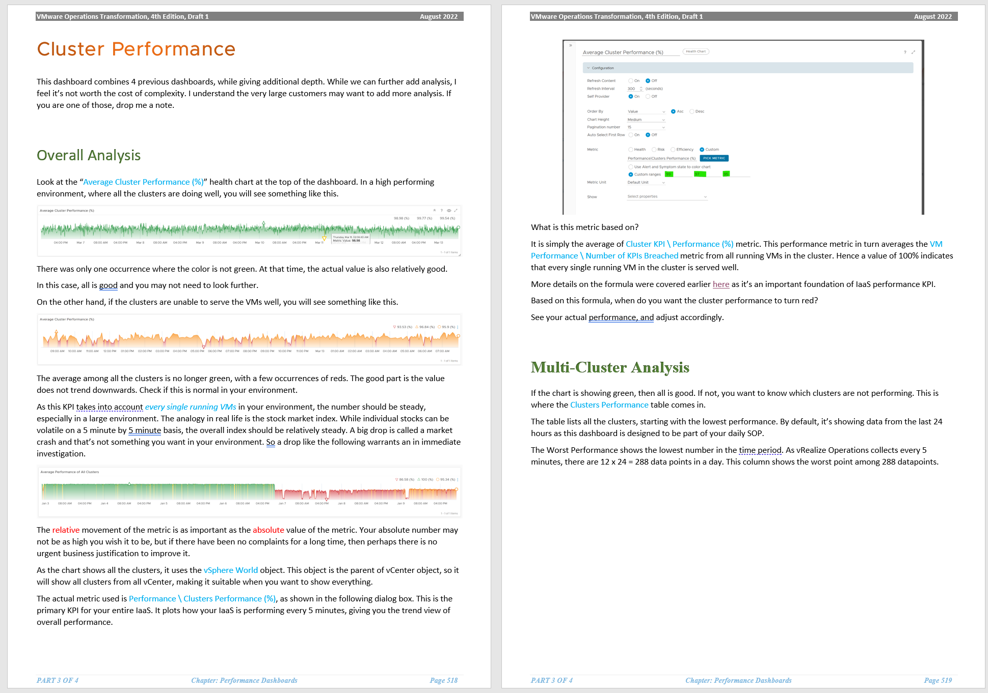
Live Demo: Infrastructure Performance Dashboard
4 dashboards
Compute: vSphere Cluster
Storage: vSphere datastore
Network: Distributed Switch
HCI: vSAN
They are interconnected.
Dashboard to Dashboard navigation, with context passing
Further Reading
Part 1 Chapter 2: Performance Management
Part 2 Chapter 7: Operations Metrics
Part 3 Chapter 2: Performance Dashboards
Future Enhancement
Integrate with physical network
Integrate with physical storage
Notes:
Future Enhancement
20-sec instead of 5 minute
New formula. No longer based on Yes/No (meet or not meet), but green-yellow-orange-red framework (similar to Horizon)

Slide 65
vSphere Cluster Performance (%)
 | Metrics | Green | Yellow | Orange | Red
How Deep? | Worst vCPU Ready among all VMs | 0 – 2% | 2 – 4 | 4 – 8 | 8 - 16%
 | Worst vCPU Co-Stop among all VMs | 0 – 1% | 1 – 2 | 2 – 4 | 4 – 8%
 | Worst vCPU Other Wait among all VMs | 0 – 1% | 1 – 2 | 2 – 4 | 4 – 8%
 | Worst vCPU Overlap among all VMs | 0 – 1% | 1 – 2 | 2 – 4 | 4 – 8%
 | Worst Memory Latency among all VMs | 0 – 1% | 1 – 2 | 2 – 4 | 4 – 8%
How Broad? | Average vCPU Ready among VMs | 0 – 0.5% | 0.5 – 1 | 1 – 2 | 2 – 4%
 | Average vCPU Co-Stop among VMs | 0% - 0.25% | 0.25 – 0.5% | 0.5 - 1% | 1 - 2%
 | Average Memory Latency among VMs | 0% - 0.25% | 0.25 – 0.5% | 0.5 - 1% | 1 - 2%
 | Percentage of vMotion | 0 – 1% | 1 – 2 | 2 – 4 | 4 – 8%
 | Worst network error + dropped packets among all ESXi hosts | 0% - 0.2% | 0.2 – 0.4% | 0.4 – 0.8% | 0.8 – 1.6%
 | Percentage of memory swapped + zipped | 0% - 0.25% | 0.25 – 0.5% | 0.5 - 1% | 1 - 2%
While the impact on VMs are the same with Ready, using the same range will elevate the score, as practically these 3 have lower score
More stringent than the Worst() metric, as it takes more effort to raise these number
Threshold is set a bit higher as they are leading indicator. A cluster typically has 2 TB of RAM, so 1% is 20 GB. Same with network
Notes:
We’re not doing 95th percentile
We’re not doing 95th Percentile and Average for Other Wait and Overlap. They are less popular metrics, less practical too. As at 7 Aug 2022, the bug on CPU Other Wait on vSphere 7.0U2 or later has not been fixed.
We’re not doing the “Percentage of VM population experience CPU Ready > 1%” and “Percentage of VM population experience Memory Contention > 0%” as they measure the same purpose with the average.
Future enhancement:
90th or 95th percentile complements Worst and Average. We put a more stringent threshold for leading indicator.
Add CPU Overlap. Low priority for now as the number is always low so it will make the overall score greener
Add CPU Other Wait once the bug in vSphere is fixed. Low priority as number is always low
Counters not available
There are counters that are only available in esxtop. They are not available in vCenter REST API, so they are not retrieveable.
Examples are Local:Remote memory ratio for VM.

Slide 66
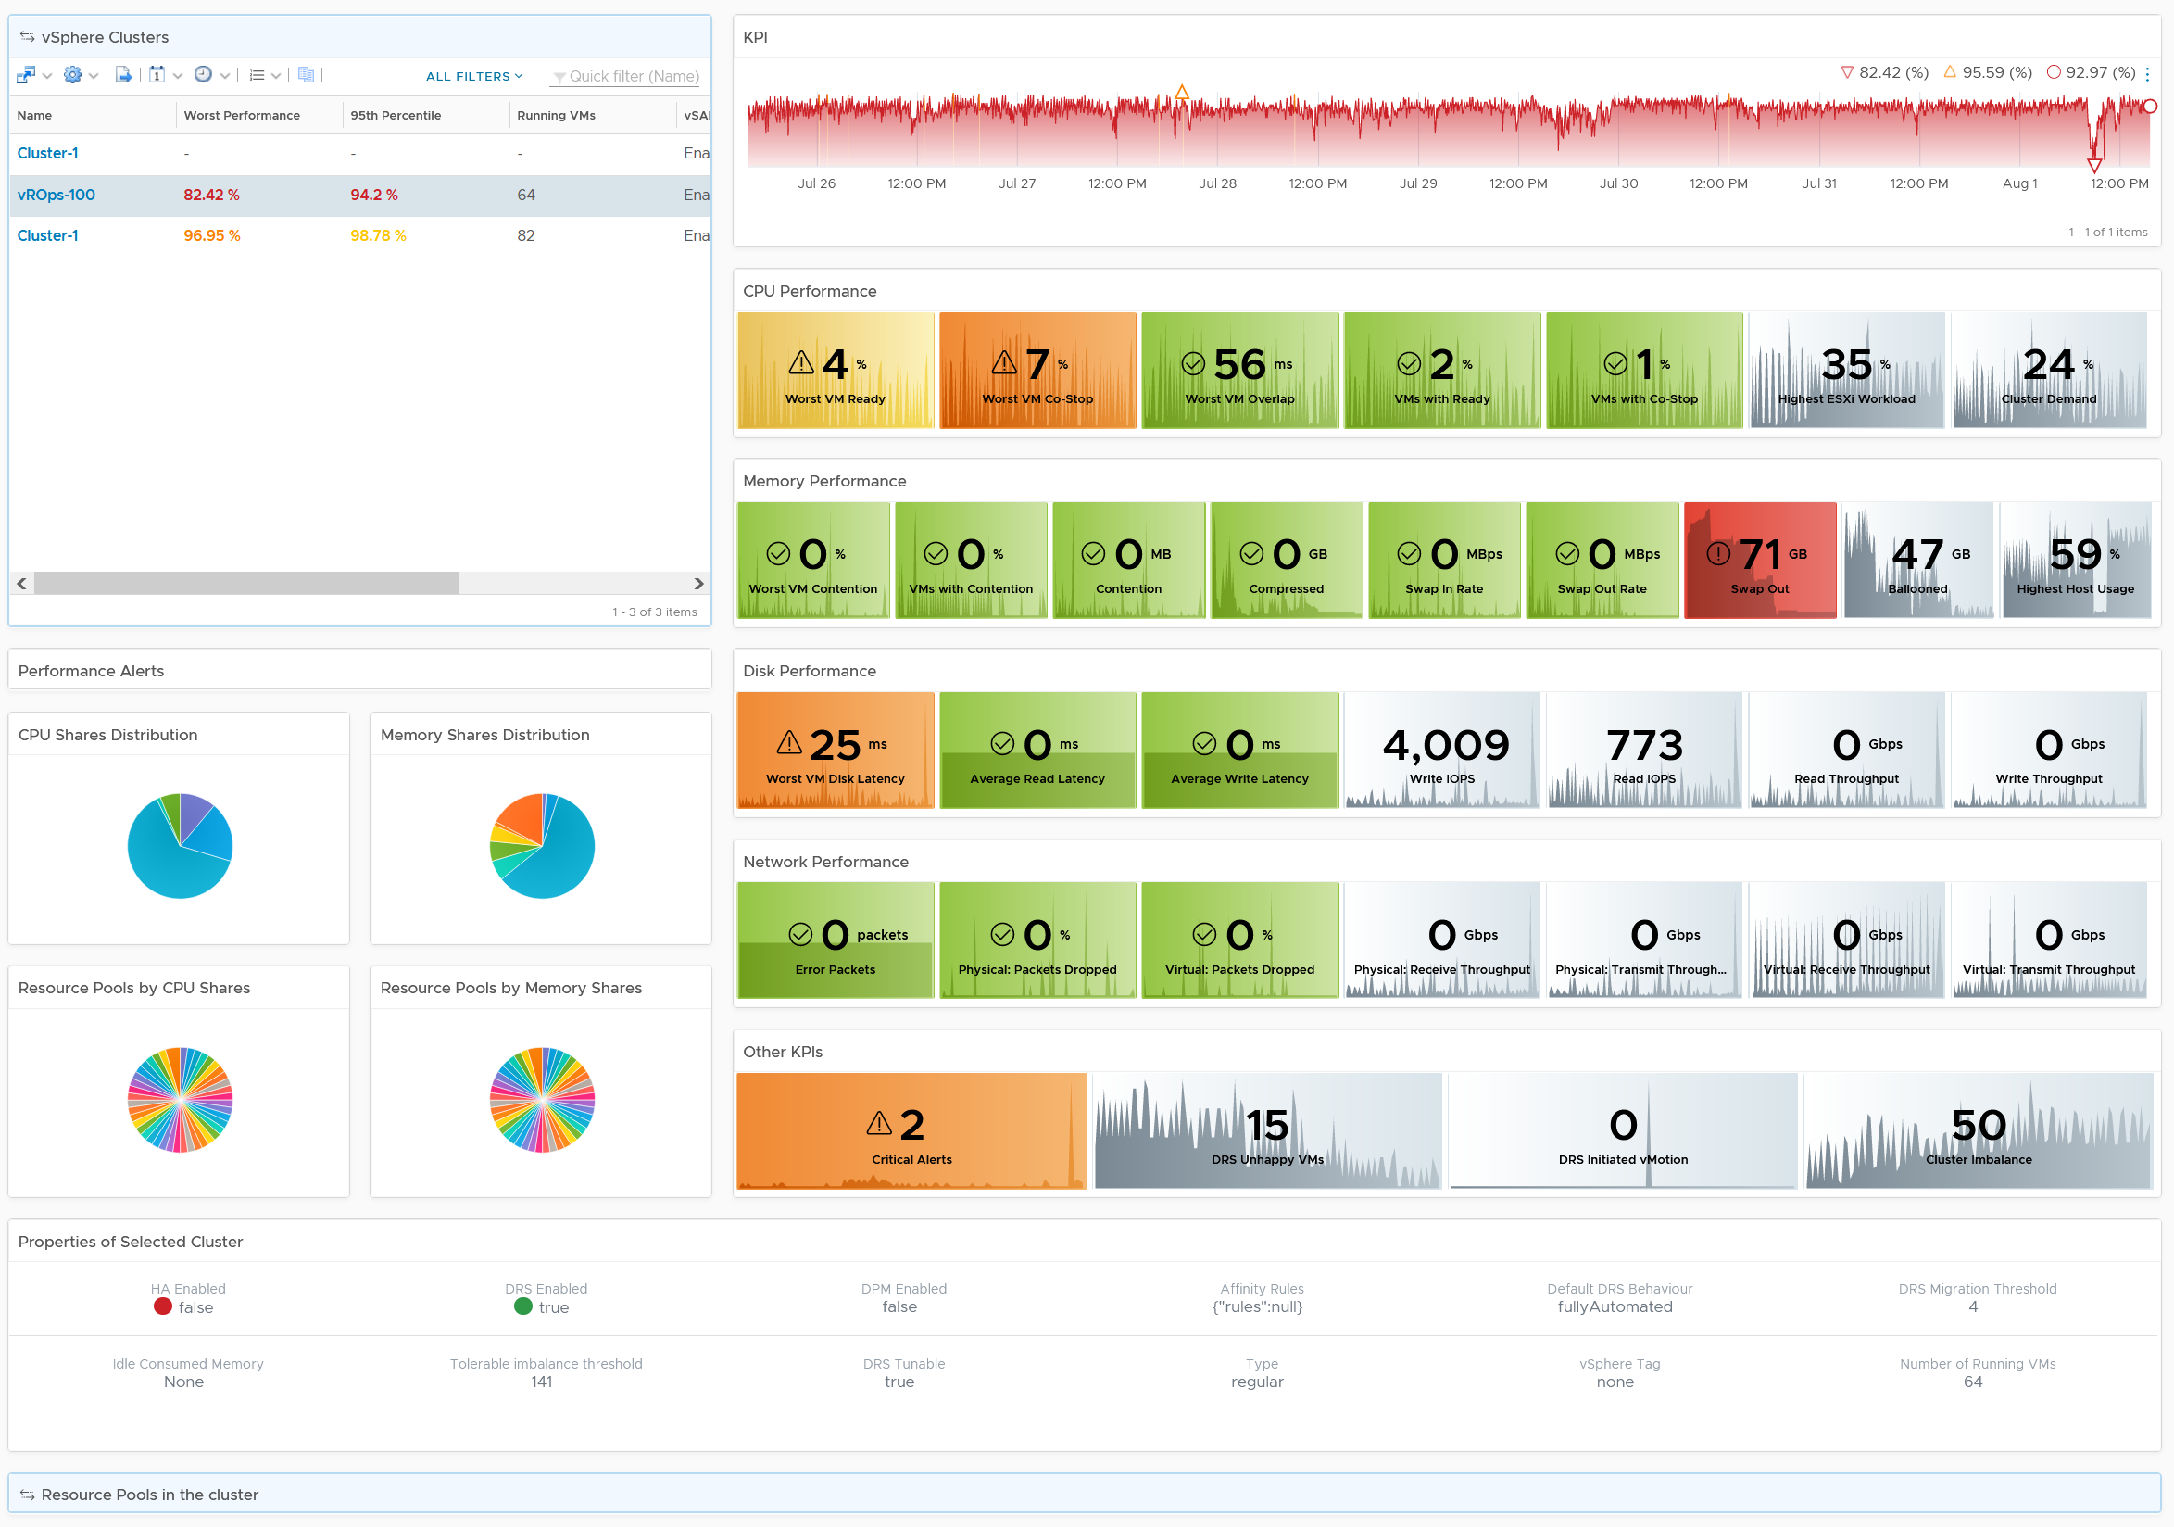
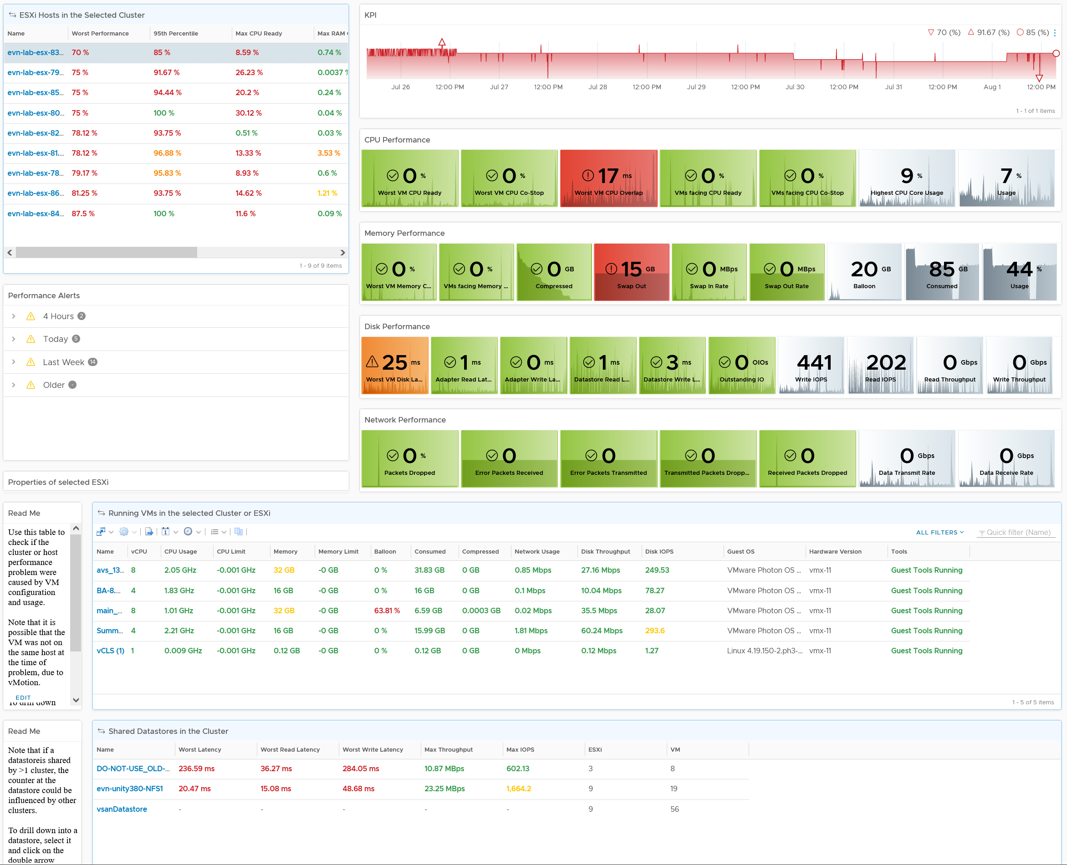
Level: Cluster
Clearly shows where the problem is
KPI line chart shows health trend over time
CPU | Memory | Disk | Network
Absolute value and Relative movement
Analyse
Many Clusters
KPI Metrics.
Contention
Utilization
Cluster
Alerts
Shares
Resource Pool
Relevant
Configuration
Level: ESXi
Analyse
Many ESXi
KPI Metrics.
Contention
Utilization
Alerts
Configuration
Analyse
Many VMs
Level: VM
Datastore
Analyse
Many Datastores
Notes:
Clearly show what the problem is
Read or Write?
Received or Transmit?
Contention caused by high utilization?
Relevant alerts added.
Relevant configuration added
Drill down
Resource Pool is now added. It’s missing in 8.2
In-place drill down to ESXi. No need to context switch into another dashboard.
More with Less
Less dashboard but more info.
Optimized for larger monitor
Great excuse to get that 4K monitor. E1 uses 43” and he recommends one. You’re welcome.

Slide 67
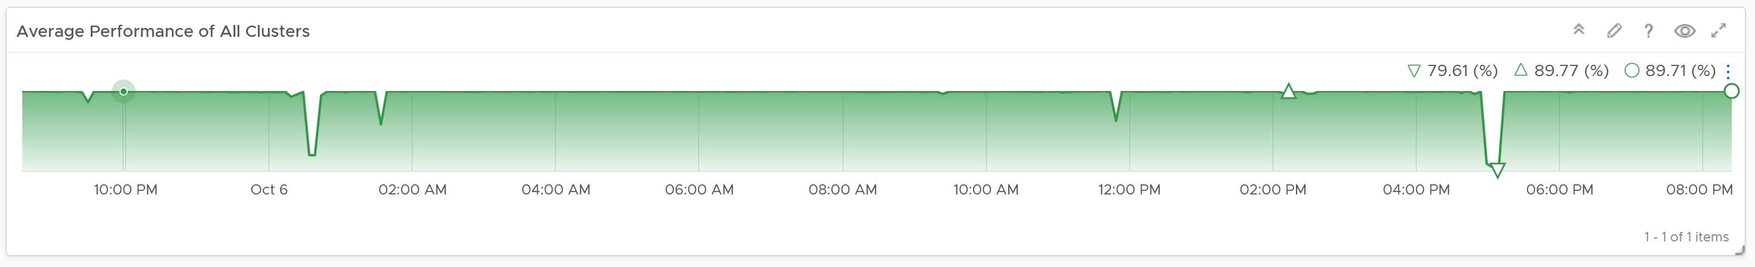
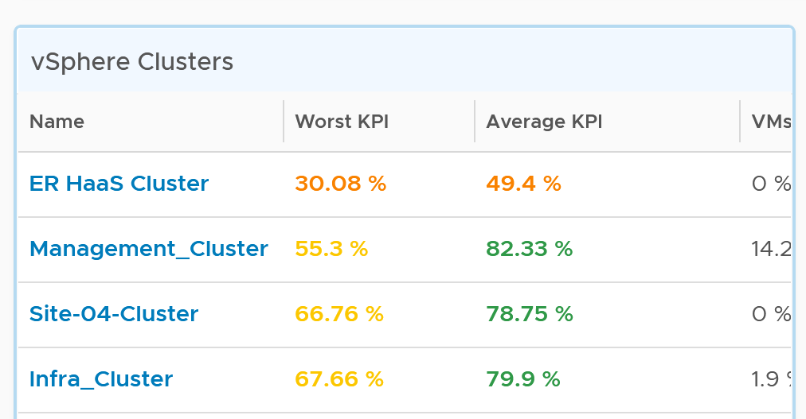
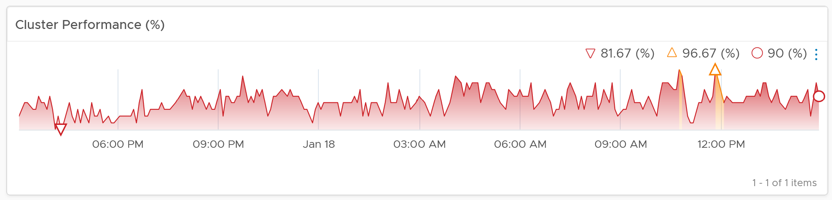
vSphere Cluster Performance
Know the expected bahaviour for each class of service
1
3
2

Slide 68
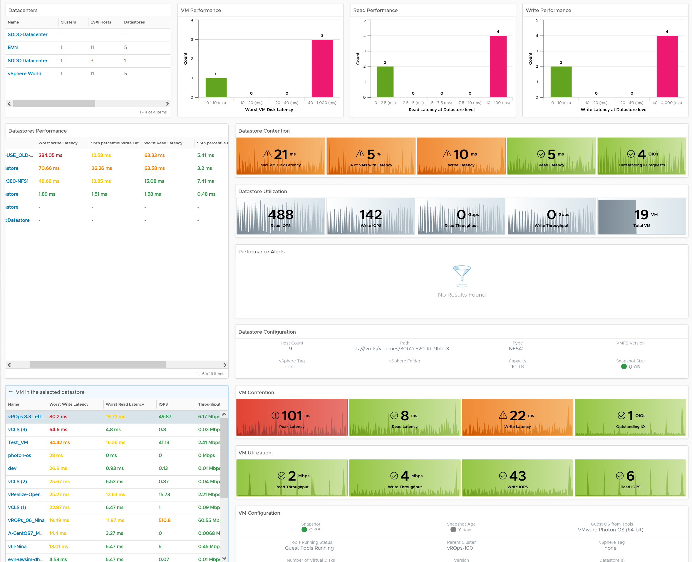
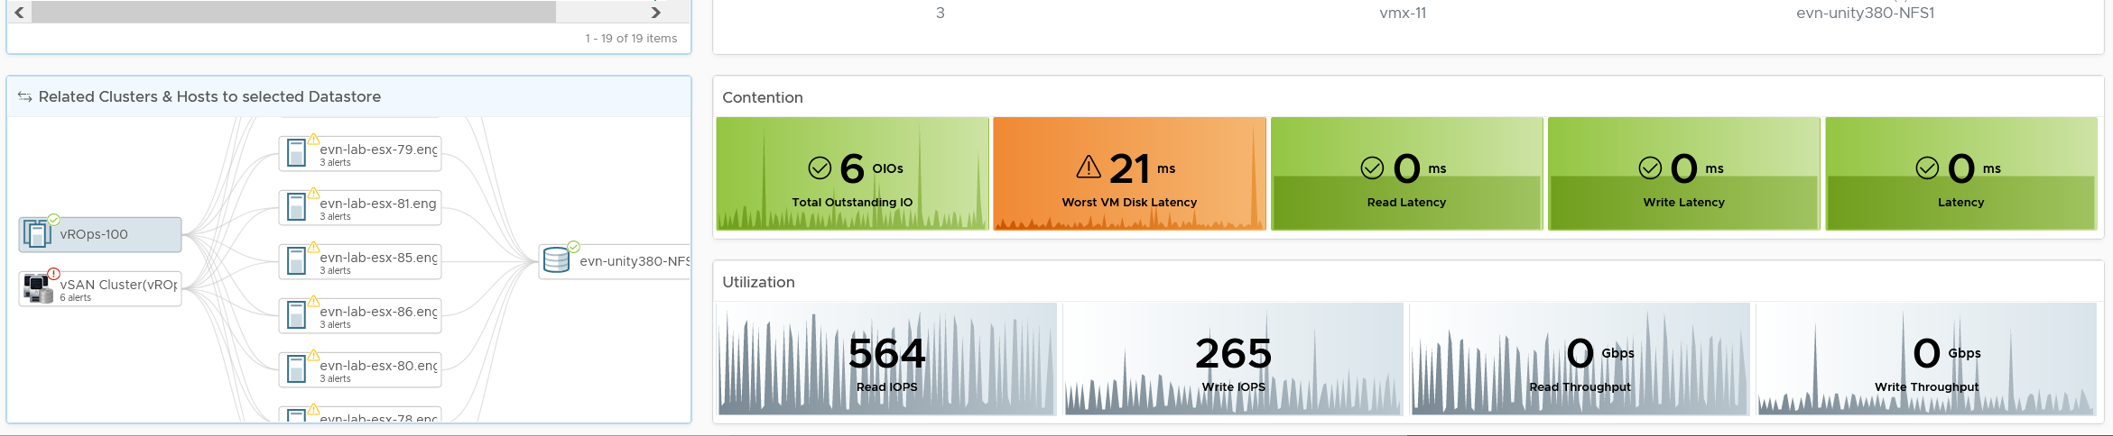
Level: World
Datastore
Level: Datastore
Performance
Utilization
Alerts
Configuration
Level: VM
Level: Related

Slide 69
Monitoring a vSAN cluster
vSAN Cluster
10 ESXi, 40 NICs, 10 vSAN network, 20 Cache Disks, 120 Capacity Disks
Is any of the ESXi running high CPU utilization?
Is any of the ESXi running high Memory utilization?
Is any of the NIC running high utilization?
40 TX and 40 RX. Keep all below 80% utilization.
Is vSAN vmkernel network congested?
Is the Read Cache used?
Is the Write Buffer sufficient?
Is the Cache Tier performing fast?
Each disk has Read Cache Read Latency, Read Cache Write Latency, Write Buffer Write Latency, Write Buffer Read Latency
Total 4 x 20 = 80 counters to check.
Is the Capacity Disks performing fast?
Check both Read and Write latency.
Total 120 x 2 = 240 counters.
Is any of the Disk Group running low on space?
Is any of the Disk Group facing congestion?
Keep each <60.
Count the number of occurance >60
Is there outstanding IO on the Disk Group?
ESXi
ESXi
ESXi
ESXi
530 instances of metrics to check
ESXi
ESXi
ESXi
ESXi
CPU
RAM
CPU
RAM
NIC
NIC
NIC
NIC
NIC
NIC
NIC
NIC
NIC
NIC
NIC
NIC
NIC
NIC
NIC
NIC
NIC
NIC
2 Disk Groups. Each has 6 Capacity Disk
NIC
NIC
NIC
NIC
NIC
NIC
NIC
NIC
NIC
NIC
NIC
NIC
NIC
NIC
Notes:
Is any of the ESXi running high CPU utilization?
Keep Demand <90% after taking into account HA
Is any of the ESXi running high Memory utilization?
Keep Consumed <97% after taking into account HA
Is any of the NIC running high utilization?
40 TX and 40 RX. Keep all below 80% utilization.
Is vSAN vmkernel network congested?
Ensure 0 dropped packet in all 10 vSAN vmk ports.
Is the Read Cache used?
Ensure none has hit rate <95%
Is the Write Buffer sufficient?
Ensure none drops below <10%
Is the Cache Tier performing fast?
Each disk has Read Cache Read Latency, Read Cache Write Latency (for writing into cache), Write Buffer Write Latency, Write Buffer Read Latency (for destaging purpose)
Ensure none has latency >5 ms as they are average among all VMs.
Total 4 x 20 = 80 counters to check.
Is the Capacity Disks performing fast?
Ensure none has latency >10 ms as they are average among all VMs.
Check both Read and Write latency.
Total 120 x 2 = 240 counters.
Is any of the Disk Group running low on space?
This will trigger re-balance
Is any of the Disk Group facing congestion?
Keep each <60.
Count the number of occurance >60
Is there outstanding IO on the Disk Group?
Keep each <30 OIO
Point of the slide: vSAN monitoring can be quantified too.
Reference in the book:
Part 2 Chapter 4 Storage Metrics: read the vSAN section

Slide 70
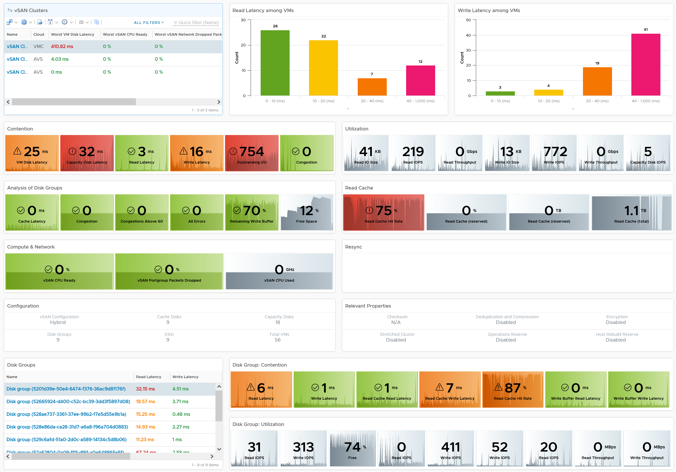
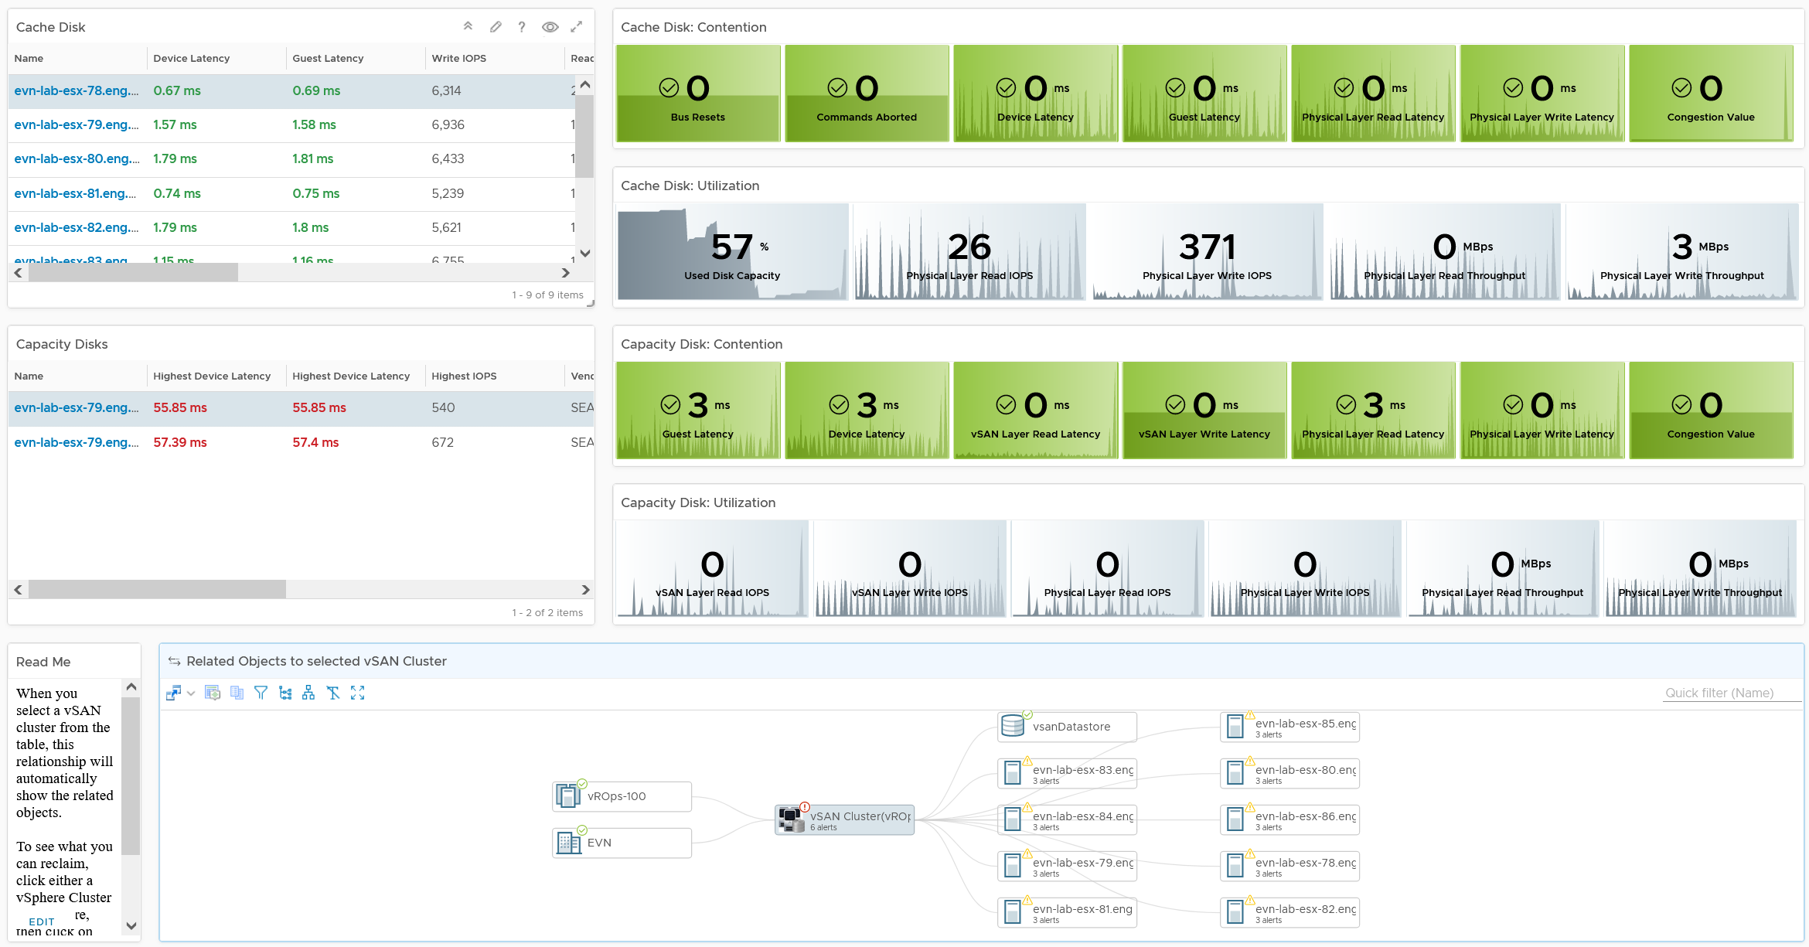
Level: World
vSAN
Level: Cluster
Level: DG
Level: Cache Disk
Level: Capacity Disk
Navigate

Slide 71
Monitoring a vSAN cluster
vSAN Cluster
10 ESXi, 40 NICs, 10 vSAN network, 20 Cache Disks, 120 Capacity Disks
Is any of the ESXi running high CPU utilization?
Is any of the ESXi running high Memory utilization?
Is any of the NIC running high utilization?
40 TX and 40 RX. Keep all below 80% utilization.
Is vSAN vmkernel network congested?
Is the Read Cache used?
Is the Write Buffer sufficient?
Is the Cache Tier performing fast?
Each disk has Read Cache Read Latency, Read Cache Write Latency, Write Buffer Write Latency, Write Buffer Read Latency
Total 4 x 20 = 80 counters to check.
Is the Capacity Disks performing fast?
Check both Read and Write latency.
Total 120 x 2 = 240 counters.
Is any of the Disk Group running low on space?
Is any of the Disk Group facing congestion?
Keep each <60.
Count the number of occurance >60
Is there outstanding IO on the Disk Group?
ESXi
ESXi
ESXi
ESXi
530 instances of metrics to check
ESXi
ESXi
ESXi
ESXi
CPU
RAM
CPU
RAM
NIC
NIC
NIC
NIC
NIC
NIC
NIC
NIC
NIC
NIC
NIC
NIC
NIC
NIC
NIC
NIC
NIC
NIC
2 Disk Groups. Each has 6 Capacity Disk
NIC
NIC
NIC
NIC
NIC
NIC
NIC
NIC
NIC
NIC
NIC
NIC
NIC
NIC
Notes:
Is any of the ESXi running high CPU utilization?
Keep Demand <90% after taking into account HA
Is any of the ESXi running high Memory utilization?
Keep Consumed <97% after taking into account HA
Is any of the NIC running high utilization?
40 TX and 40 RX. Keep all below 80% utilization.
Is vSAN vmkernel network congested?
Ensure 0 dropped packet in all 10 vSAN vmk ports.
Is the Read Cache used?
Ensure none has hit rate <95%
Is the Write Buffer sufficient?
Ensure none drops below <10%
Is the Cache Tier performing fast?
Each disk has Read Cache Read Latency, Read Cache Write Latency (for writing into cache), Write Buffer Write Latency, Write Buffer Read Latency (for destaging purpose)
Ensure none has latency >5 ms as they are average among all VMs.
Total 4 x 20 = 80 counters to check.
Is the Capacity Disks performing fast?
Ensure none has latency >10 ms as they are average among all VMs.
Check both Read and Write latency.
Total 120 x 2 = 240 counters.
Is any of the Disk Group running low on space?
This will trigger re-balance
Is any of the Disk Group facing congestion?
Keep each <60.
Count the number of occurance >60
Is there outstanding IO on the Disk Group?
Keep each <30 OIO
Point of the slide: vSAN monitoring can be quantified too.
Reference in the book:
Part 2 Chapter 4 Storage Metrics: read the vSAN section

Slide 72
vSAN OSA KPI
Quantifying its performance, not utilization
Name | What it is
Max Capacity Disk Latency (ms) | Highest Latency among all Capacity Disks. We take the worst, not average, as the latency in a single Capacity Disk is already an average of all its VMs. If there are 50 VMs on the disk, and 30 are issuing IO on it, then it’s a average among 30.
Min Disk Group Write Buffer Free (%) | Lowest free capacity among all the Disk Group Write Buffers. If this number is low, one of your buffer is not enough. While you want to maximize your cache, a low number is an early warning for capacity management.
Max Disk Group Read Cache/Write Buffer Latency (ms) | Each disk has Read Cache Read Latency, Read Cache Write Latency (for writing into cache), Write Buffer Write Latency, Write Buffer Read Latency (for destaging purpose). This takes the highest among these 4 numbers, then the highest among all disk groups. It’s the Max of Max, because each of 4 datapoint is average of all the VMs on it.
Sum Disk Group Errors | Sum of Bus Reset + Sum of Commands Aborted among all the Disk Groups. We sum, not get the max, as each member should return 0.
Count Disk Group Congestion Above 60 | The number of Disk Group congestion greater than 60. 60 is hardcoded in the MP as it’s good starting point. As any congestion above 60 serves as early warning, we count how many of such occurance happens.
Max Disk Group Congestion | The highest congestion among all the disk groups. A high number indicates at least 1 Disk Group is not performing
Min Disk Group Capacity Free (%) | The lowest free capacity among all disk groups. A low space will trigger rebalance.
Min Disk Group Read Cache Hit Rate (%) | The lowest hit rate among the disk group read cache. Ensure this number is high, indicating read is served by cache.
Sum vSAN PortGroup Packets Dropped (%) | Sum of all vSAN vmkernel port RX Dropped Packet + TX Dropped Packet. You should expect no dropped packet in your vSAN network
Notes:
Point of the slide: how we quantify vSAN KPI
A Capacity Disk Latency is the average latency experienced by all VMs on that single disk. There can be many VMs on that disk. If the average is 5 ms, the worst VM may experience a much higher number.
Reference in the book:
Part 2 Chapter 4 Storage Metrics: read the vSAN section

Slide 73
vSAN Performance (%): OSA Hybrid
1 Metric (as it’s 1 object), but 3 logics (for ESA, OSA All Flash, OSA Hybrid)
 | Metric | Weightage | Green | Yellow | Orange | Red
Disk Group | % of Disk Group Congestion Above 60 | 5% | 0% - 2.5% | 2.5 – 5% | 5 - 10% | 10 - 20%
 | Max Disk Group Congestion | 10% | 0 – 75 | 75 – 125 | 125 - 175 | 175 - 225
 | Min Disk Group Capacity Free (%) | 5% | 40 - 50% | 30 – 40% | 20 – 30% | 10 – 20%
Cache Disk | Max Disk Group Read Cache/Write Buffer Latency (ms) | 5% | 0 – 20 | 20 – 40 | 40 – 80 | 80 – 160
Cache Disk | Min Disk Group Read Cache Hit Rate (%) | 10% | 97.5 – 100% | 95 – 97.5% | 90 – 95% | 80 – 90%
 | Min Disk Group Write Buffer Free (%) | 5% | 30 - 40% | 20 – 30% | 10 – 20% | 5 – 10%
Capacity Disk | Max Capacity Disk Latency (ms) | 10% | 0 – 10 ms | 10 – 20 ms | 20 – 40 ms | 40 – 80 ms
Network | Max vSAN PortGroup Packets Dropped (%) | 10% | 0% - 0.25% | 0.25 – 0.5% | 0.5 - 1% | 1 - 2%
CPU | Max vSAN CPU Ready among ESXi host |  | 0 – 2% | 2 – 4% | 4 – 8% | 8 – 16%
IaaS high utilization | vSAN Memory Contention (?) |  | 0% - 0.25% | 0.25 – 0.5% | 0.5 - 1% | 1 - 2%
Sum Disk Group Errors | 10% | 0 – 1 | 1 – 2 | 2 – 4 | 4 – 8
VM is not included as that’s already covered by vSphere Cluster Performance

Slide 74
Capacity Management
It depends on what exactly is being managed and whether it’s free or not
VM is the most common form. If it’s basically free, then pricing can’t be used to prevent wastage.
What You Sell |  | Overcommit | Class of Service | If it’s free | Reclamation
Consumer | VM. VM size defines the quantity of capacity sold. | Possible, and typically required for cost reason | Possible. | VM sizing & class of service done via business justification | If VM is free, it’s complex (political). If VM is not free, it’s not even applicable.
Provider | A slice of infra. This means Resource Pool (with reservation, not limit). The reservation defines the quantity of capacity sold | Not possible. What is sold is chunk of hardware. | Not applicable. Up to RP Owner to squeeze within his own RP | Not common. RP is typically not free as it’s basically hardware | Not applicable. Up to RP Owner to squeeze within his own RP
 | The whole infra. This means an entire vSphere Cluster sold to 1 owner | Possible. Up to the owner of the cluster | Possible but complex. Cluster can have RP with different shares | Not possible. Everyone will want one ;-) | Not applicable. Up to owner to manage

Slide 75

Business-driven Capacity Management
Demand
2
Control Demand by correct Pricing Model
3
Optimize Demand by Reclamation
4
Account for Latent Demand, Potential Demand and Unmet Demand
5
Monitor Demand by tracking Excessive Usage
Supply
1
Plan Supply by using Class of Service
6
Monitor using Demand|Performance + Allocation. Together
Notes:
Capacity Management is about meeting demand with the lowest possible cost. There are 6 levers you can play. By using them correctly, you don’t have to struggle justifying budget to people who don’t even understand what you’re architecting. Their focus is money. That means you gotta talk money. Present in business terms that CIO and Finance can appreciate.
Reclaimation is covered under Cost section. We can’t include their value into Capacity until it’s realized.

Slide 76

Overall Process of Capacity Management
Example of how Capacity Management fits into your overall IT Operations and be date-aware
Jan | Feb | Mar | Apr | May | Jun | Jul | Aug | Sep | Oct | Nov | Dec
Demand Management
Reclamation and Right size. Weekly cadence throughout the year
Gather & Estimate
Check Point
Adjustment
Check Point
Supply Management
Lead Time
Lead Time
Procurement
On-boarding
Procurement
On-boarding
Technology Refresh?
Technology Refresh?
Discipline in capacity optimization is critical due to excess wastage. Establish a weekly cadence that is executed regularly (depending on the size of the environment)
Technology Refresh is an integral part, as new technology delivers both lower cost and higher capacity, not to mention faster performance and tighter security.

Slide 77
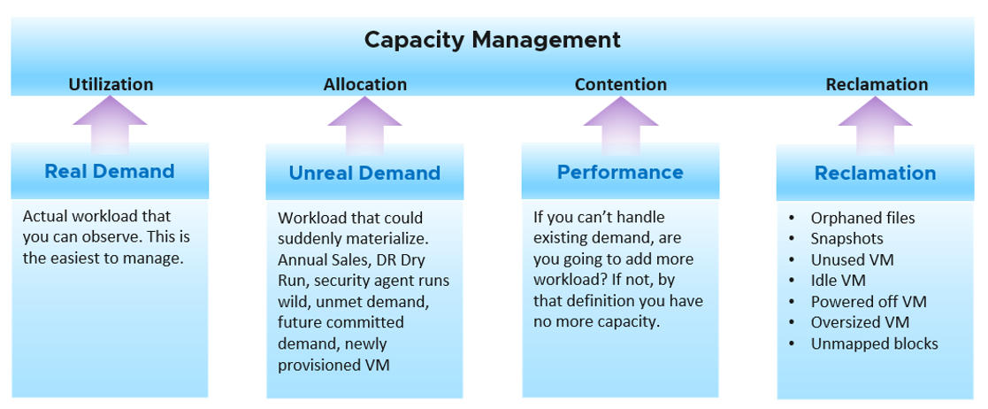
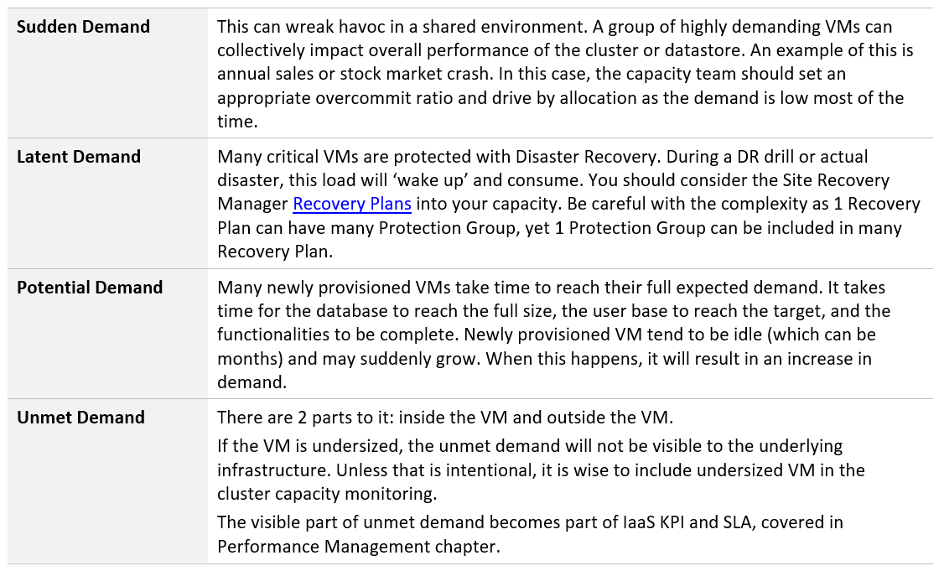
6 Inputs to Capacity
Complete coverage
Utilization
Tracking what’s visible, hence most popular counter
Reservation
What you’ve officially promised
Allocation
Tracking what’s not visible
Performance
What you care the most if you overcommit
Reclamation
Needs to be elevated due to excessive wastage
Availability
Concentration Risk (blast radius of down)
Part of Business Continuity Policy
Notes:
Point of the slide:
Reference in the book:
Part 1 Chapter 3 Capacity: read the “End to End Capacity” section

Slide 78
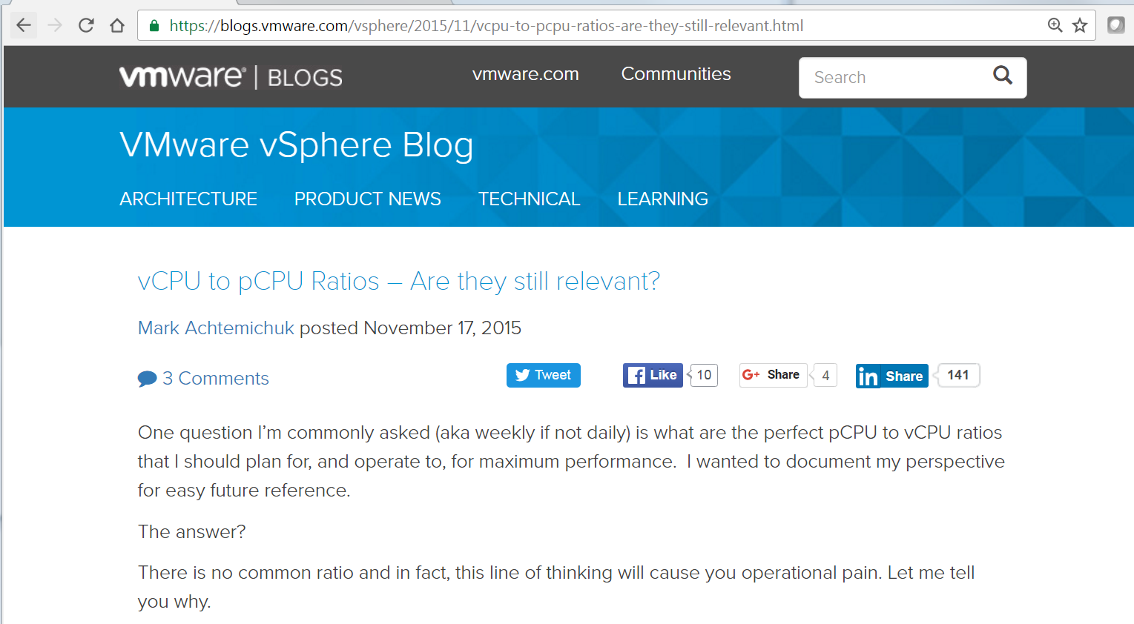


Allocation
Required to account for Latent Demand when utilization is not high enough
@vmMarkA
Ratios are useful as initial guidance for P&L, and New VM (they take time to grow!)
Notes:
Use ratio when you do not have the actual workload. Once you have the actual workload, the use of ratio can lead to wrong conclusion.

Slide 79
Overcommit Ratio best practices
Use them when utilization can’t cover
Actual Utilization not considered
IaaS workload not considered
VM size not considered
Total Demand can be higher at lower overcommit ratio
You can pack more small VMs than a few large ones.
VMkernel, vSAN, NSX
Infra VM: Agent VM
Exception is for new VMs that are not yet “used” and Committed Project
Notes:
Example:
A global bank called me up, sharing that their Tier 3 clusters are performing better than their Tier 2 cluster. I asked how do they know this? Answer is the typical: “we got complain”. The same owner is happy with her Tier 3 VM but unhappy with her Tier 2 VM.
Example:
A host with 1 sockets, 20 cores, 40 HT.
You cannot run 2 VM (10 vCPU and 11 vCPU) at the same time since there is not enough physical cores. The host utilization will be low as the VM is taking turn to run.
You get better “performance” running 40 VMs, each with just 1 vCPU. Your host will be highly utilized, delivering a lot more throughput.
IaaS has its own workload. In ESXi with >14 cores per socket, this is generally not a problem. In smaller ESXi, having too many of such services can impact the net usable resource available for business workload

Slide 80
Live Demo: Capacity
Use them together as a set
Infrastructure
Cluster Capacity
Datastore Capacity
vSAN Capacity
NSX Capacity
VM Rightsizing
Oversized can cause performance problem
Undersize cause capacity problem (cannot meet demand)
Only focused on VMs that need adjustment.
VM Capacity
Complement VM Rightsizing by showing the entire VM population.
VM Reclamation
Contribute to cluster and datastore capacity

Slide 81
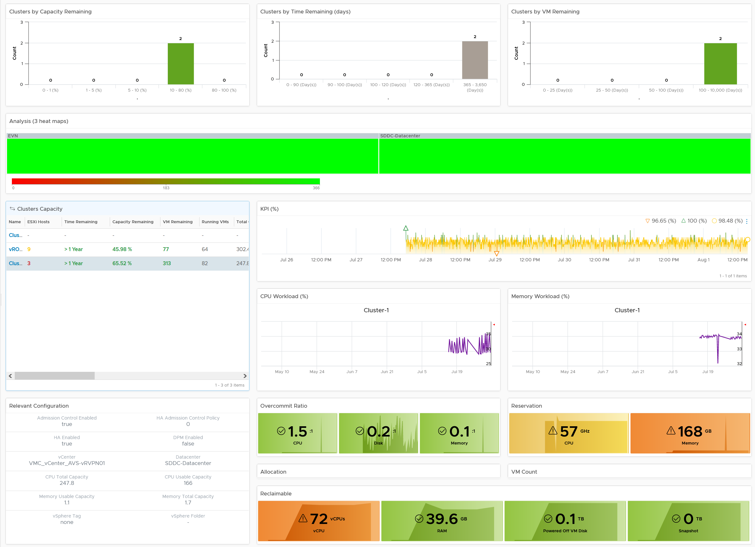
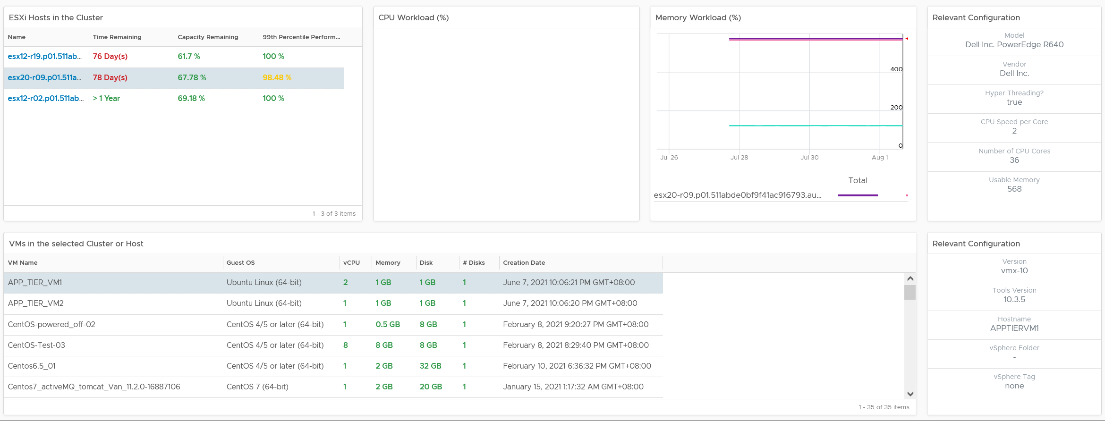
Level: World
Cluster
Level: Cluster
Performance
Utilization
Allocation
Reservation
Reclamation
Level: ESXi
Level: VM

Slide 82
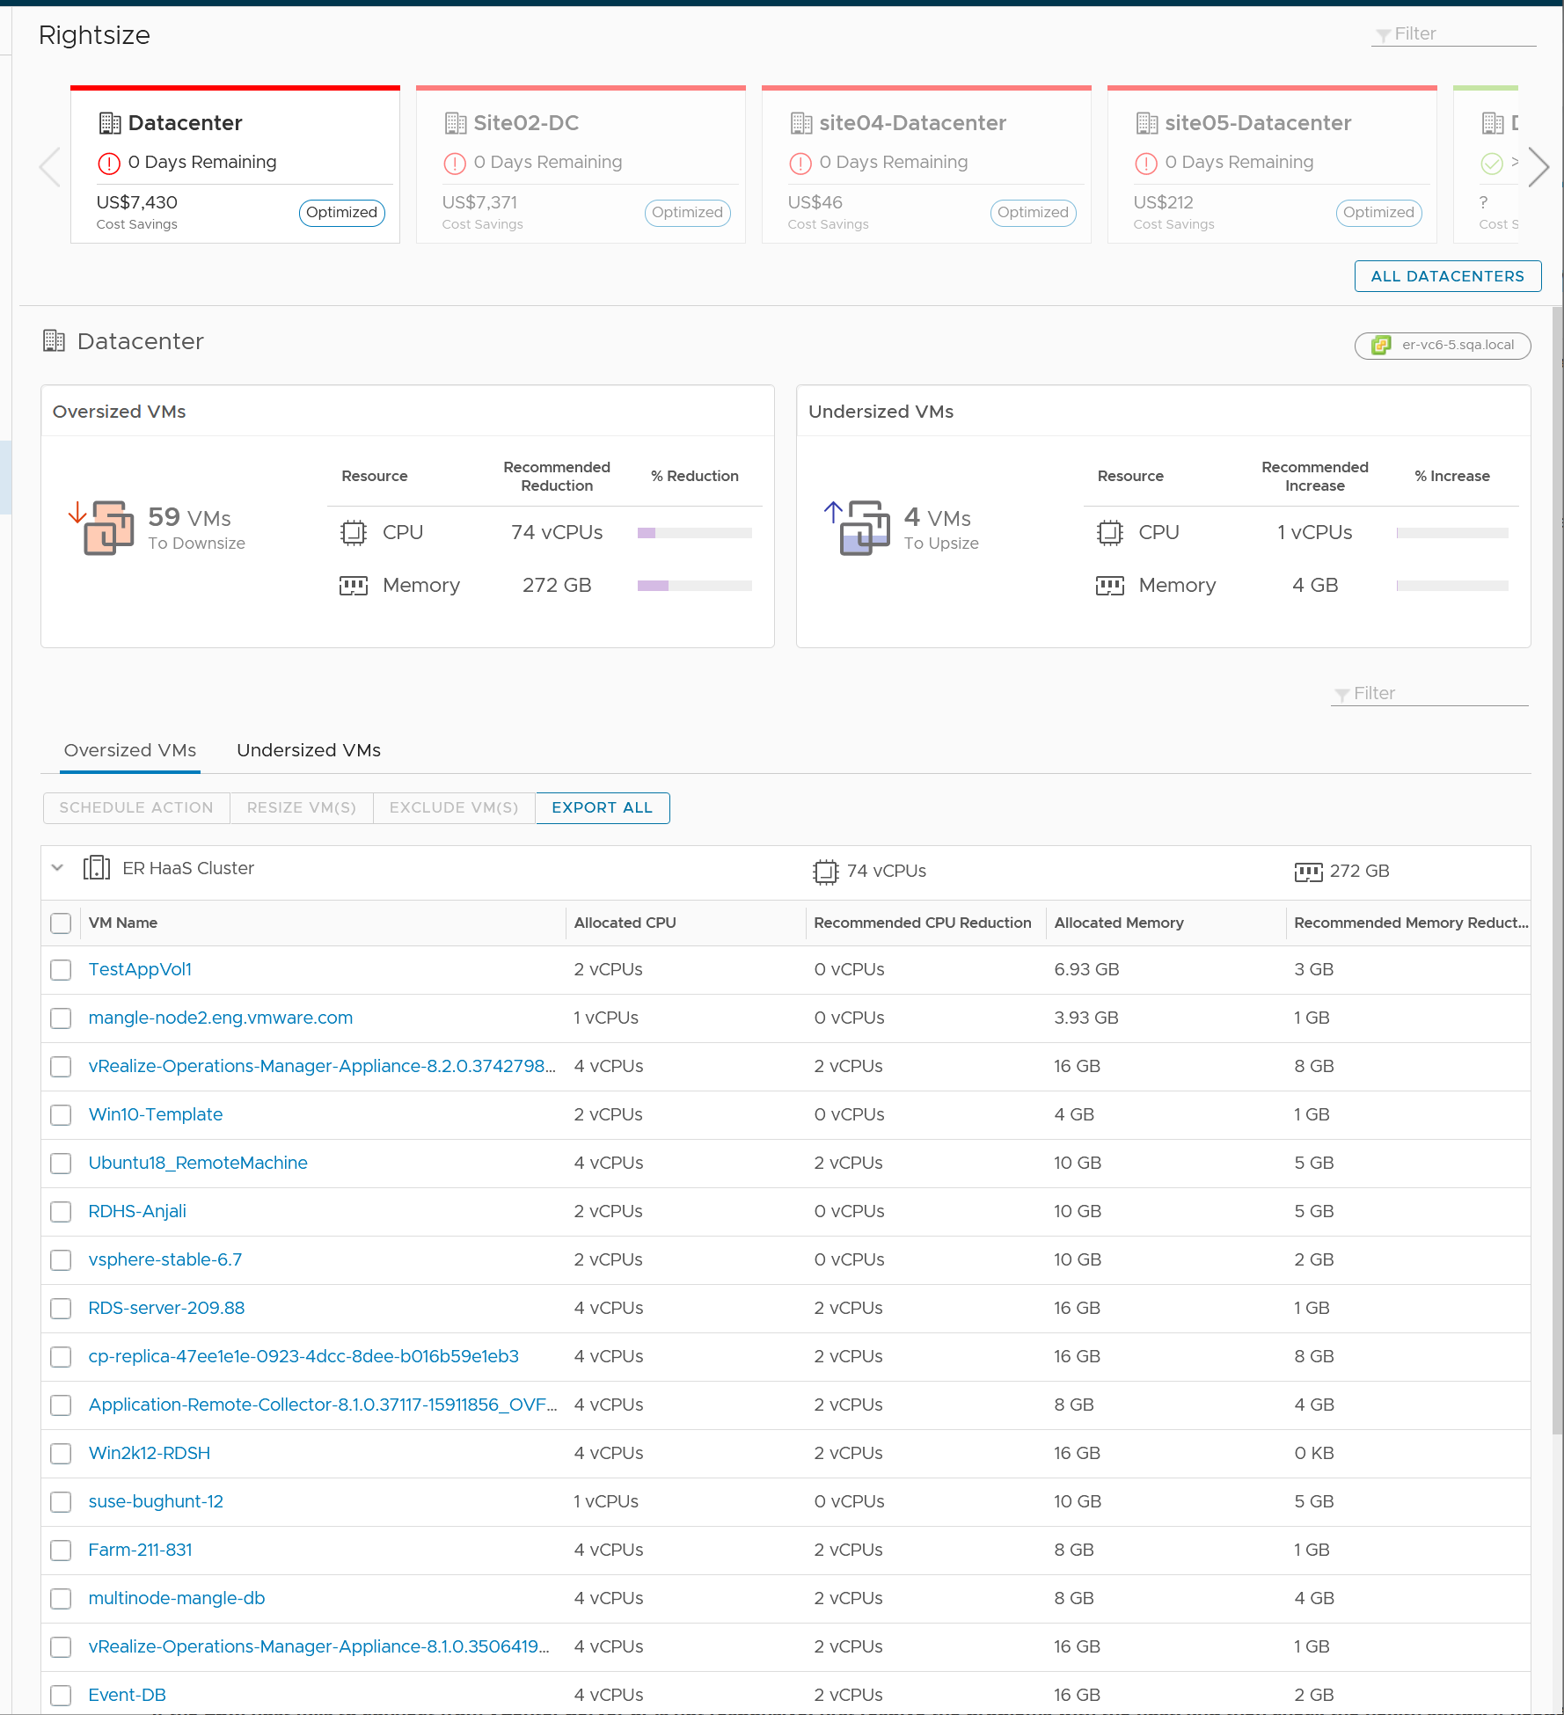
VM Rightsizing
Synergy with the Rightsizing page
+ Focus on ease of use, especially smaller environment
+ % reclaimable are shown.
+ Focus on power users, especially larger environment
+ table value color coded. Visually easier to focus on the “big” one
+ reclaimation context. You want to focus on clusters & datastore running low
+ Use distribution chart for better analysis
+ can drive at DC or Cluster level
+ timeline. Can quickly cycle thru many VMs as it's on the same dashboard
+ Shows context of VM, such as creation date.
+ can be customized as it's just a dashboard.
Page
Dashboard

Slide 83
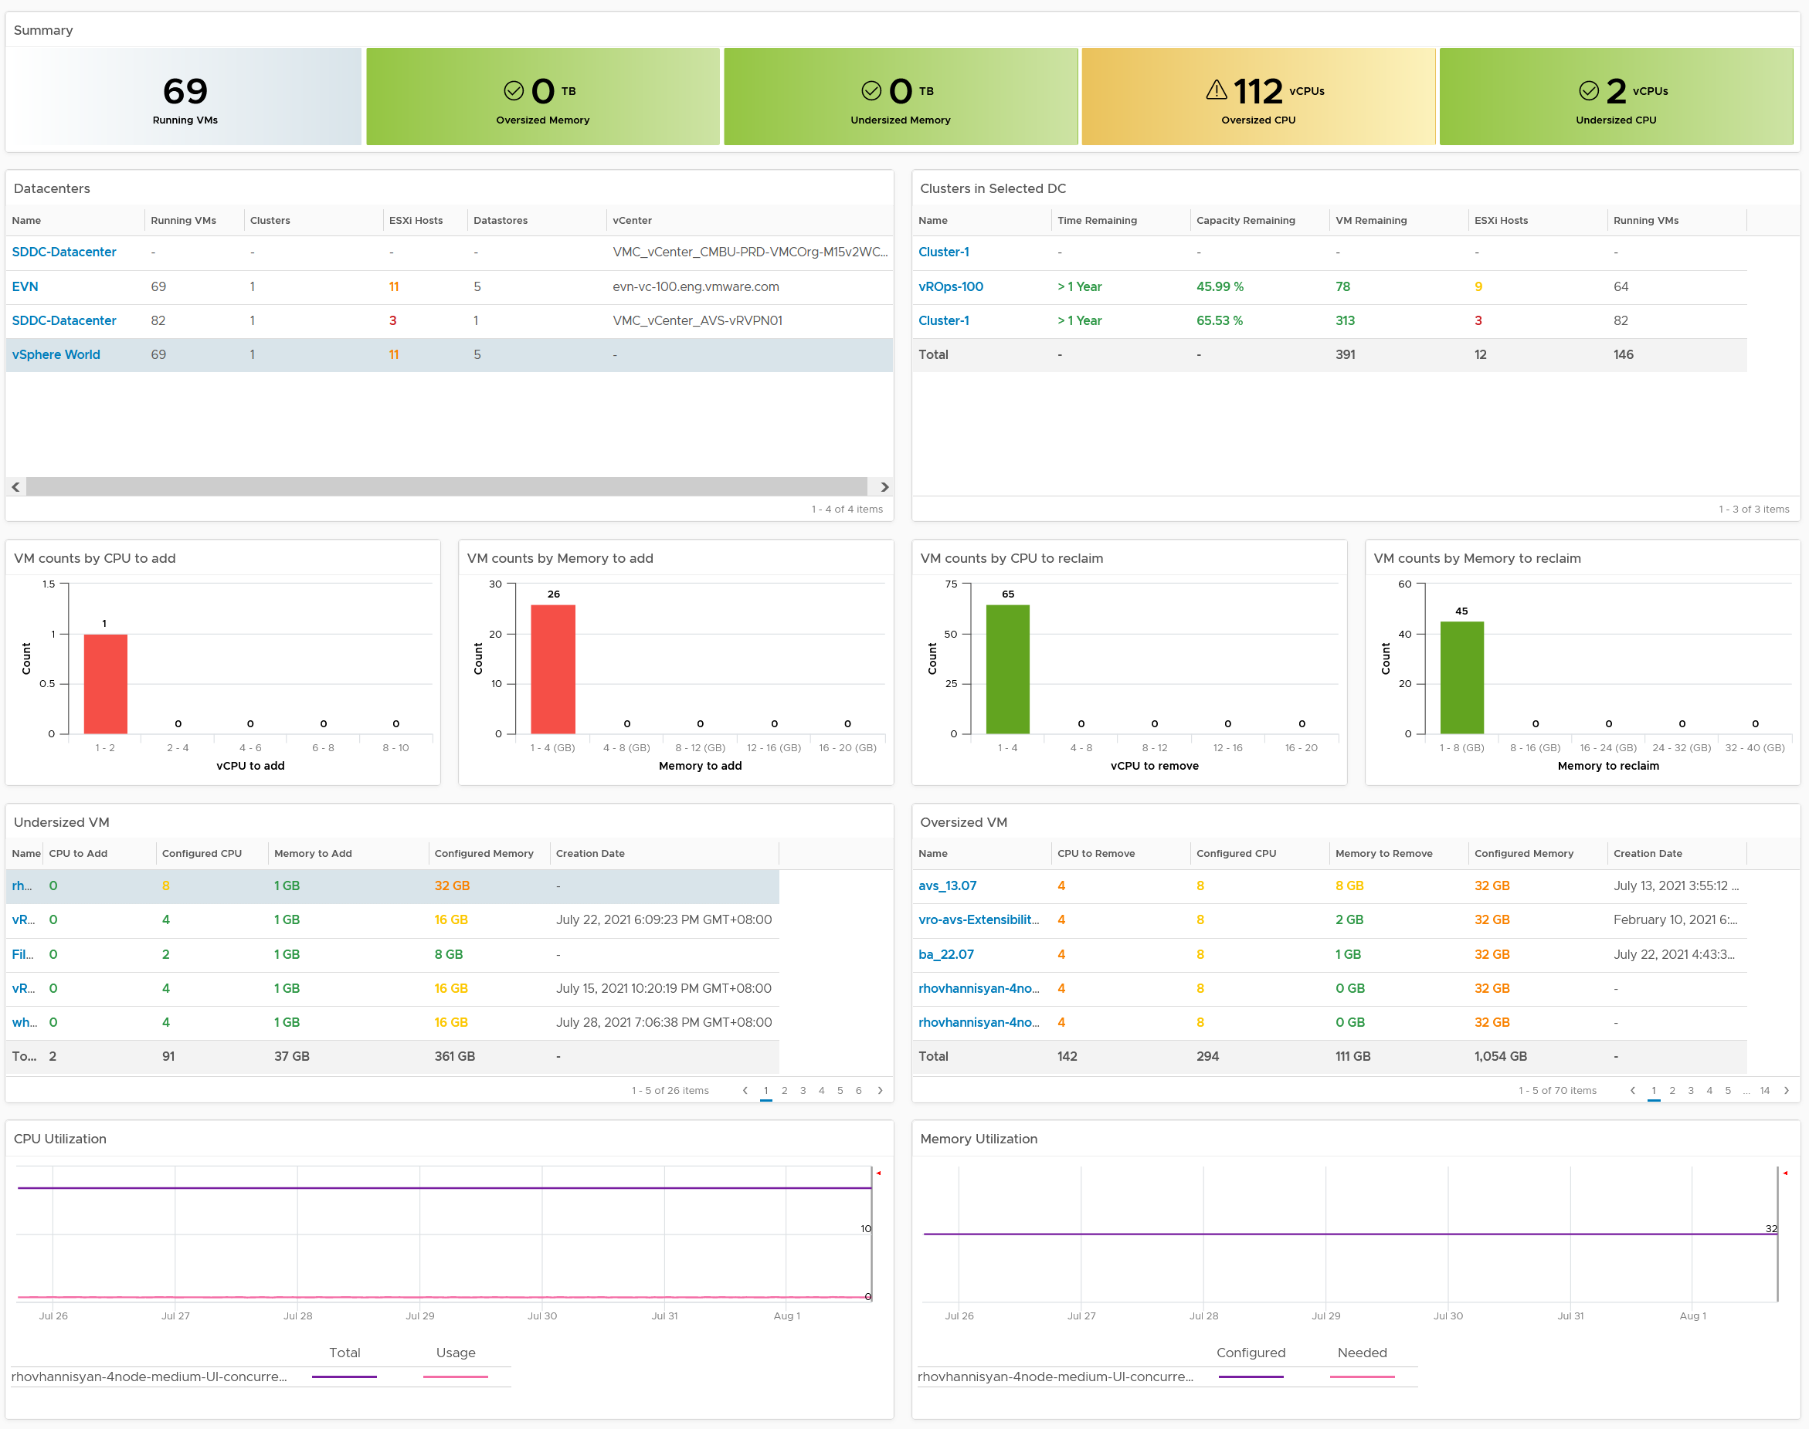
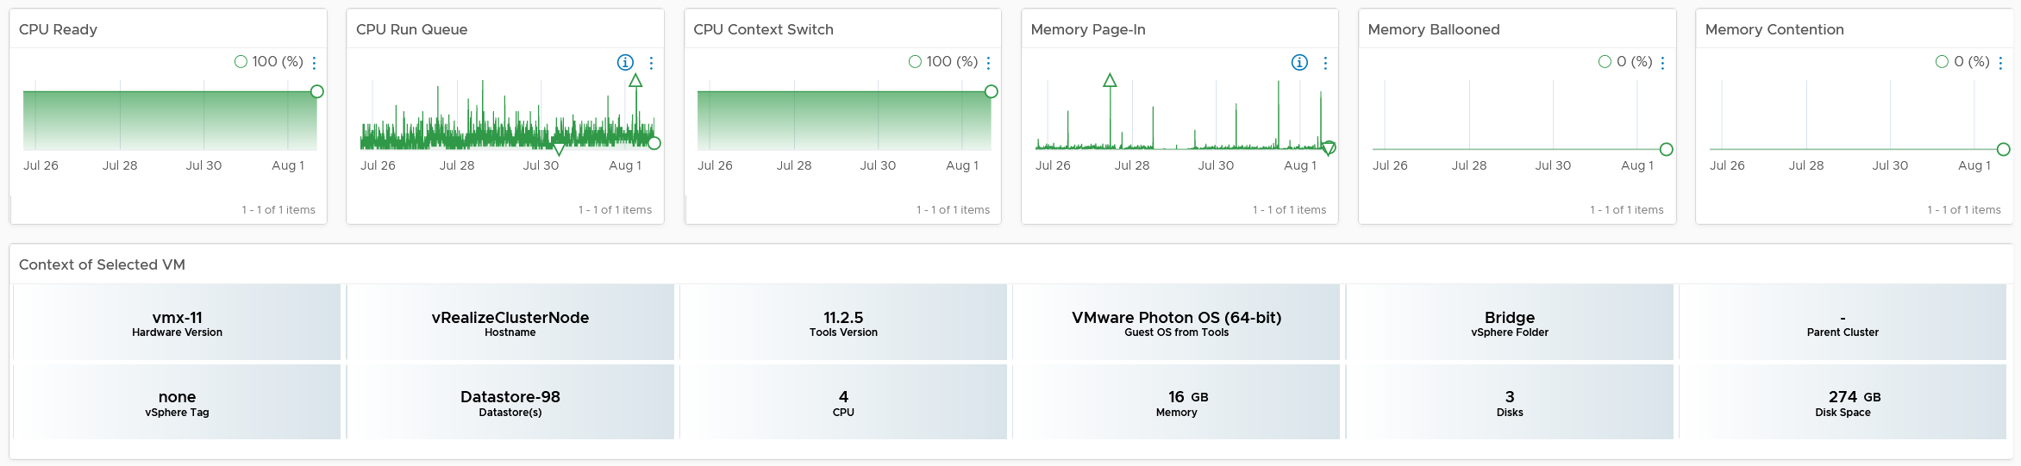
Overall
Analysis
Selector
Analysis
Rightsize
VMs
Utilization
Guest OS + VM Metrics
Performance
Guest OS + VM Metrics
Configuration

Slide 84


Overall
Analysis
VM
Analyse
many VMs.
Sort, review, export, etc
Recommendation
Raw Utilization Metrics
Disk Partition
Relevant
Config

Slide 85
Reclamation
Start from the easiest
Non VM
Orphaned
Powered Off
Idle
Oversized
Unused?
ISO
TRIM
VMDK
RDM
LUN
Disk
LUN
Power off first
Power off first
Power off first
CPU allocation only
CPU allocation only
CPU
Memory
Memory
Memory
Need a stoke-take process as owners may not reply
Move them here first, as fall back just in case you make a mistake
Notes:
Point of the slide: many areas of opportunities
Reference in the book:
Part 1 Chapter 2 Performance: read the Contention vs Utilization section

Slide 86

Reclamation
Synergy with the Reclamation page
+ Powered Off: has number of days powered off
+ Idle: has number of days idle.
+ Looks nice. % reclaimable are shown.
+ Orphaned disks show actual file name, size and date last modified.
+ Can see big picture. World level, not just DC level. Useful in large environment
+ table value color coded. Visually easier to focus on the “big” one
+ reclaimation context. You want to focus on clusters & datastore running low
+ Use distribution chart for better analysis
+ can drive at DC or Cluster level
+ Powered Off VM: location (datastore) is shown. Can sort by datastore.
+ Snapshot: location (datastore) is shown. Can sort by datastore.
+ Timeline. Can quickly cycle thru many VMs as it's on the same dashboard
+ Shows context of VM
+ can be customized as it's just a dashboard.
Page
Dashboard

Slide 87


Overall
Analysis
Selector
Analysis
Reclaim
VMs
Trends
Configuration

Slide 88
Capacity Management with no Chargeback
When resource is free, alter capacity management approach
Pricing
Since it’s free, class of service is done via business justification. Typically, Prod and Non-Prod environment are 2 different classes.
Within production, there are typically 2 sub-classes, as not all applications are mission critical. In smaller environment where we do not have separate clusters, how do you distinguish Mission Critical vs Non MC?
Availability: higher priority restart, more frequent replication
Performance: higher reservation (~2x higher). Reservation & share creates operational overhead if you do not reserve 100%
Demand Management
Stress Test
A critical application going live may need to simulate their full load. This scalability test can’t be performed in production.
Ideal solution is to triple purpose the DR Site. It’s DR + Dev + Test. The test includes scalability test.
If not possible, then burst to cloud, as it’s temporary workload.
Oversized VM
Since VM is free, reclaiming from app team is harder. The approach should be driven by VM performance, not IaaS capacity. The former is relevant to VM Owner, the later is not.
Aggressive reclamation from oversized VM can result in application developers playing creative, generating dummy workload during quiet hours. This is impossible to distinguish from real workload
VM Sizing
Since VM is free, Infra team has to play the custodian of the shared IaaS. They size the VM, at least the initial sizing.

Slide 89

Dashboards for Storage Team
Basic Visibility
Performance
Availability
What have we got?
What’s the performance? How is Storage as a Service delivering?
If it’s below SLA, which VMs and ESXi are affected?
What’s our Virtual Storage Availability?
What’s our Physical Storage Availability?
Service
Capacity
Configuration
When VM Owner thinks Storage is the culprit….
Is any VM or ESXi near its peak?
Is our network near its peak?
Who are the top consumer for each physical datacenter?
How is the workload distributed?
Are the config consistent? Do they follow best practice?
Notes:
Point of the slide: you need to collaborate with storage team, to minimize ping pong. What information do they need? What do you need from them?
Reference in the book:
Part 3 Chapter 9 Other Dashboards: read the “Storage Team” section

Slide 90


Level: World
Datastore
Level: Datastore
Level: VM
Local Datastore
Notes:
vRealize Operations
This Photo by Unknown Author is licensed under CC BY-SA-NC.
Source http://brewminate.com/ukrainian-scientist-creates-battery-that-can-power-smartphones-for-12-years/

Slide 91


Level: World
vSAN
Level: vSAN
Level: Disk Group
Level: VM

Slide 92
Dashboards for Network Team
Basic Visibility
Performance
Availability
What have we got?
Any errors in our networks?
If yes, which VMs and ESXi are affected?
Too many special packets in our networks?
What’s our Virtual Network Availability?
What’s our Physical Network Availability?
Service
Capacity
Configuration
When VM Owner thinks Network is the culprit….
Is any VM or ESXi near its peak?
Is our network near its peak?
Who are the top consumer for each physical datacenter?
How is the workload distributed?
Are the config consistent? Do they follow best practice?
Notes:
Point of the slide: you need to collaborate with network team, to minimize ping pong. What information do they need? What do you need from them?
Reference in the book:
Part 3 Chapter 9 Other Dashboards: read the “Network Team” section

Slide 93

NOC Dashboards
Best practices
No interaction
Color
code
KISS.
Large numbers
Drives action
5 second Test
Notes:
Point of the slide: you need to collaborate with Call Center team, so they can value add and filter. What information do they need? What do you need from them? What’s the Exit Criteria and Entry Criteria?
Reference in the book:
Part 3 Chapter 6 NOC Dashboard

Slide 94

Live! Cluster Performance
VMs not getting what it asks
Are the ESXi struggling to serve its VM?
Color by Percentage of VMs not being served well. Not using Max (too extreme, focus on VM) nor Average (too late).
Percentage of VMs also enable a standard metric used for all
Size is fixed, as the focus is performance, not capacity.
Cluster unbalanced?
Showing ESXi, grouped by cluster, hence unbalanced can be seen
Expected Action
Balance the cluster
Stop provisioning
Not showing other KPI for now
Overlap, Swap Wait, IO Wait, Error Packets,
UI limitation and counter limitation
Notes:
Point of the slide: An example of design. Improve as you deem appropriate for your operations
Reference in the book:
Part 3 Chapter 6 NOC Dashboard

Slide 95

Live! Cluster Utilization
Complement Cluster Performance
2 counters for Memory
Consumed is not enough as it’s mostly cache
Balloon also persist,
Size is fixed
Else the 3 heat maps won’t be identical. Very hard to see across 3.
Notice the 3 heat maps are perfectly identical. Even the position of each group is the same!
Notes:
Point of the slide: separate utilization from contention, so the team knows what to focus.
Reference in the book:
Part 3 Chapter 6 NOC Dashboard

Slide 96
Log Analysis
Never operates SDDC & EUC without log analysis that understands the domain
No situation of deleted log
No uploading of logs
Speed up resolution of SR
Proactive Health Check
Encourage self-service
Speed up future analysis
Audit: Who did What When
Notes:
Point of the slide: While 99% of logs are not required, you need have logs analysed properly.
Reference in the book:
Part 1 Chapter 2 Performance: read the Contention vs Utilization section

Slide 97
Root Cause Analysis
Example of analysis without Log Insight
vmware.log
2016-02-01T23:42:15.266Z| vmx| I120: GuestRpcSendTimedOut: message to vdiagent timed out.
2016-02-01T23:42:15.266Z| vmx| I120: GuestRpc: app vdiagent's second ping timeout; assuming app is down
vmkernel log
2016-02-01T23:42:14.842Z cpu3:49141417)NetPort: 2916: resuming traffic on DV port 588
Analysis:
The message “resuming traffic” means VM was unavailable for a brief duration and resumed traffic transmission.
This implied that the issue occurred on the server side and not on the client side. Coinciding with the GuestRPC timedout messages, we conclude that the Guest was unresponsive during this time and resumed subsequently.
This is the conclusion you will get if you only analyse the object with problem.
What you should do is search of the above strings in your entire environment, especially against healthy objects. Also, search for other objects type, just in case they emit the same problem.
Notes:
When a vendor support tells you that a particular line of logs is the one causing the problem, what can you do?
Not much, really. The reality is log is not documented.
The only thing you can do is google it, and hopefully someone has encountered it before.
You cannot validate the logs, as there is no documentation.
But if you have proper logs, you can validate the finding. We can check each of the above error messages on VMs that are healthy. If they show the same log messages, that means the above log is not what we want.
Point of the slide:
Reference in the book:
Part 1 Chapter 2 Performance: read the Contention vs Utilization section

Slide 98

Notes:
… and that exactly what I did. I had a problem with 42 VM. I had 600 VMs in production, so majority was not affected.
Let’s see if they also see the same symptom.
I search the same string for all VMs.
Voila! It happens >1000x
“resuming traffic on DV port” probably does not mean anything. Too many of them and there is a clear pattern following office hours.
Does it mean the network has severe dropped packets?

Slide 99
Audit
Who did what to which object and when?
Focus on the privileged users (e.g. vSphere Admin, NSX Admin).
Prove that they are not taking advantage of their administrator-level access.
Who executed what ESXi console commands, to which ESXi and when?
List of the actual commands. This also proves that Admin has self-check in-place, setting a high standard for others to follow.
Who made what changes to Infrastructure?
Example: cluster settings, ESXi settings, VM template
From security point of view, template is more critical than a single VM as it’s used to create new VM.
Audience: What other questions do your auditor ask?

Slide 100


VM Configuration Change

Slide 101
Onboarding OYW

Slide 102

What is in OYW package?
Changes and Addition made to vRealize Operations
Parts
Dashboards | 7 New and modified dashboards
Views | 32 New and modified views
Alerts | 20 → 4 alerts consolidation
Super Metrics | 17 new super metrics
Metrics | 10 peak metrics enabled
Documentation

Slide 103


OYW: Dashboards
What dashboard and views customization does OYW make?
Enhance existing dashboards.
Notice their existing folder is maintained.
New dashboards.
Extending the use cases or coverage.
Guest OS requires Telegraf agent.

Slide 104


OYW: Alerts
20 alerts deleted. Replaced with 4 news alerts AND 1 Daily SOP Dashboard
Alerts | Reduction
VM CPU performance alerts | 12 alerts → 1 new alert. | 1 Daily SOP Dashboard needed to cover the gaps with existing alerts
VM Memory performance alerts | 3 → 1
VM Disk performance alerts | 3 → 2
Snapshot | 1 → 0
VMware Tools | 1 → 0
The 20 deprecated alerts.
The 4 new alerts

Slide 105

OYW: Super Metrics
Mandatory:
Virtual Machine
Cluster
vSphere World
vSphere Data Center
Optional
Business Application
Application Tier
Business Applications

Slide 106


OYW: Super Metrics
This is the Cluster KPI (%)
No, I’m not expecting most people to know how to create complex super metric like this. This is just to show what’s possible, as it’s actually used in OYW. If you’re curious, see the book for the full documentation.
Green?
Red value calculation
Yellow?
Notes:
For complex supermetric, use a code editor to make major modification

Slide 107


Implementation & Documentation
Review Part 4 Chapter 3 of the book
Don’t be disheartened. Most supermetrics aren’t this complex ☺

Slide 108
Implementation
On-boarding OYW into your environment
Step | Step | Notes
1 | Login as admin | Other user ID does not work as the OOTB dashboard is owned by admin. You will overwrite existing dashboard, hence the admin account is needed
2 | Import the supermetric Import the new alerts Import the deprecated alerts Note: I combined as the order does not matter. | No need to unzip the file. See next slides for screenshot. To see that import works, sort by the date modified. Your newly imported will appear at the top Enable will be done later step, after we import alerts, as it’s easier to bulk enable.
3 | Import the new alerts
4 | Import the deprecated alerts
5 | Enable 20-second peak metrics Enable super metrics Enable new alerts Disable deprecated alerts | Do in default policy (the one marked with capital D). Make sure it’s inherited in other dependent policies. See screenshot
6 | Save the default policy
7 | Import the views Import the dashboard Note: I combined as the order does not matter. | 4 separate files provided. No need to unzip the file. Choose overwrite. Yes, you’re modifying existing content.
8 | Import the dashboard
9 | Wait for 10 minutes | The supermetrics need 2 cycles (10 minutes) to calculate. In large environment, it can take 20 minutes for all objects to be fully populated.
Optional Steps
Only if you are using the Business Applications dashboard.
Steps | Step | Notes
1 | New Group Type? | For Business Applications.
2 | Create new group | 1 group for each business application 1 group for each tier in the business applications Make sure they are VM. Other objects will be ignored

Slide 109

How to Import
This is the import dialog box. It looks the same whether it’s views, alerts, dashboards, etc.
Make sure you choose Overwrite. It does not work otherwise as the import results in different IDs created

Slide 110

How to Import
After import, you get a confirmation screen like this.
Make sure it says 0 skipped. Everything should be imported

Slide 111

Edit Policy
Click here
Your default policy has a marked D. Edit it

Slide 112

Edit Policy
Your policy, in edit model already.
We will modify 2 things
Click here to begin the process of enabling metrics and super metrics

Slide 113

Enable super metrics
Type “super metrics” here, then enter to search them
You will enable for all objects except Pod. Select 1 object.
Expand the super metrics.
See next slide for bulk enabling.

Slide 114

Enable super metrics
Bulk action on many metrics
Repeat for each object type
After all objects done, click Save at the bottom

Slide 115

Enable 20-sec peak metric
To find them, type “collection” here
Don’t worry about this. Not applicable
Choose the VM object type. Ignore Pod
Enable all peak metrics except these 2. Not required

Slide 116

Enable ESXi Total Network packets
To find them, type “total” here
Bulk enable them

Slide 117

Enable VM Operations Metric
There are 20 of them, in 3 subcategories
Enable them in vSphere World object, DC object, and Cluster object
Bulk enable them
They are used in super metrics

Slide 118

Deprecate Alerts
To find them, type deprecated in the Quick filter field.
Mass disable all of them from here
Deprecated alerts.
After Disabled, the state changed to this.

Slide 119

Enable new Alerts
To find them, type OYW in the Quick filter field.
Specify “Virtual Machine” here
Enable them, then save.

Slide 120

Business Apps
This is an optional step.
Only needed when you are monitoring Business Application
Create 1 business application object for each Biz App. Note this is just the top level object

Slide 121

Business Apps
Make sure the super metric above maps to Business Application

Slide 122

Business Apps Tier
Create 1 biz app tier for each tier on each business app. So if you have 10 biz apps, and they have 4 tiers each, that means 40 groups
Choose Manual Application as the Group Type.

Slide 123
A short detour into VM counters

Slide 124

Nuances in Counters
New layer alters behavior of adjacent layers. Virtualization impacts metrics differently
Nuance | Examples
Same name, different formula | Memory Usage: VM maps to Active, ESXi maps to Consumed, Cluster maps to Consumed + ESXi Overhead Memory Consumed: in ESXi this includes memory consumed by ESXi, while in Cluster it only includes memory consumed by VM (VMkernel memory excluded)
Same name, different behavior | VM RAM Reservation is permanent (once requested), hence impacts memory utilization. VM CPU Reservation is on demand, it does not impact CPU utilization.
Same name, different meaning | Disk Latency and Memory Latency indicate performance problem. CPU Latency does not. It excludes Ready & Co-Stop, the 2 main performance metrics.
Same meaning, different name | VM CPU Run = ESXi CPU Utilization. VM CPU Latency (in vCenter) = VM CPU Contention (in vR Ops)
Same name, different formula, depending on where you measure it | VM CPU Used in vCPU level does not include System time. At VM level it does. Reason is System time does not exist at vCPU level.
Notes:
Virtualization adds a layer between physical hardware and Guest OS. This changes these 2 layers substantially from management viewpoint.
This side effect of changes in architecture can also be seen in container and Kubernetes. These 2 changes how monitoring is done.
vSphere counters are more complex than physical machine counters, because it has many components. There are also inconsistencies, some are caused by the nature of virtualization. When virtualized, the 4 elements of infrastructure (CPU, RAM, Disk, Network) behave differently.
Disk Latency measures roundtrip. Memory Latency measures time spent (which is similar to roundtrip). This needs double verification if memory latency measures the amount of memory waiting.

Slide 125

Notes:
CPU utilization is merely one input to the real questions, which are
1. How much CPU do I need? This is Capacity question.
2. Am I having a CPU performance problem? This is Performance question.
A VM can have capacity problem, and not performance problem. A VM can also have performance problem, and not capacity problem. Or you can have both. They are related, but not identical. The reasons are the counters are different.
The counters you choose need to be mindful of Multi Threading and CPU Frequency Scaling. Multi-threading is available in both Intel Xeon and AMD EPYC. In the case of Intel, the 2nd thread reduces the performance of the 1st thread by 37.5%. CPU clock speed directly impacts the speed of the CPU. Power Management and Turbo Boost are not visible by the Guest OS
There are 4 types of CPU Performance:
CPU ping pong within the Guest. This is tracked by Guest OS Context Switch
Queue in one of the Guest OS CPU. This is tracked by Guest OS Run queue.
CPU ping pong at the hypervisor level. PMEM counter in VMkernel tracks this.
CPU frozen by hypervisor. Tracked by Overlap, Ready, Co-Stop
CPU waiting is not a CPU problem. It’s IO or Memory problem. CPU waits longer for IO due to double processing of IO, is tracked by IO Wait. CPU Waiting for RAM is tracked by Swap Wait.
Notice CPU utilization is not part of the performance counters. 100% utilization is in fact perfect performance, as you get highest throughput and most amount of work done. So long there is no queue, you actually want utilization to be 100% and not 99%.
CPU Utilization is used in Capacity.

Slide 126
CPU Counters: VM vs Guest
Different vantage point
What Hypervisor sees
What Guest OS sees
8 vCPU
Run Queue
Wait
Wait
Swap Wait
Idle
IO Wait
Usage
(GHz)
vCenter only
Used
Demand
(GHz)
Run
Utilization
Context Switch
Overlap
0 vCPU
Stolen
System
MKS
Co-Stop
Ready
Limit
Notes:
This diagram applies the knowledge to use cases such as Guest OS Right-size, VM reclamation and Workload Placement. The first use case looks has to look inside the Guest OS, while the second & third looks at the impact on the ESXi. You will see that the different vantage point results in different counter.
Guest OS Rightsize
The Hyper-Threading and CPU Frequency should be excluded. The Guest OS is running, regardless of speed and throughput. The Demand and Usage counters are not suitable as their value are affected by CPU Frequency and HT.
Let’s take a VM configured with 8 vCPU. The Guest OS sees 8 threads, and will schedule up to 8 parallel processes. If there is more demand, it will queue them. This means the queue needs to be accounted for in Guest OS right-sizing. Run Queue is the primary counter for CPU performance within the Guest OS. Keep this counter below 3 for each vCPU. This queue is not visible to the hypervisor. VMware Tools, which runs inside the Guest OS, is able to see this queue. It reports this queue. vR Ops 7.0 will see this counter if the vSphere pre-requisite is met.
Run Queue is not in %. It’s a count of the queue. So mathematically, it needs a conversion to percentage. This needs some judgement. As a result, include it manually.
Idle counters should not be included because the CPU is not running. It does not matter whether it’s because the Guest OS CPU is waiting for Guest OS IO. The net result is the Guest OS is not running its CPU.
In addition to Run Queue, Guest OS sees the counters in green. Certainly, Windows and Linux have >3 counters. However for the purpose of right-sizing, the main one is the utilization counter. The Utilization may be high, but if CPU is doing a lot of context switch, it’s not doing productive work. vRealize Operations tracks the Context Switch separately.
The following counters should be included because the Guest OS actually wants to run. Had there been no blockage, the CPU would have been utilized.
Overlap, CoStop, Ready, IO Wait, Swap Wait.
Guest OS Utilization = Run + CoStop + Ready + IO Wait + Swap Wait.
Overlap is not included as it’s already accounted for in Run.
Reclamation
Since what is being reclaimed is ESXi resources, the usage inside the Guest OS is irrelevant. The queue inside the Guest does not impact the hypervisor.
The Swap Wait and IO Wait should not be included as the CPU resource is not used. You can only reclaim what it used.
The unit for reclamation is GHz, not vCPU or %. This enables aggregation in reporting across many ESXi, which may have different CPU clock speed.
You can reclaim from Idle VM or Oversized VM.
Idle VM
Idle VM differs to Oversized VM as it has absolute definition. Oversized VM depends on the size of the VM. A 64 vCPU VM running 7 vCPU is oversized, while an 8 vCPU running 7 vCPU is not. Idle VM definition does not depend on the size of the VM. It’s simply not generating enough workload.
Idle VM is defined in GHz, while Oversized VM in %. One is absolute, the other is relative.
Idle VM has a fixed threshold of 100 Mhz. This means 5% utilization in a single vCPU VM running on a 2 GHz ESXi. This also means 0.25% on a 20 vCPU on the same ESXi.
Oversized VM
Workload Placement
Moving a VM to another ESXi (in a another cluster or same cluster) means the VM total demand on the ESXi will be transferred. Just like reclamation, you need to account for GHz difference in the 2 hosts

Slide 127
VM RAM Counters
Don’t confuse space vs speed
What Hypervisor sees
What Guest OS sees
Page File
Page File Used
8 GB
Page Out
Page In
Swap File
Swapped
Hardware Reserved
Swap In
Swap Out
Balloon
Guest Free
Balloon Target
Shared Saved
Granted
Compressed Saved
Guest Cache/Buffers
Compressed
Windows Modified
Consumed
Linux “Used”
Balloon
Shared
Zip
Unzip
Windows “In Use”
Balloon
Windows “Compressed”
Reservation
Active
0 GB
Overhead
Notes:
Balloon may come from Free Pages, which is what Guest OS will choose as its first preference. If it comes from Free Page, then it’s not part of the Guest OS need. If it comes from the
Page-out. When does Guest OS page out and why? It has proactive Pre-fetch. Proactive destage when In Use is high?
What about RAM consumed by Systems? Where is this charged? Logically, it should be consistent with CPU and separate counter called RAM System required.
Review by Brandon Gordon:
I’m concerned that excluding Modified Inactive memory from rightsizing will cause inaccurate recommendations for VMs running Java, databases, or similar. Just because memory is inactive, that doesn’t mean it’s not needed. Removing it can cause crashes and/or performance issues if the applications inside the VMs aren’t adjusted at the same time.

